Slide 1


WHY QUALITY IN RADIOLOGY MATTERS IN 2023 AND BEYOND
WWW.RMIPC.NET

Slide 2

DISCLOSURES
I have a relevant financial relationship with iCAD, GE and Merge/Merative as a consultant.

Slide 3
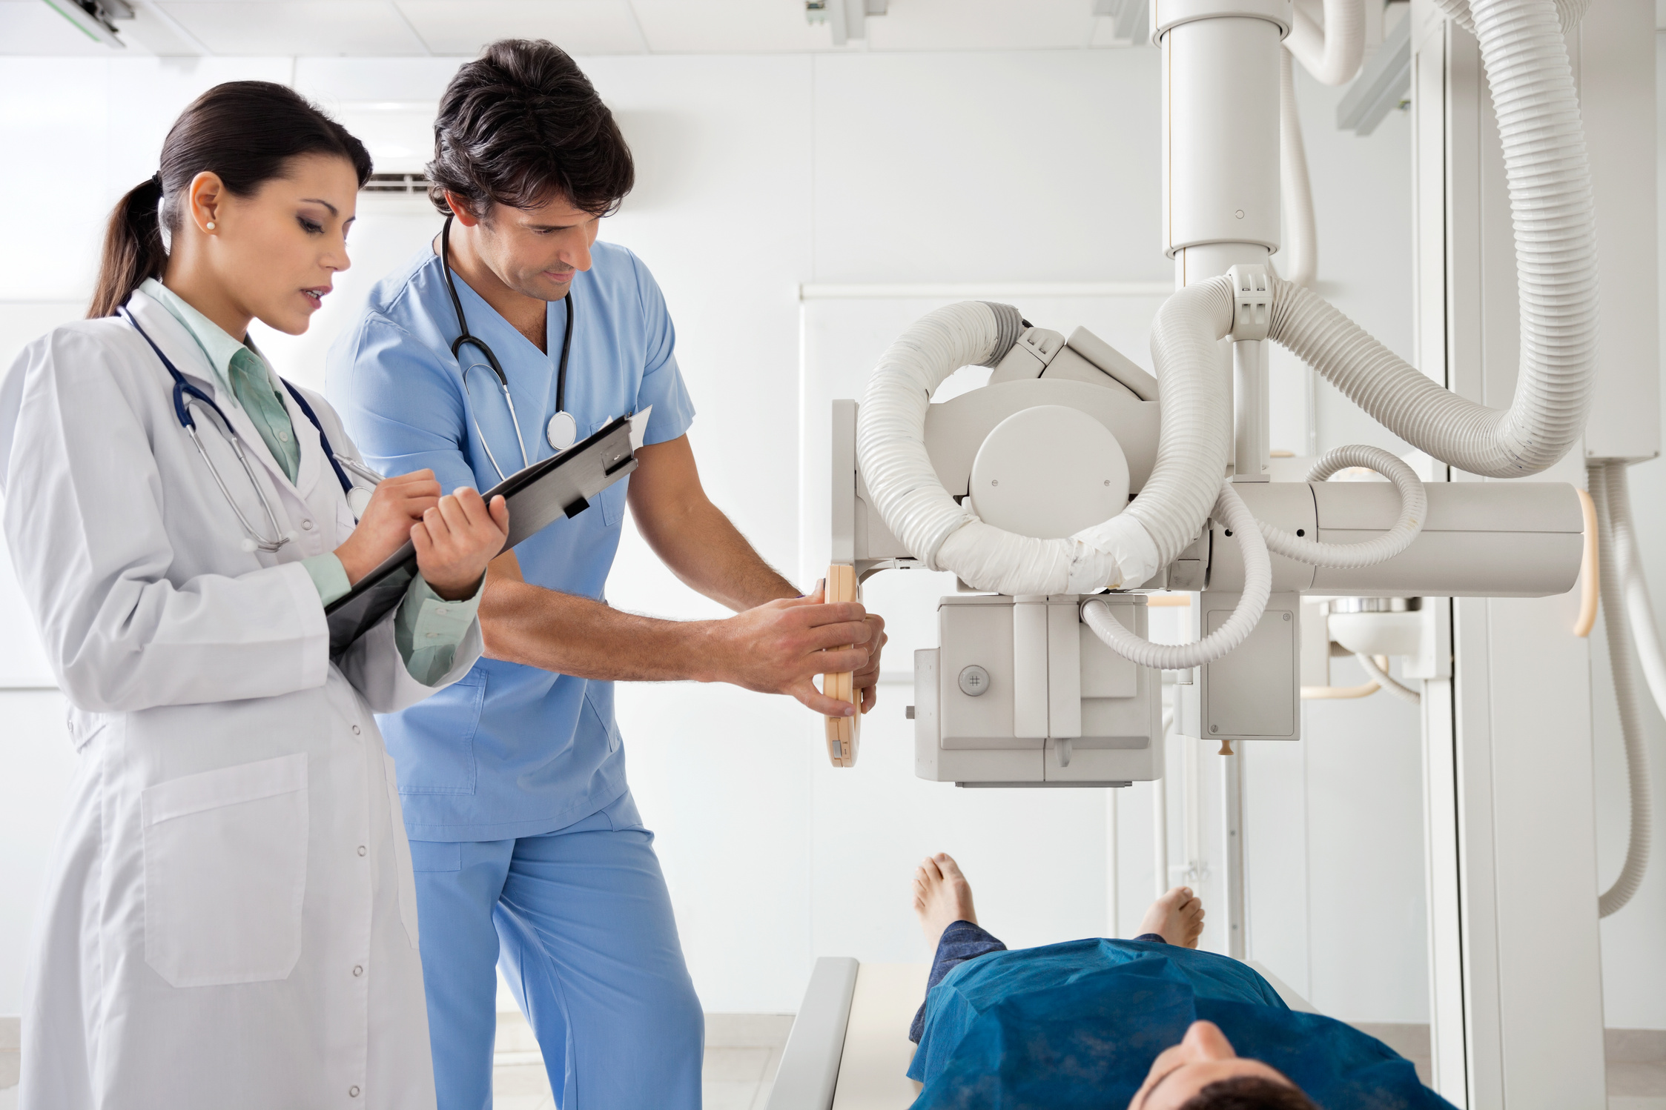

OBJECTIVES
1
WHY QUALITY IN RADIOLOGY MATTERS IN 2023 AND BEYOND
CURRENT EXAMPLE OF MICHIGAN MARKETPLACE PRESSURE FOR UNDERSTANDING QUALITY AND DIFFERENTIATING COMPANIES BASED ON QUALITY
2
RADIOLOGISTS’ OPPORTUNITY TO EMBRACE CHANGE AND LEAD WITH QUALITY
3
LEARN HOW PARTNERING WITH INDUSTRY CAN HELP TO STRENGTHEN OUR GOALS AS RADIOLOGISTS
4

Slide 4
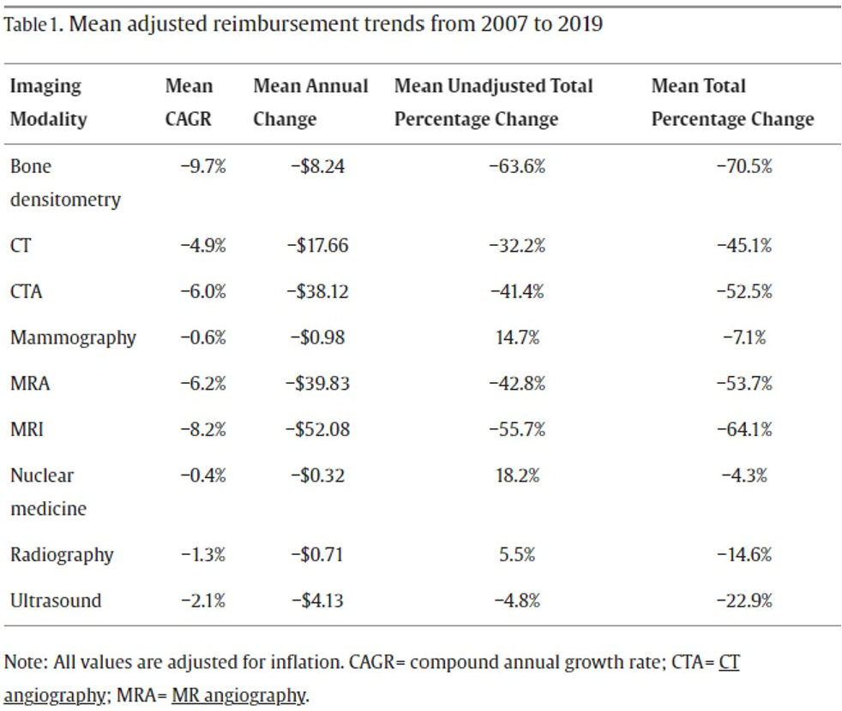
JACR

Slide 5
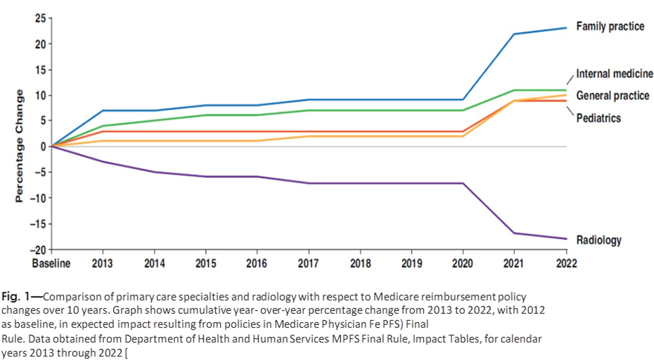
HHS MPFS FINAL RULE
IMPACT TABLES

Slide 6




Between 2005 and 2021, when adjusted for inflation, reimbursement to radiologists per Medicare beneficiary declined by 24.9%
JACR
AUGUST 2023
(Lauren and Greg Nicola)
Additionally, the conversion factor for radiology for the budget neutrality equation over this period declined by 7.9%
RVUs per beneficiary performed by rads increased by 13.9%
All of this means more services/patient with less overall pay!

Slide 7

RADIOLOGY
BUSINESS PROBLEMS
  Rising costs
  More and more regulation and need for complex systems to navigate the landscape
  Professionals leaving the industry
  No one available to run equipment
  Lack of measures that apply to radiology and the topping out of measure in use today, leaves radiology with no ability for uplifts and real risks of penalties in the MACRA/MIPS Medicare programs

Slide 8

NEED TO PARTNER WITH
REGIONAL BC/BS PROGRAMS
  We must demonstrate our value to the carriers and gain their respect for what we bring to the table
  Our colleagues in large POs must also understand the value of quality imaging services and the money they can save by working with great radiology teams
  Radiology groups will need to assess their strengths and weaknesses in this environment

Slide 9

MICHIGAN HAS A LARGE PATIENT POPULATION
THAT IS BEING MOVED INTO VALUE-BASED SYSTEMS

Slide 10

WHAT’S THE VALUE?
Good outcomes require quality services that reduce unnecessary tests and use the shortest and most efficient pathway to maintaining the populations’ good health
Healthcare industry has moved to value-based pay
Fee for service is a dying model which rewarded people for doing more
Under value-based pay healthcare providers are paid for outcomes

Slide 11

VALUE RELEVANCE
Shareholder Value
Stakeholder Value
  Company Owner
    Earnings (EBITDA)
    Brand Valuation
  Radiologists
  Employees
  Referring (PO) Facilities
  Communities

Slide 12

HOW DO
WE DO THIS?
MICHIGAN RADIOLOGICAL SOCIETY
  Radiology is at the center of this transformative change
  More and more providers are depending on imaging to diagnose and direct treatment in patient care
  Radiologists need to be engaged in this transformation

Slide 13
W. EDWARDS DEMING
THE FATHER OF QUALITY
“Uncontrolled variation is the enemy of quality”
Putting a good person in a bad system will not lead to quality

Slide 14



Slide 15

WE MUST REDUCE VARIABILITY
AND IMPROVE QUAL﻿ITY
By improving process, we can reduce variability and improve quality of care
This is the value proposition for radiologists moving forward

Slide 16

  Incentive programs have developed that reward quality-based radiology groups that can deliver quality care at a reduce cost to the system
  Decreasing reimbursements have put tremendous pressure on the industry
  Efficiency gains are tough to come by
  How is quality rated in the industry?

Slide 17



FEEDBACK
IS IMPORTANT
In Michigan companies are working with payers to develop cost effective value care systems
Covera is in the marketplace working with BC/BS to identify quality players in radiology
A multiyear project that Covera has taken on to transform the industry and work to bring value-based pay to the practice of radiology in Michigan

Slide 18


EXPERIENCE WITH COVERA
  Clinical image datasets are analyzed with AI powered intelligence platform
  Provide feedback on quality and give insight as to where work is needed to drive right diagnosis and care
  Accurate diagnosis leads to reduced costs
  Those with the best teams and systems will draw the attention of the payers and POs

Slide 19
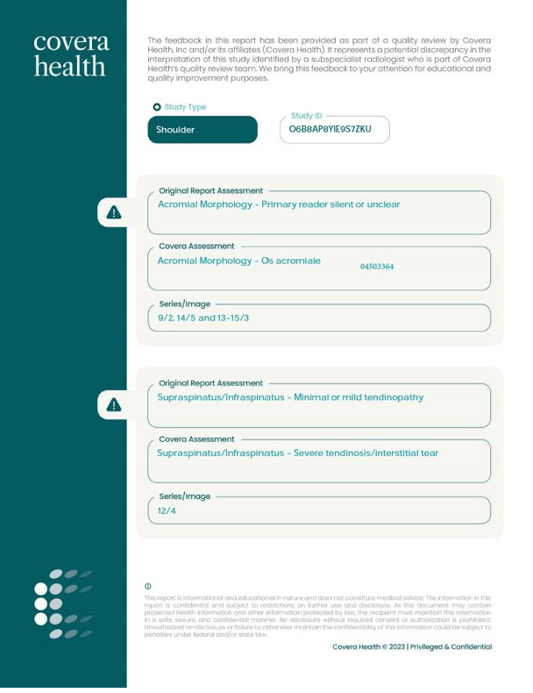
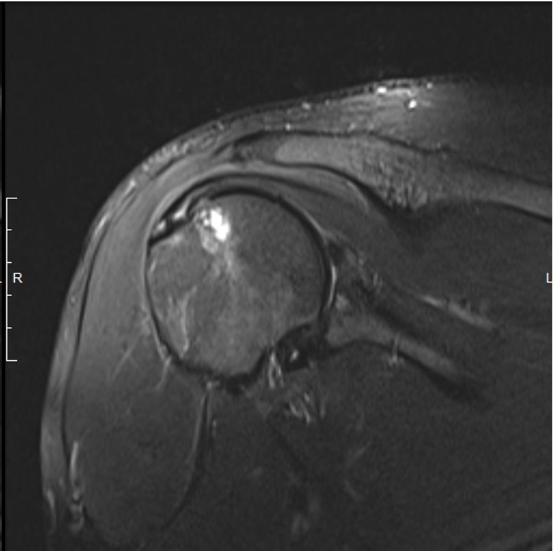
Feedback
On Discrepancies

Slide 20




BUILDING
PARTNERSHIPS
Michigan radiologists need to work with industry to show our value
Sharing data to improve quality throughout the state
To be of value we will need to work on reducing variability in the profession

Slide 21




HOW
TO IMPROVE
Through industry partnerships radiology groups can gain an understanding of where they are in quality metrics compared to others in the state of Michigan and around the country
In doing so, quality metrics can be reviewed in a confidential manner and radiologists can work to improve these metrics
Working with industry, radiologists can change the way we are paid by demonstrating our quality/value
Improved metrics/quality leads to improved value

Slide 22

WHERE DO WE
GO FROM HERE?
At RMI we have adopted a policy of working with all players in industry to gather feedback wherever we can
We are driven by change and working to be the best that we can be
We work to make change where we can at RMI to have best in class service and care

Slide 23

RADIOLOGY GROUPS IN MICHIGAN
NEED TO PUSH FOR QUALITY AND REDUCED VARIABILITY

Slide 24

EMBRACING
CHANGE
  Radiology is rapidly evolving with AI touching everything we do
  We will need to evolve with this change and learn to use the tools that are now being used by others to look at our diagnostic work
  Managing this barrage of change is challenging at best and overwhelming at worst

Slide 25

ACR/MRS
ORGANIZATION LEADERSHIP
  ACR has worked to help control variability and bring some organization to interpretation by deploying BI-RADS, O-RADS, TI-RADS, LUNG RADS and PI-RADS
  ACR directed Clinical Decision Support tools are now embedded in most dictation systems
  We are working to reduce variability and improve quality across the industry

Slide 26

MY RECOMMENDATIONS
TO YOU
Invest in things that make you better
Reduce variability in your group
Drive for efficiency
Develop and use communications systems that work for patients and physicians
Stay Engaged with Industry leaders

