Slide 1

Healthcare Economics and the
Future of Radiology
Howard B. Fleishon, MD, FACR, MMM
Immediate Past President, ACR
Professor, Emory Dept. of Radiology

Slide 2

Disclosures
I have no financial disclosures relevant to this presentation.
Investor and Advisor: RomTech, Inc.
Investor: Focused Cryo, Inc.
Notes:
Several biases
Bullish on the future of radiology
I believe strongly in the power of organized radiology

Slide 3


Slide 5
Agenda
Brief History of Radiology
Healthcare Economics 101
Physician Reimbursement
Future State

Slide 6
Brief History of Radiology

Slide 7
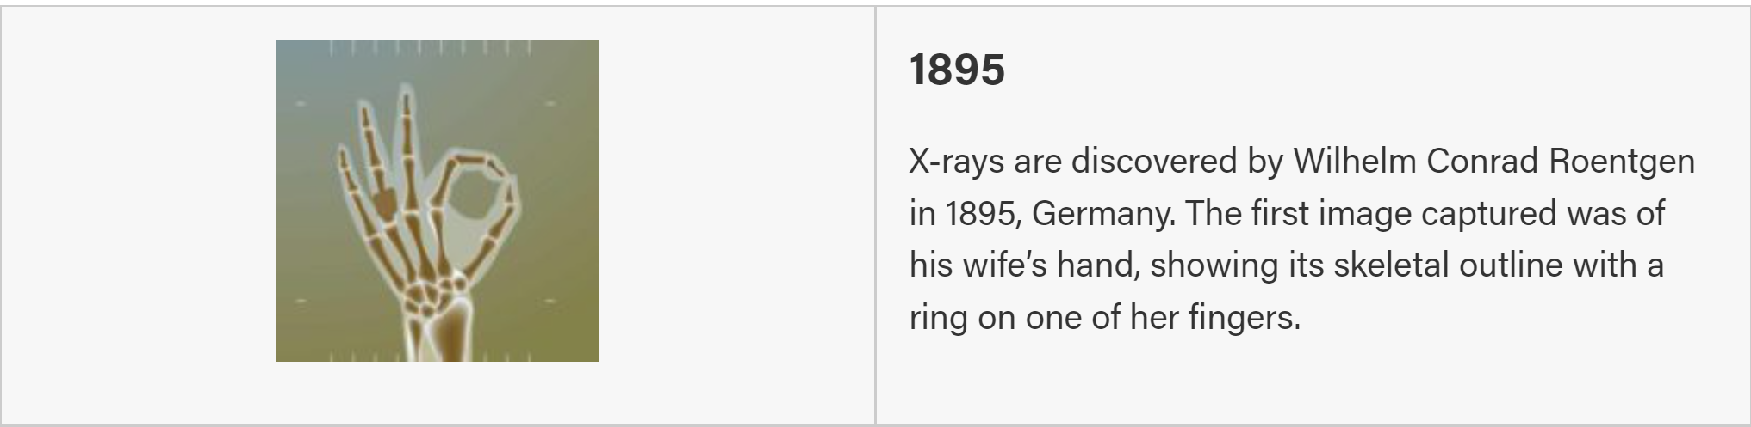
Notes:
This was also the period when Antoine-Henri Becquerel quite by accident discovered radioactivity and subsequently Pierre and Marie Curie went on to win the Nobel prize for their investigations.

Slide 8
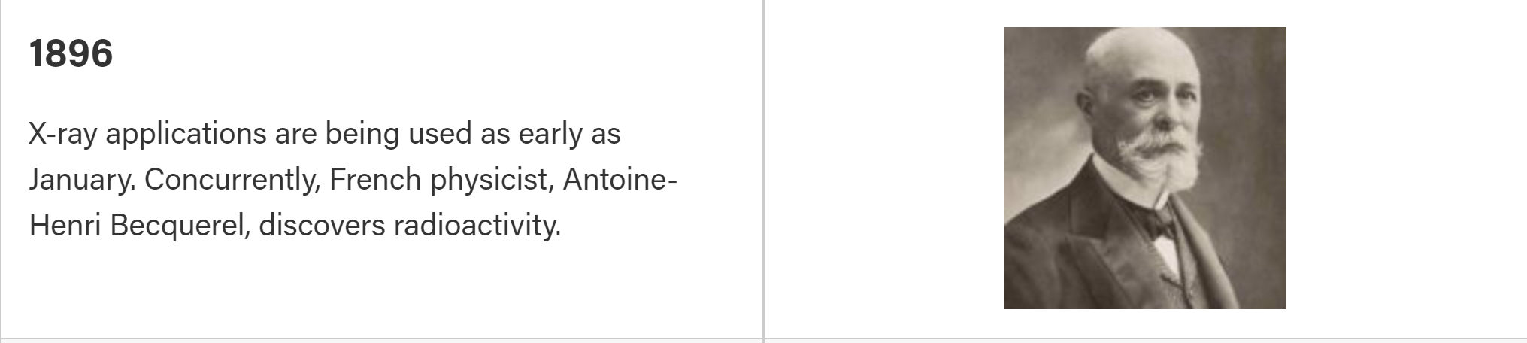
Notes:
Becquerel first heard about Roentgen’s discovery in January 1896 at a meeting of the French Academy of Sciences. Becquerel thought that the phosphorescent uranium salts he had been studying might absorb sunlight and reemit it as x-rays.
To test this idea (which turned out to be wrong), Becquerel wrapped photographic plates in black paper so that sunlight could not reach them. He then placed the crystals of uranium salt on top of the wrapped plates, and put the whole setup outside in the sun. When he developed the plates, he saw an outline of the crystals.
Becquerel took this as evidence that his idea was correct, that the phosphorescent uranium salts absorbed sunlight and emitted a penetrating radiation similar to x-rays. He planned to continue his experiments. But the weather in Paris did not cooperate; it became overcast for the next several days in late February. Thinking he couldn’t do any research without bright sunlight, Becquerel put his uranium crystals and photographic plates away in a drawer.
On March 1, he opened the drawer and developed the plates, expecting to see only a very weak image. Instead, the image was amazingly clear.
The term radioactivity was actually coined by Marie Curie, who together with her husband Pierre, began investigating the phenomenon recently discovered by Becquerel. The Curies extracted uranium from ore and to their surprise, found that the leftover ore showed more activity than the pure uranium. They concluded that the ore contained other radioactive elements. This led to the discoveries of the elements polonium and radium. It took four more years of processing tons of ore to isolate enough of each element to determine their chemical properties.

Slide 9
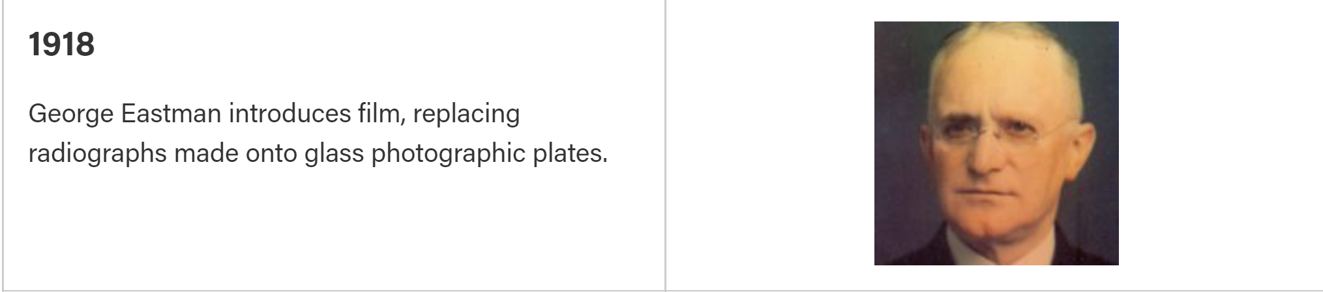

Slide 10
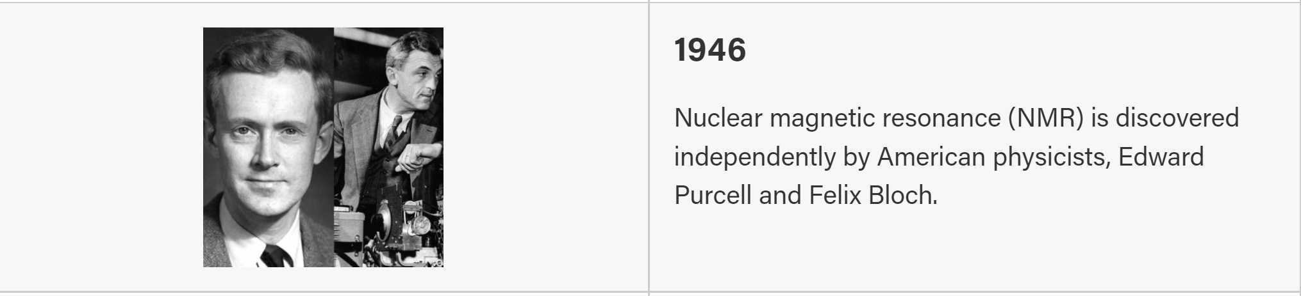
Notes:
Nobel prize 1952

Slide 11
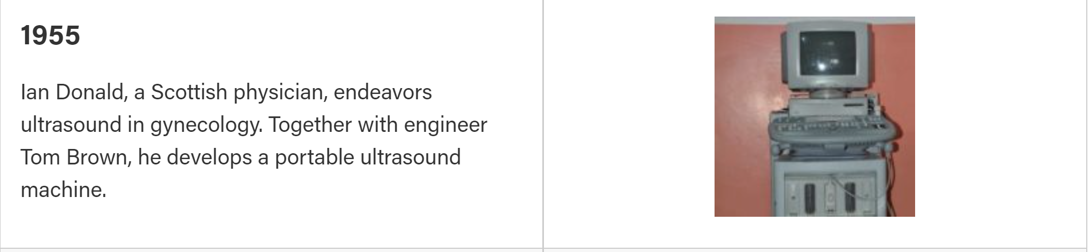

Slide 12
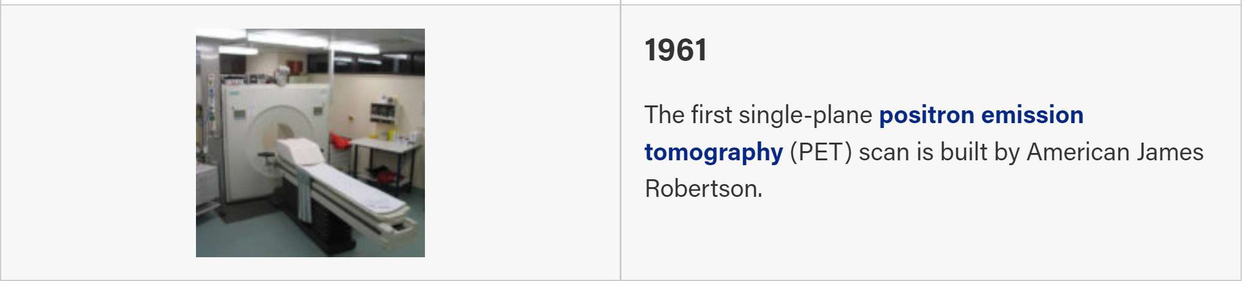
Notes:
Concept instruments were designed at the University of Pennsylvania, Washington University School of Medicine.^{[78][79]} James Robertson and his associates at Brookhaven National Laboratory built the first single-plane PET scan installed at MGH.

Slide 13
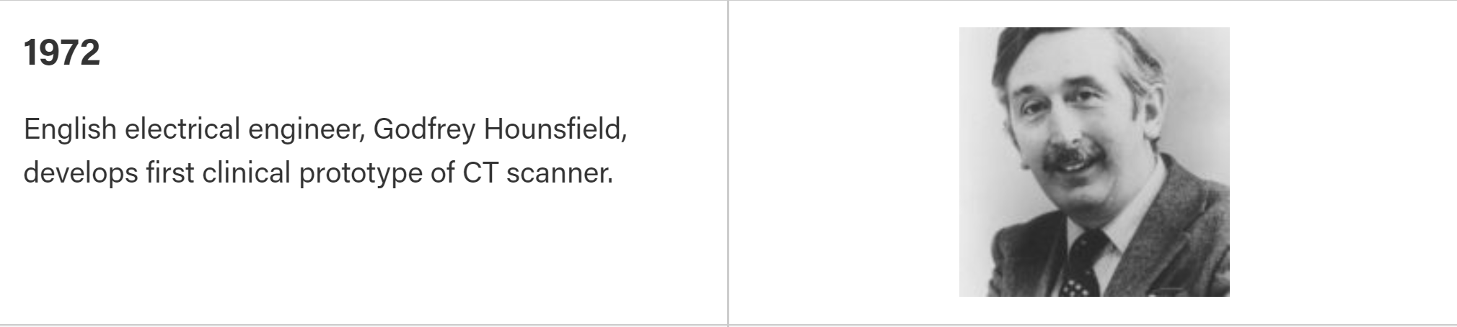
Notes:
The first CT scanner developed by Hounsfield in his lab at EMI took several hours to acquire the raw data for a single scan or "slice" and took days to reconstruct a single image from this raw data.
1979 Nobel prize in Physiology and Medicine

Slide 14
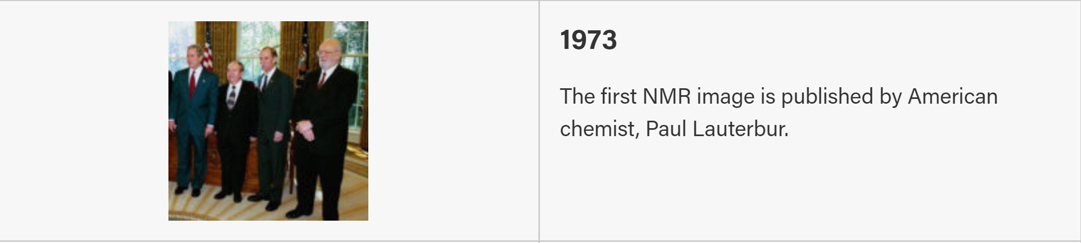
Notes:
Lauterbur used the idea of Robert Gabillard (developed in his doctoral thesis, 1952) of introducing gradients in the magnetic field which allows for determining the origin of the radio waves emitted from the nuclei .of the object of study.

Slide 15
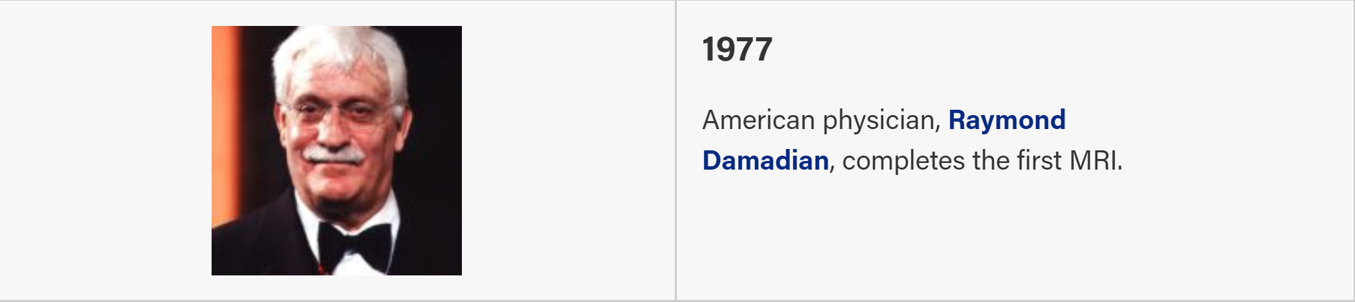
Notes:
In 1974, he received the first patent in the field of MRI when he patented the concept of NMR^{[17]} for detecting cancer. He and Lauterbur were awarded
the national Medal of Technology by President Ronal Reagan in 1988.

Slide 16
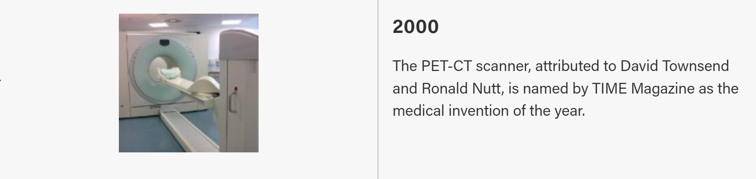

Slide 17
10 Health Advances That Changed the World
From vaccines to clean water, health advances have changed the world.
By DAN CHILDS and SUSAN KANSAGRA, M.D.<br>ABC News Medical Unit
September 20, 2007, 7:10 AM
Vaccines
Surgical Anesthetic and Antisepsis
Clean Water and Improved Sanitation
Antibiotics and Antivirals
The Birth Control Pill
Improvements in Heart Surgery and Cardiac Care
Randomized Controlled Trials
Radiologic Imaging
Advancements in Childbirth
Organ Transplantation

Slide 18
History of Radiology
Relatively new discipline in Medicine
Rapid technological innovation
Imaging has become widely recognized as high value
Notes:
Hippocrates, father of medicine: 5th century BC.
25 Nobel prizes and counting.

Slide 19
Healthcare Economics 101

Slide 20
Healthcare Economics
Supply and Demand Theory:
The main interested parties are the buyers and sellers.
Health Care:
Third parties—insurers, governments, and other—often have an interest in healthcare outcomes.

Slide 21
Healthcare Economics
Supply and Demand Theory:
The main interested parties are the buyers and sellers.
Buyers are good judges of what they get from sellers.
Health Care:
Third parties—insurers, governments, and other—often have an interest in healthcare outcomes.
Patients often don’t know what they need and cannot evaluate the treatment they are getting.

Slide 22
Healthcare Economics
Supply and Demand Theory:
The main interested parties are the buyers and sellers.
Buyers are good judges of what they get from sellers.
Buyers pay sellers directly for the goods and services being exchanged.
Health Care:
Third parties—insurers, governments, and other—often have an interest in healthcare outcomes.
Patients often don’t know what they need and cannot evaluate the treatment they are getting.
Healthcare providers are often paid not by the patients but by private or government health insurance.

Slide 23
Healthcare Economics
Supply and Demand Theory:
The main interested parties are the buyers and sellers.
Buyers are good judges of what they get from sellers.
Buyers pay sellers directly for the goods and services being exchanged.
Market prices are the primary mechanism for coordinating the decisions of market participants.
Health Care:
Third parties—insurers, governments, and other—often have an interest in healthcare outcomes.
Patients often don’t know what they need and cannot evaluate the treatment they are getting.
Healthcare providers are often paid not by the patients but by private or government health insurance.
The rules established by these insurers, more than market prices, determine the allocation of resources.

Slide 24
Healthcare Economics
Supply and Demand Theory:
The main interested parties are the buyers and sellers.
Buyers are good judges of what they get from sellers.
Buyers pay sellers directly for the goods and services being exchanged.
Market prices are the primary mechanism for coordinating the decisions of market participants.
Result is efficient allocation of resources.
Health Care:
Third parties—insurers, governments, and other—often have an interest in healthcare outcomes.
Patients often don’t know what they need and cannot evaluate the treatment they are getting.
Healthcare providers are often paid not by the patients but by private or government health insurance.
The rules established by these insurers, more than market prices, determine the allocation of resources.
Allocation of resources in the healthcare market can end up highly inefficient.

Slide 25
Healthcare Economics
Supply and Demand Theory:
The main interested parties are the buyers and sellers.
Buyers are good judges of what they get from sellers.
Buyers pay sellers directly for the goods and services being exchanged.
Market prices are the primary mechanism for coordinating the decisions of market participants.
Result is efficient allocation of resources.
Health Care:
Third parties—insurers, governments, and other—often have an interest in healthcare outcomes.
Patients often don’t know what they need and cannot evaluate the treatment they are getting.
Healthcare providers are often paid not by the patients but by private or government health insurance.
The rules established by these insurers, more than market prices, determine the allocation of resources.
Allocation of resources in the healthcare market can end up highly inefficient.

Slide 26
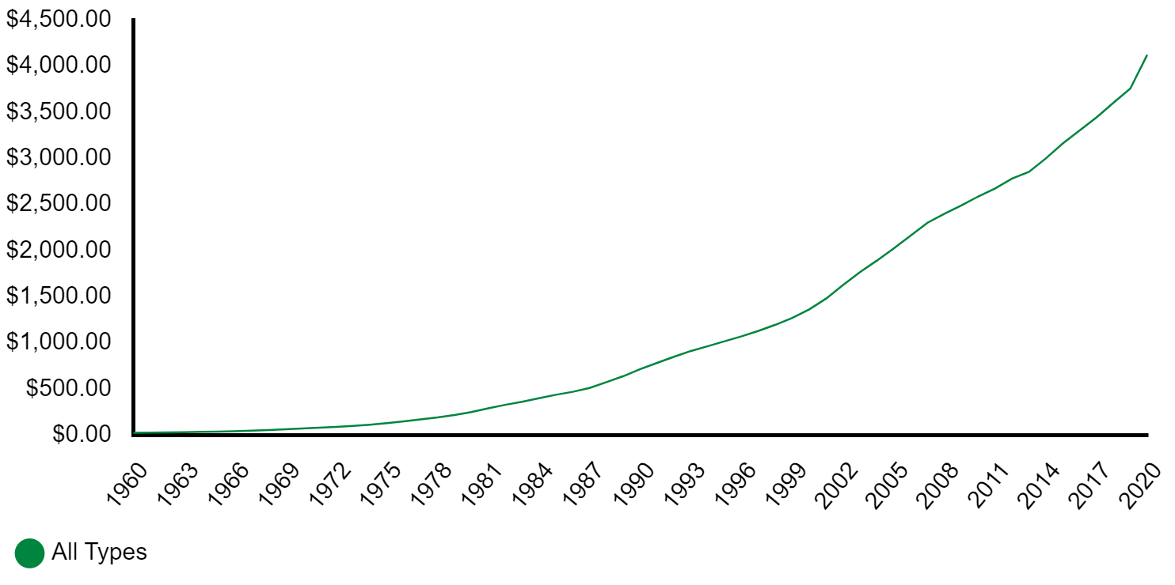

HEALTH EXPENDITURES 1960 - 2020
Notes:
U.S. health care spending grew 9.7 percent in 2020, reaching $4.1 trillion .

Slide 27
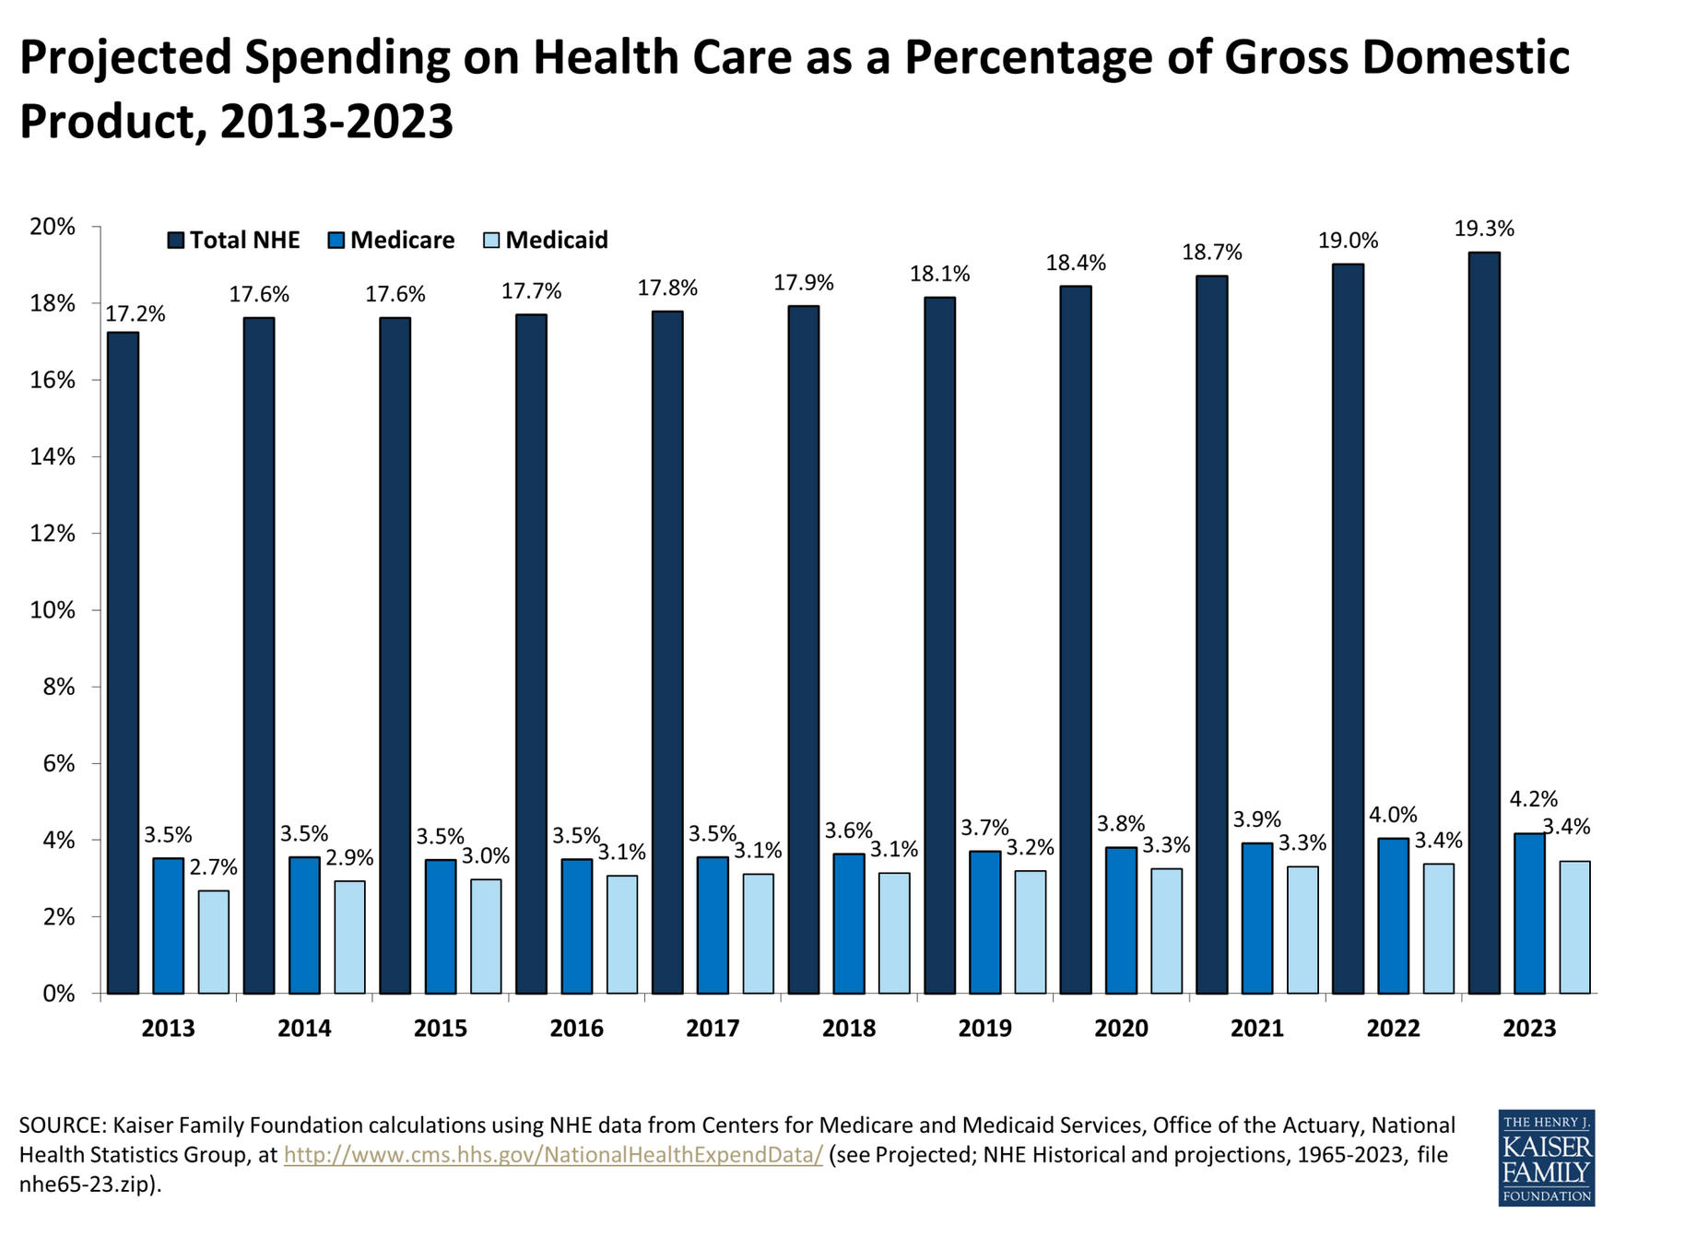
Projected Health Care Spending as % GDP
Notes:
19.3%

Slide 28
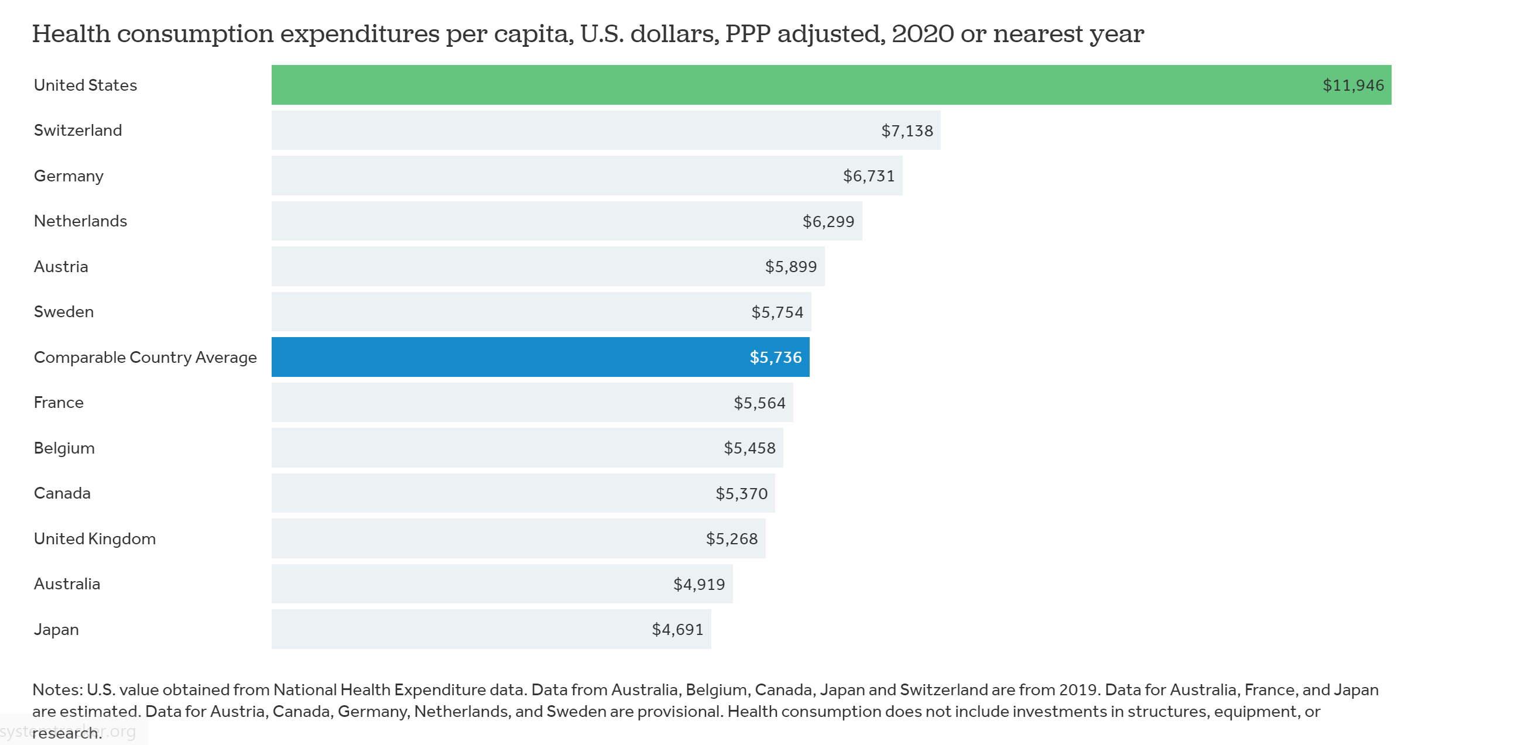
Healthcare Expenditures per Capita, 2020
Notes:
$11946

Slide 29
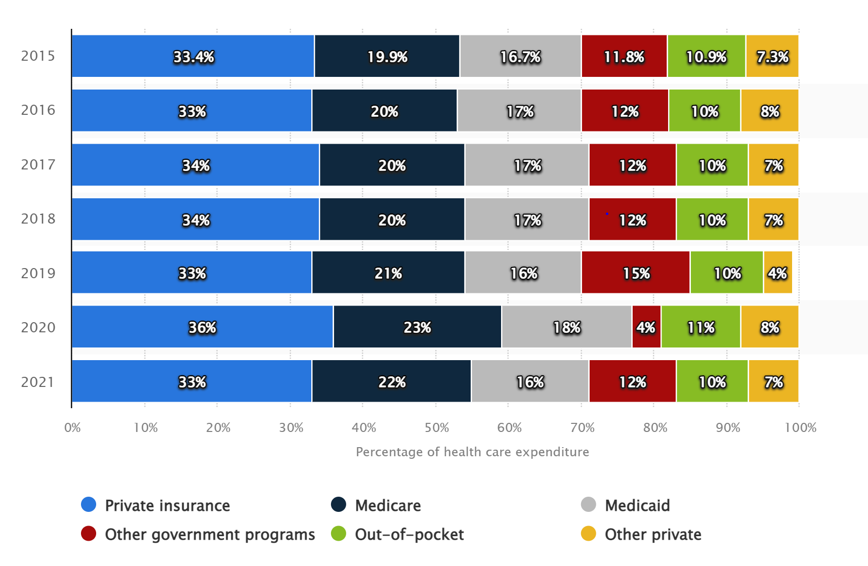
Distribution of U.S. Health Care Expenditure by Payer: 2015 to 2021
Health care expenditure distribution by payer U.S. 2021 | Statista
Notes:
Government program, black grey and red about 50%
Blue commercial payors

Slide 30
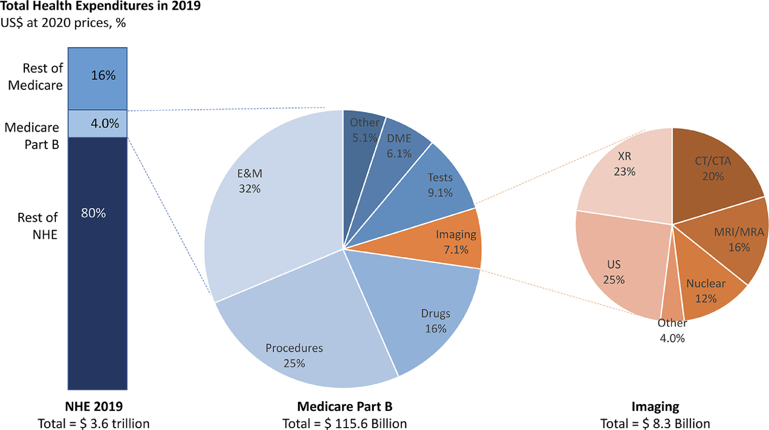
Total Health Expenditures: 2019
https://pubmed.ncbi.nlm.nih.gov/34600796/
Notes:
Total business of radiology about $110 billion dollars.
Senator Jon Kyl

Slide 31
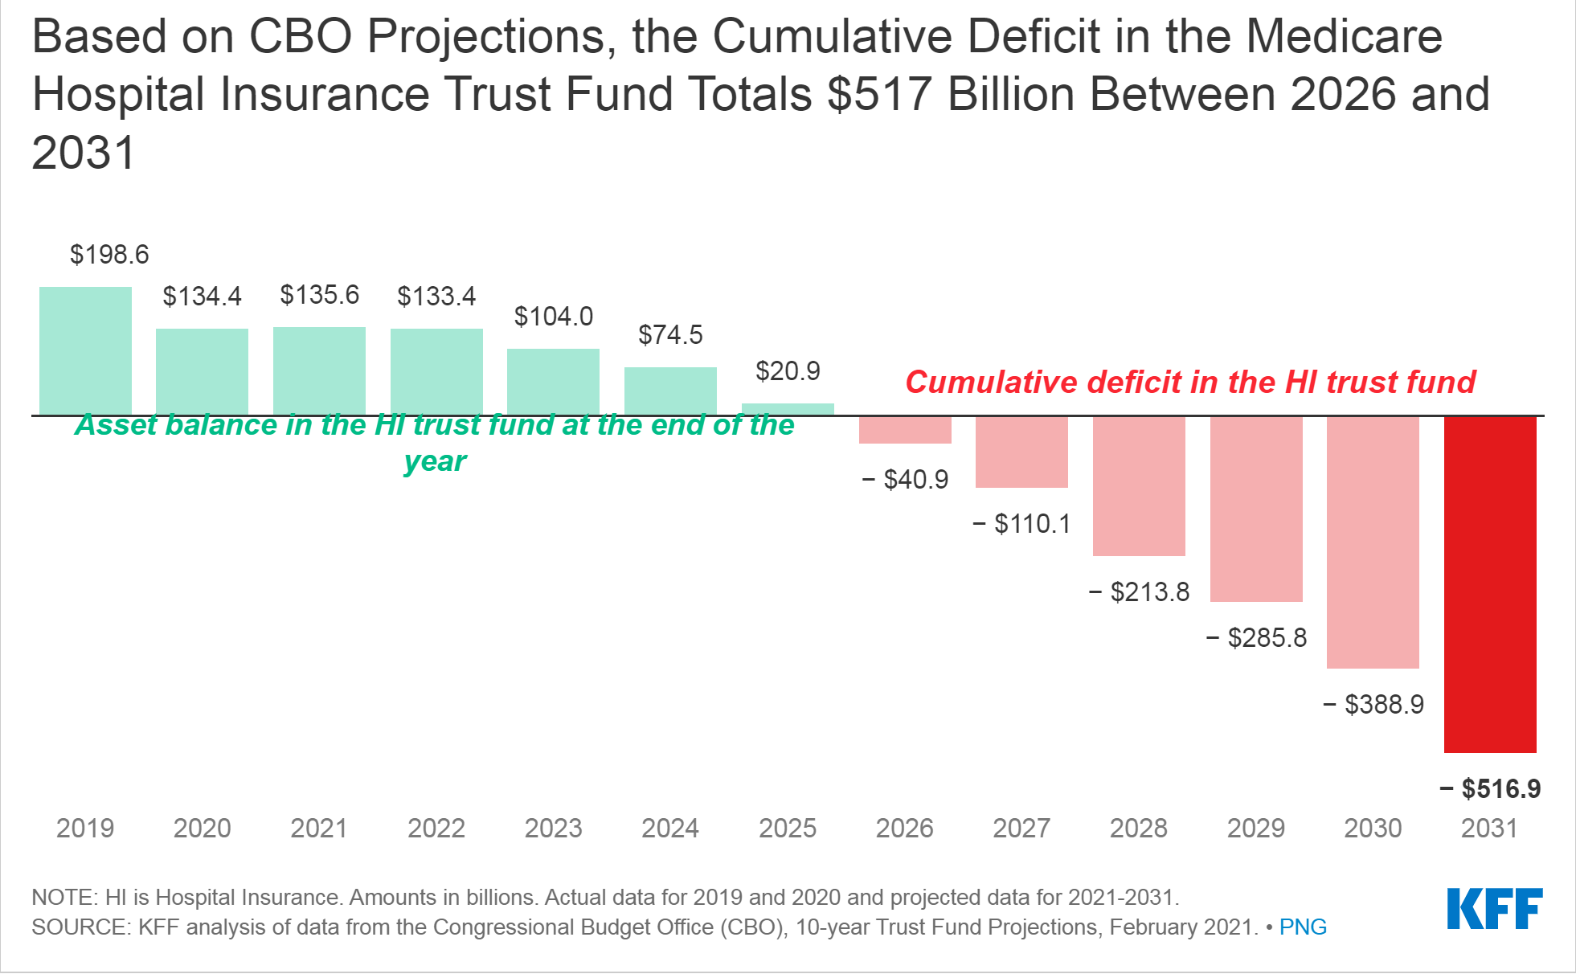
CBO Medicare Trust Fund Projections
Notes:
Somewhat deceptive since Medicare expenditures come out of the general fund.

Slide 32
Burden of Healthcare Costs: Personal Debt
One in six Americans have past-due health care bills on their credit report. https://www.healthaffairs.org/doi/full/10.1377/hlthaff.2018.0349
In the 2016 National Health Interview Survey, nearly three-quarters of Americans between ages 20 and 65 said they were insured but could not pay their medical bills. https://www.cdc.gov/nchs/nhis/index.htm
17.8% of individuals in the US had medical debt in collections in June 2020
https://jamanetwork.com/journals/jama/article-abstract/2782187
Medical bills were the largest single cause of bankruptcy filings and more than half of debtors had medical debts as part of their bankruptcies.
Austin D. Medical Debt As a Cause of Consumer Bankruptcy (Jan. 2014),
Medical debt now outweighs all other personal debt in U.S.
https://www.fiercehealthcare.com/finance/medical-debt-now-outweighs-all-other-personal-debt-us-those-medicaid-nonexpansion-states
Notes:
Imaging not cheap.
When we recommend additional studies or follow up, someone has to pay for it.

Slide 33
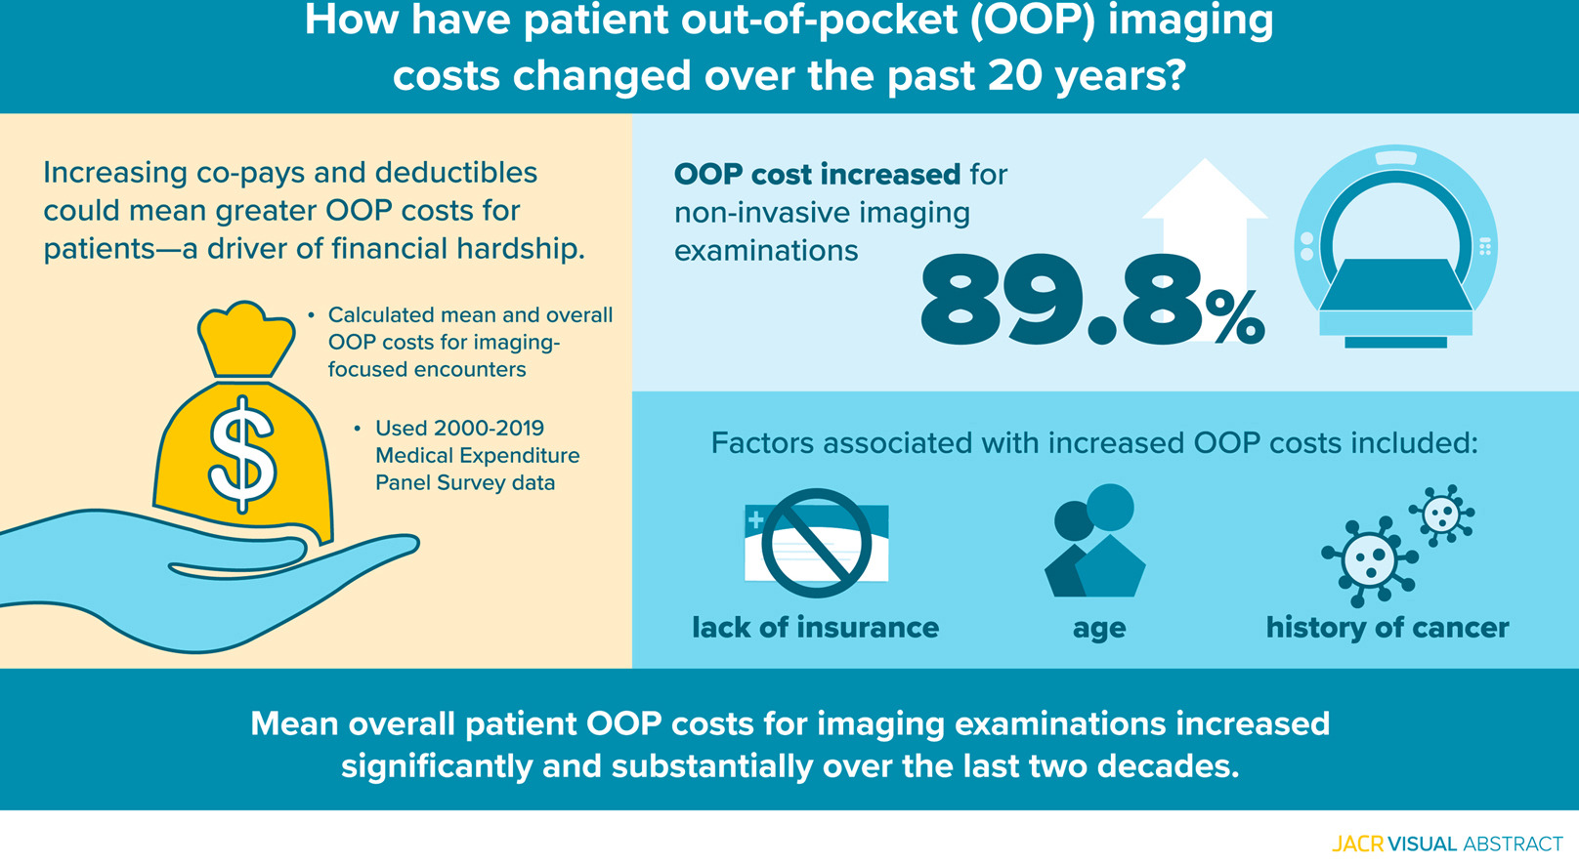
https://doi.org/10.1016/j.jacr.2022.07.014
Notes:
Take-Home Points
▪Between 2000 and 2019, there was an 89.8% increase in the mean overall “out-of-pocket” patient costs for noninvasive imaging examinations (from $97.97 to $185.91).

Slide 34
“CLINICAL INDICATION: Pt is a 49 year old female who reports being told of bilateral breast masses 2 years ago, unable to receive treatment due to financial issues.”

Slide 35
Physician Reimbursement

Slide 36
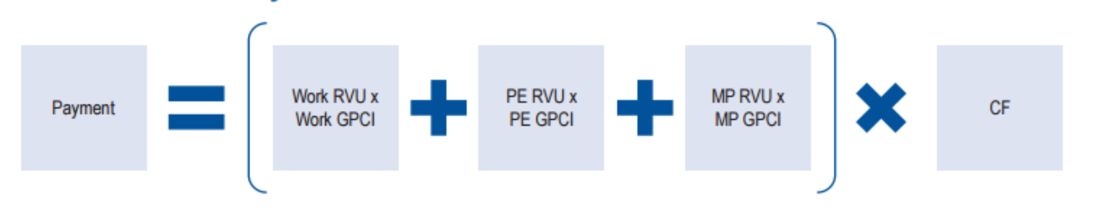
Medicare Physician Fee Schedule (MPFS)
Notes:
Relative Value Units (RVU)
Three separate RVUs are associated with the calculation of payment under the Medicare PFS:
Work RVUs reflect the relative time and intensity associated with furnishing a Medicare PFS service and account for approximately 50 percent of the total payment associated with a service;
PE RVUs reflect the costs of maintaining a practice (such as renting office space, buying supplies and equipment, and staff costs); and
MP RVUs reflect the costs of malpractice insurance.
Conversion Factor (CF)
The CF, a national dollar multiplier, is used to ‘convert’ the geographically adjusted RVU to determine the Medicare-allowed payment amount for a particular physician service. The CF is used separately to price facility and non-facility payment amounts. Facility pricing typically covers services provided to inpatients or in a hospital outpatient clinic setting or other off-site hospital facilities. Non-facility pricing covers services generally provided in a physician’s office or other freestanding settings such as an Independent Diagnostic Testing Facility.
The formula specifies that the update for a year is equal to the Medicare Economic Index (MEI) adjusted up or down depending on how actual expenditures compare to a target rate called the Sustainable Growth Rate (SGR). The MEI is a measure of inflation faced by physicians with respect to their practice costs and general wage levels.
The SGR is calculated based on:
Medical inflation;
Projected growth in the domestic economy;
Projected growth in the number of beneficiaries in Fee-For-Service Medicare; and
Changes in law or regulation.
Geographic Practice Cost Indices (GPCI)
GPCIs are adjustments that are applied to each of the three relative values used in calculating a physician payment, as described above. The purpose of these adjustments is to account for geographic variations in the costs of practicing medicine in different areas within the country.
Work GPCI: A GPCI for physician work
PE GPCI: A GPCI for practice expense, and
MP GPCI: A GPCI for malpractice.
The above variables capture the efforts and productivity of the physician, his/her individualized costs for staff, and for productivity-enhancing technology and materials. The information in this article applies only to the Medicare Fee-For-Service Program (also known as Original Medicare).

Slide 37
Current Procedure Terminology (CPT)
Medical code set that is used to report medical, surgical, and diagnostic procedures and services to entities such as physicians, health insurance companies and accreditation organizations.
CPT is a registered trademark of the American Medical Association. The CPT® Editorial Panel is responsible for maintaining the CPT code set
Category 1: Procedures and contemporary medical practices
Covers procedures and contemporary medical practices that are widely performed. Category 1 identifies a procedure or service that is approved by the Food and Drug Administration (FDA), performed by healthcare professionals nationwide, and is proven and documented.
Category 2: Performance Measures
Supplementary tracking codes that are used for performance measures and are intended to help collect information about the quality of care delivered.
Category 3: Emerging technologies, services and procedures
Temporary codes that cover emerging technologies, services and procedures.
Notes:
Proudly, our own Bill Thorwarth, now CEO of the ACR, was a previous chair of the CPT committee.
AI 255

Slide 38
Relative Value Units (RVU’s)
Measure of “value” used in the Medicare reimbursement formula for physician services.
RVUs are a part of the resource-based relative value scale (RBRVS).
Omnibus Budget Reconciliation Act of 1989
RVU’s recommended by a private group of 32 physician members of the American Medical Association's Specialty Society Relative Value Scale Update Committee (RUC). Final determination by HHS Secretary.
Medicare Reimbursement formula contains three RVUs:
Physician work
Practice expense
Malpractice expense
Notes:
RVU’s were developed to be used for comparative purposes especially between specialties. They were not designed to be a measure of productivity. Using them for that purpose is convenient but has lots of flaws and using current terminology “biases”.
Work RVUs reflect the relative time and intensity associated with furnishing a Medicare PFS service and account for approximately 50 percent of the total payment associated with a service;
PE RVUs reflect the costs of maintaining a practice (such as renting office space, buying supplies and equipment, and staff costs); and
MP RVUs reflect the costs of malpractice insurance.

Slide 39
Geographic Practice Cost Index (GPCI)
MPFS adjustments to reflect the variation in practice costs from area to area.
A geographic practice cost index (GPCI) has been established for every Medicare payment locality.
RVU’s are adjusted (multiplied) by the GPCI for that component.
  Work
  Practice expense
  Malpractice

Slide 40
Conversion Factor
Overall multiplication factor to determine reimbursement
Determinants
  Prior to 2015, the conversion factor was calculated using a complex and flawed formula called the Sustainable Growth Rate (SGR).
  The Medicare Access and CHIP Reauthorization Act of 2015 (MACRA) removed the SGR and replaced it with a series of regular 0.5% conversion factor updates through 2019 along with QPP
  Budget Neutrality: requires any increase in the relative expenditures in one area of the Medicare program to be offset by cuts in other areas.
  Legislative Changes

Slide 41
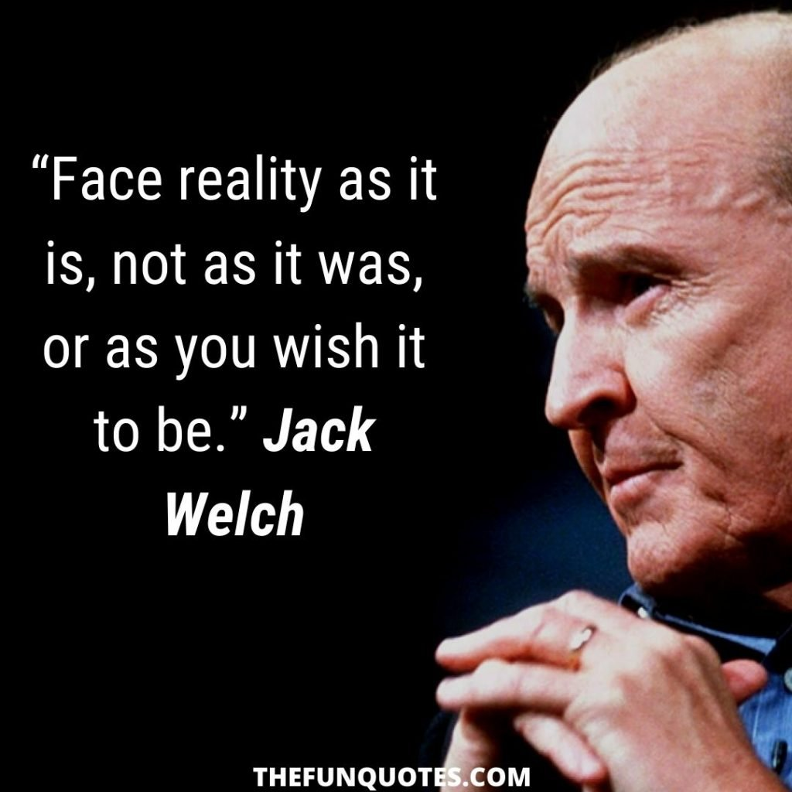

Slide 42
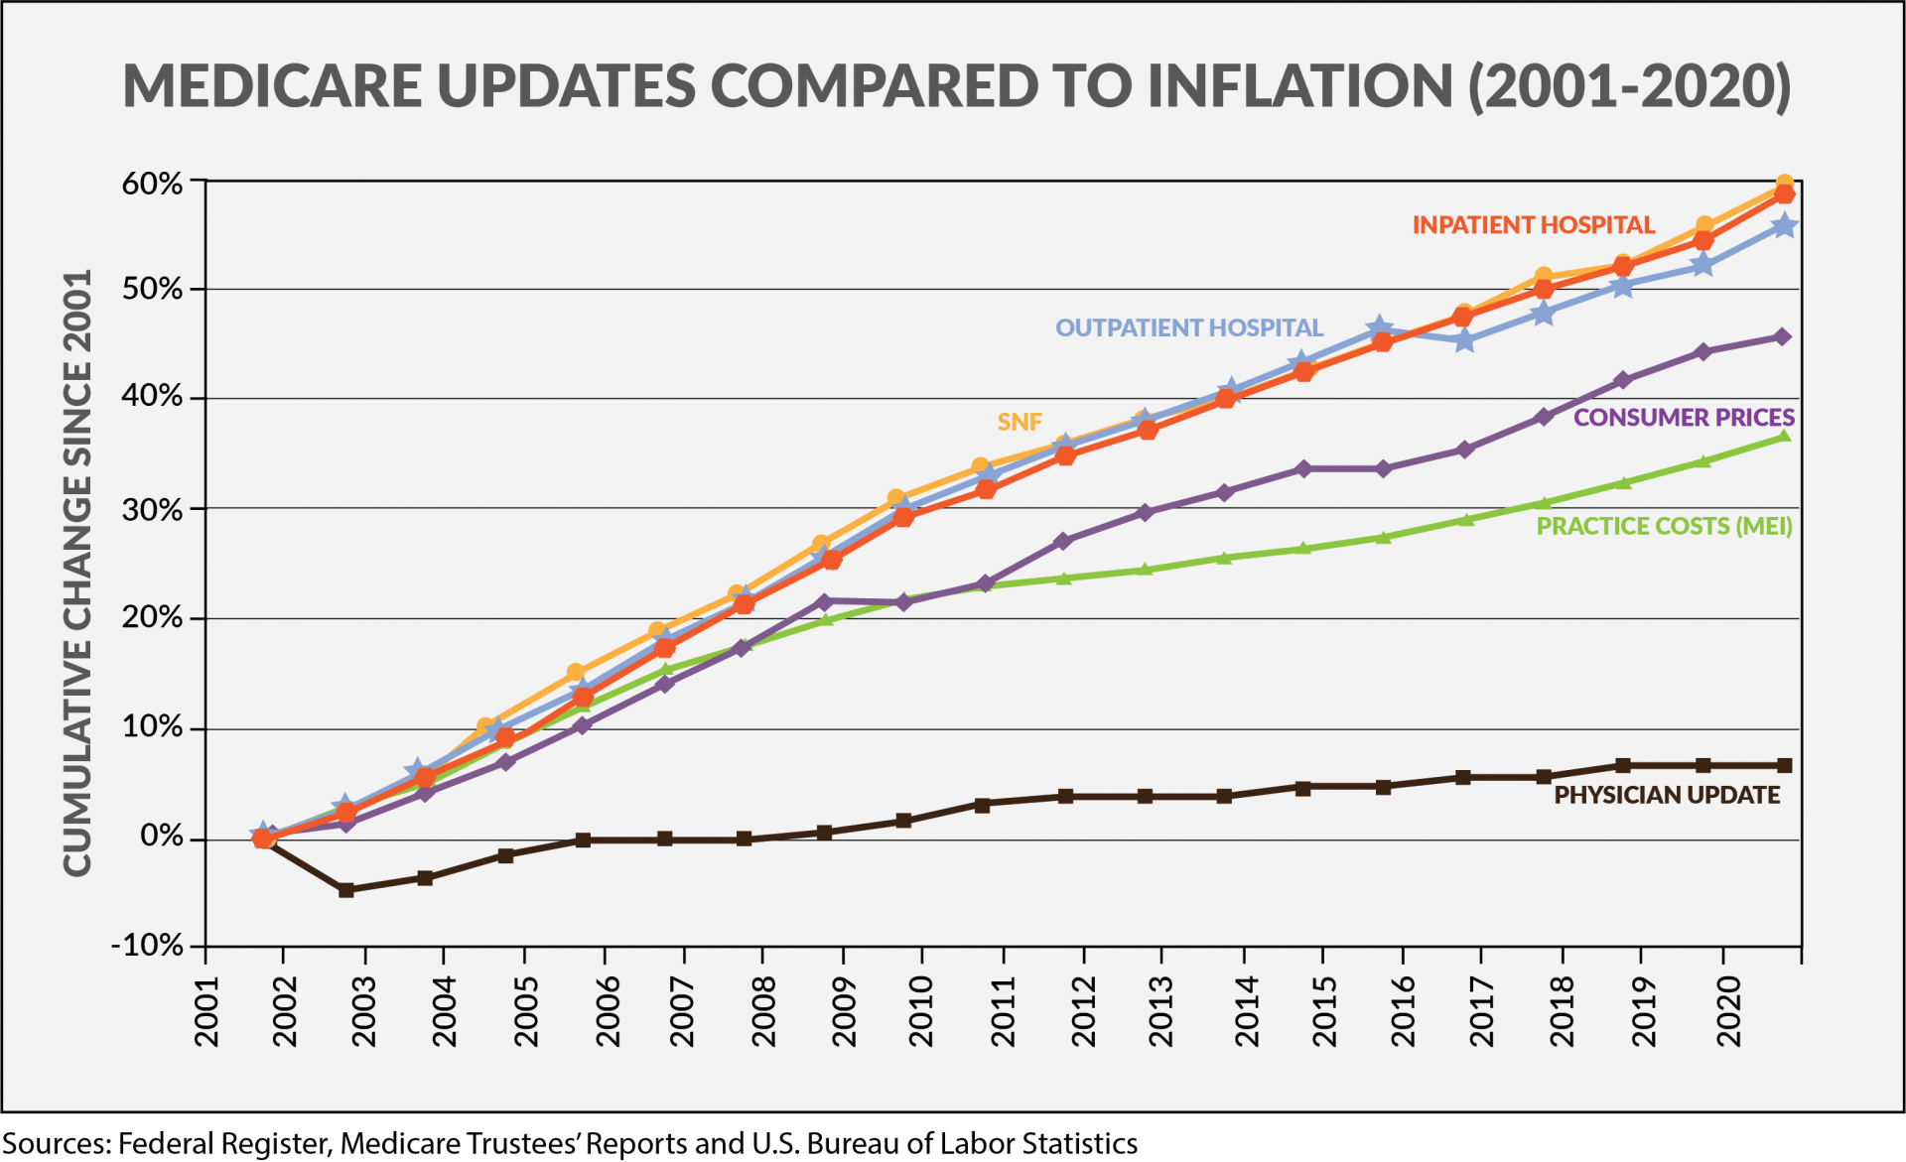

Slide 43
Radiology and Fee for Service
Kulmar, S. Trends in Diagnostic Imaging Medicare Reimbursements: 2007 to 2019, JACR, Vol. 17, Issue 12,2020, Pgs. 1584-1590,
Notes:
Practices doing well despite reductions:
Increasing productivity.
Working harder, less vacation, more weekends, less outsourcing, longer hours.
Great resignation
burnout, workforce shortages and radiologists selling off the assets of their practices are signs of deteriorating pricing power.
This is probably unsustainable without additional compromises. Many, including me, conclude that FFS reimbursement is going to have to change in the not too distant future.

Slide 44
Budget Neutrality and Medicare Physician Fee Schedule Reimbursement Trends for Radiologists, 2005 to 2021
Unadjusted reimbursement to radiologists per beneficiary increased 4.2% between 2005 and 2021, but when adjusted for inflation, it declined 24.9%.
Between 2005 and 2021, the conversion factor declined 7.9%, and when adjusted for inflation, it declined 33.6%.
RVUs per beneficiary performed by radiologists increased 13.1% from 2005 to 2021, but this increase did not offset conversion factor and inflation declines.
From 2005 through 2023, the inflation-adjusted conversion factor declined 43.1%.
https://doi.org/10.1016/j.jacr.2023.07.009
Notes:
This is just for medicare beneficiaries. What is not included in the methodology was the significant increase in number of beneficiaries not to mention number of images per study.

Slide 45
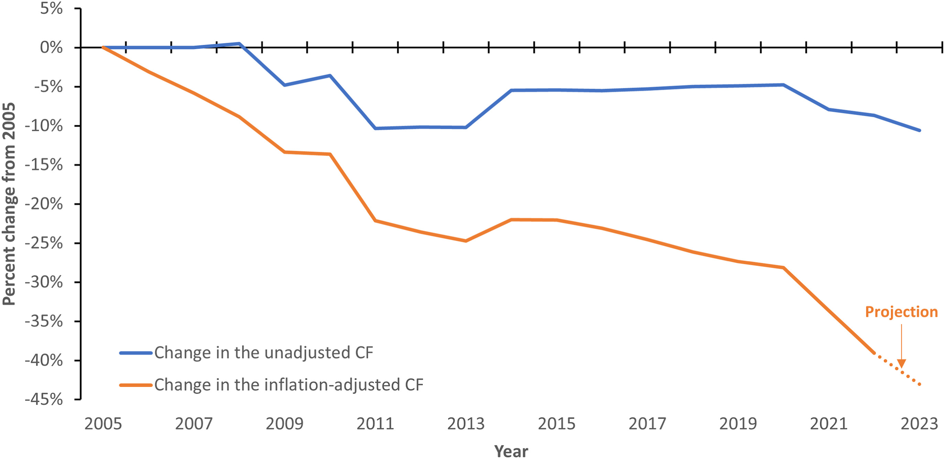

Slide 46
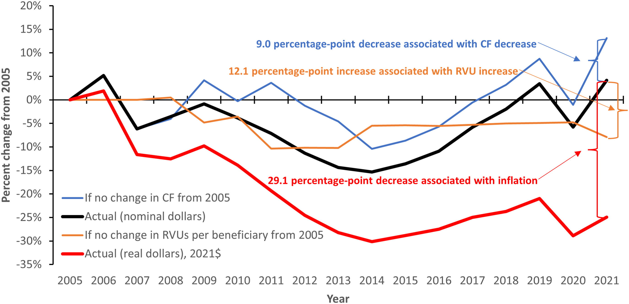
Fig. 1
Journal of the American College of Radiology DOI: (10.1016/j.jacr.2023.07.009)
Copyright © 2023 American College of Radiology Terms and Conditions
Notes:
Percentage change in total reimbursement per Medicare fee-for-service beneficiary for radiologists, 2005 to 2021. CF = conversion factor; RVU = relative value unit.

Slide 47
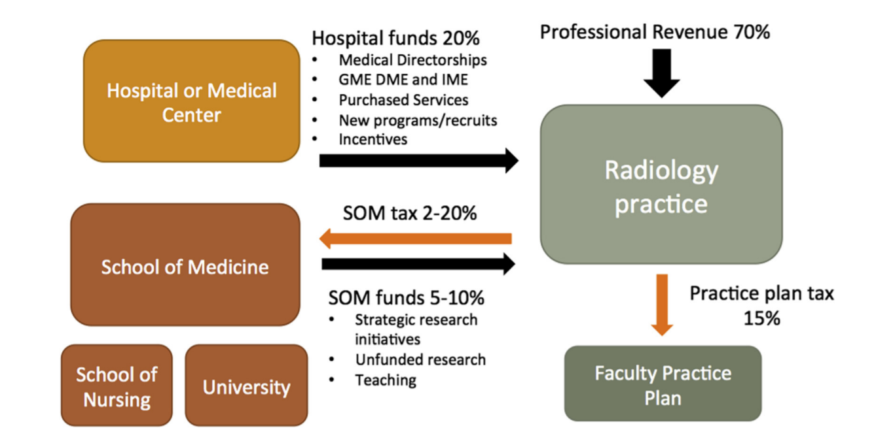
Academic Radiology Funds Flow
Itri JN, Mithqal A, Krishnaraj A. Funds Flow in the Era of Value-Based HealthCare. J Am Coll Radiol. 2017 Jun;14(6):818-824.
Notes:
Funds flow model in academia and for some multispecialty practices.
Centralized multispecialty revenue cycle management with additional parameters such as Dean’s tax and others.
Buffers faculty from the reimbursement cuts.

Slide 48
Future of FFS: MedPAC
MedPAC report (March 2021)
Despite temporary issues caused by the COVID-19 pandemic, Medicare beneficiaries have had stable access to clinician services over the last decade. MedPAC believes the temporary cash flow issues experienced by providers was resolved by temporary relief passed by Congress.
Access was equal to or better than that of privately insured individuals.
MPFS updates in the range of 0 percent to 1 percent over the last 10 years have been sufficient to ensure beneficiary access to care.
Recommendation for 2022: no update
Citing compensation differences between primary care physicians and specialists, MedPAC continues to have concerns about the “mispricing of fee schedule services and its impact on primary care”.
Notes:
MedPAC is an advisory panel for Congress. They presented a report to Congress last March.

Slide 49
Future of FFS: MedPAC
MedPAC report (March 2021)
Despite temporary issues caused by the COVID-19 pandemic, Medicare beneficiaries have had stable access to clinician services over the last decade. MedPAC believes the temporary cash flow issues experienced by providers was resolved by temporary relief passed by Congress.
Access was equal to or better than that of privately insured individuals.
MPFS updates in the range of 0 percent to 1 percent over the last 10 years have been sufficient to ensure beneficiary access to care.
Recommendation for 2022: no update
Citing compensation differences between primary care physicians and specialists, MedPAC continues to have concerns about the “mispricing of fee schedule services and its impact on primary care”.
Notes:
MedPAC is an advisory panel for Congress. They presented a report to Congress last March.

Slide 50
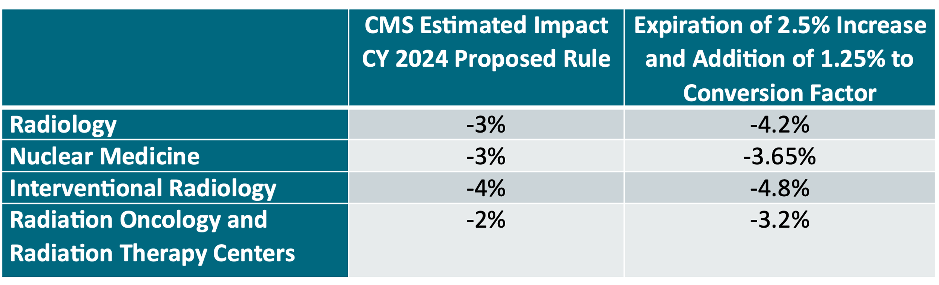
ACR Update:
Impact Table: 2024
Notes:
add-on code G2211 complexity code billed primarily for office and outpatient evaluation and management encounters
Congress added a 2.5% bump to the fee schedule conversion factor in 2023, which is being halved in 2024 to account for a 1.25% pay reduction.

Slide 51
Volume to Value Transition
Accountable Care Act (2010)
Medicare Access and CHIP Reauthorization Act of 2015 (MACRA):
Quality Payment Program (QPP) consists of two major tracks:
  The Merit-based Incentive Payment System (MIPS):
    Quality (40% of score)
      Promoting Interoperability (25% of score)
      Improvement Activities (15% of score)
      Cost (20% of score)
  Alternative Payment Models (APMs):
    Accountable care organizations (ACOs),
    Episode- based payment models,
    Comprehensive Primary Care models,
    Others
Notes:
Design was to reward those above average and withhold from those below average. All in all, Qpp has not lived up to expectations in incentivizing value especially in radiology

Slide 52
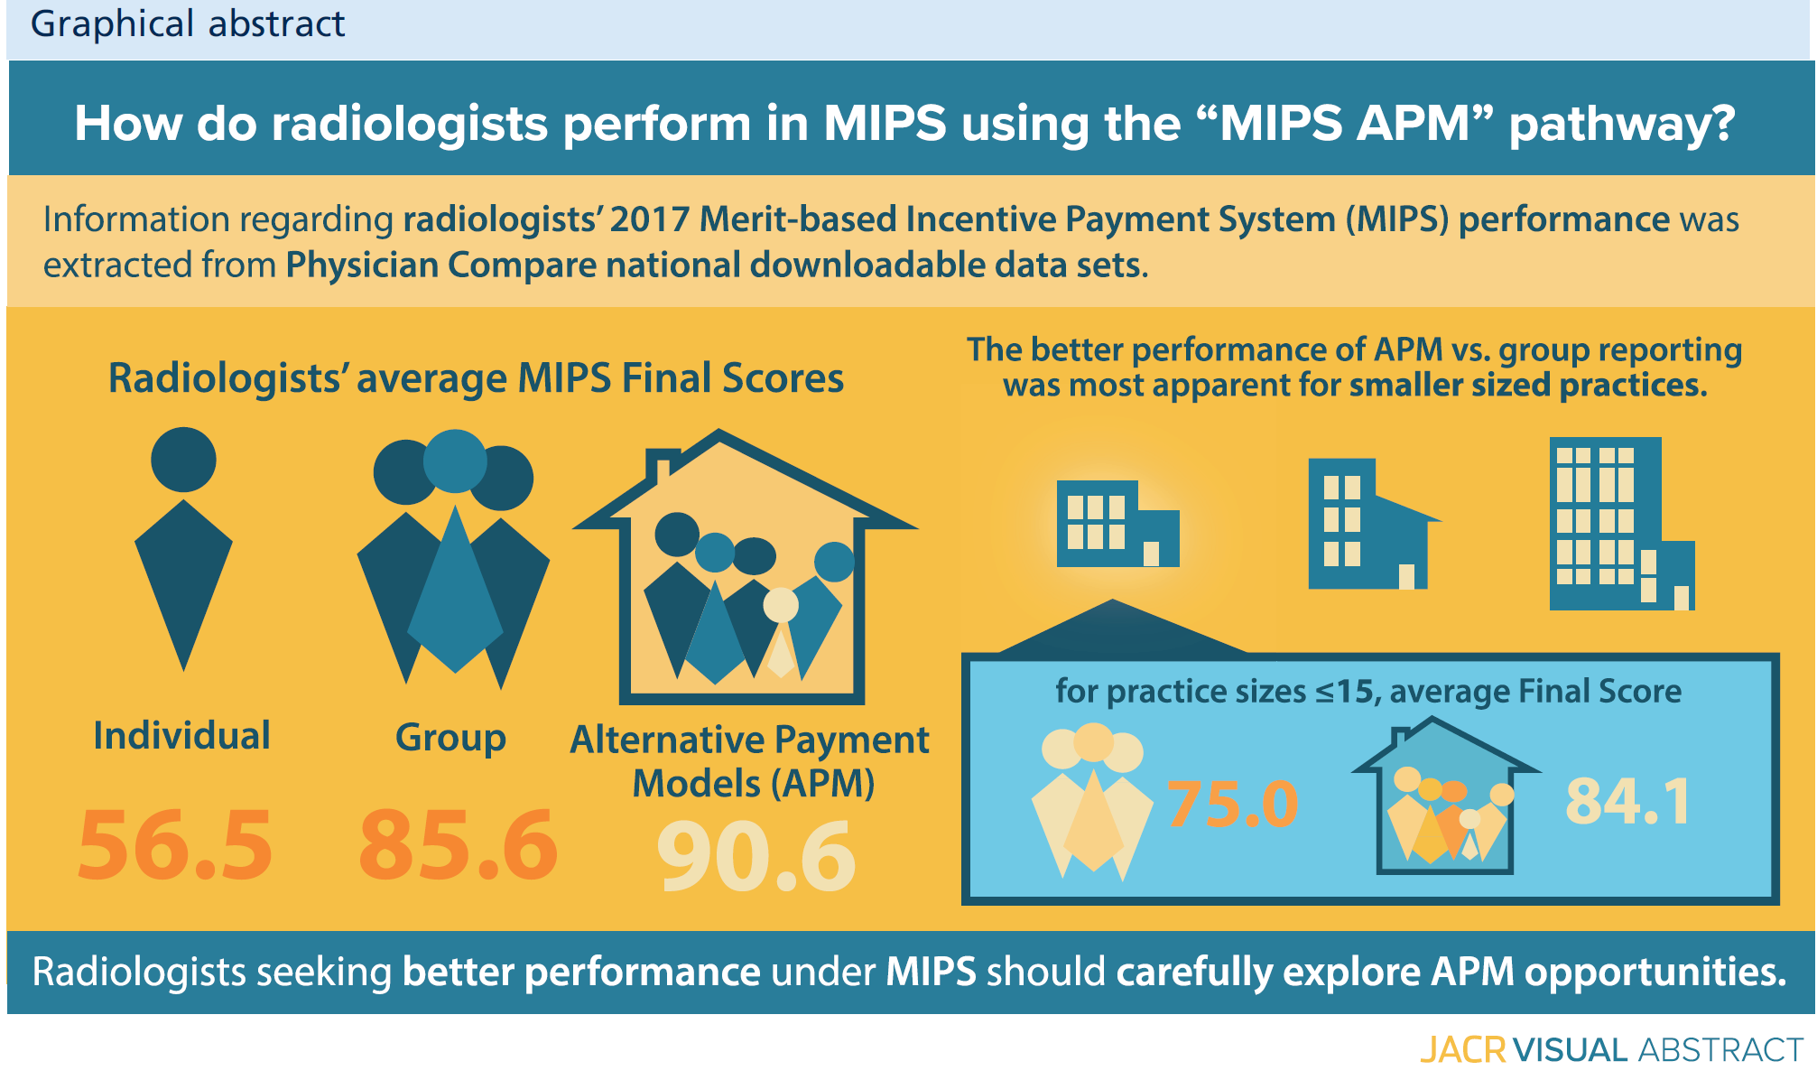
https://www.jacr.org/article/S1546-1440(2019)31189-5/pdf
Notes:
Some practices have been successfully utilizing apm reimbursement models.

Slide 53
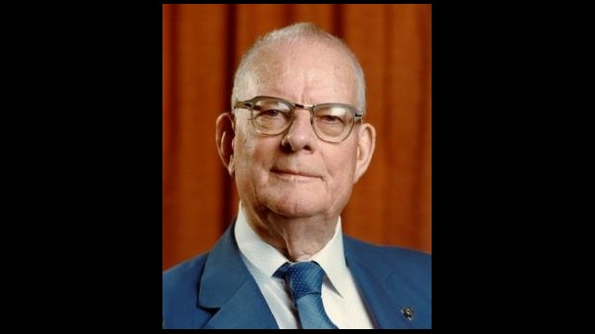
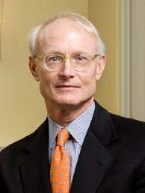
Definition of Value
Value= Quality/Price
Value= Outcome/Price
Porter ME. What is value in healthcare? N Engl J Med 2010;363: 2477-81.
Notes:
William Edwards Deming (1900-1993) is widely acknowledged as the leading management thinker in the field of quality. He was a statistician and business consultant whose methods helped hasten Japan’s recovery after the Second World War and beyond. He derived the first philosophy and method that allowed individuals and organizations to plan and continually improve themselves, their relationships, processes, products and services. His philosophy is one of cooperation and continual improvement; it avoids blame and redefines mistakes as opportunities for improvement.
Michael Porter

Slide 54
`
Several medical imaging societies ask to be involved in Congressional Medicare reform efforts
Dave Fornell | February 25, 2022 | Economics
Numerous medical imaging societies were among about 100 healthcare groups that signed onto a letter sent to Congressional leaders Feb. 25 that requests collaboration as legislators work to reform the Medicare physician payment system.

Slide 55
Radiology: Future State
Innovation
Opportunities
Leadership

Slide 56
Innovation

Slide 57
Innovation
Interventional
  Embolotherapy: “Emborhoid”, Bariatric, inflammatory joint disease
  Interventional Immuno-oncology
  Percutaneous AV fistula for dialysis access
  Image Fusion Intervention with virtual reality
Radiation Therapy
  Stereotactic radiotherapy
  Intrafraction motion
  FLASH
  Proton Beam
  VMAT: Volume modulated arc therapy
Nuclear Medicine: Theragnostics
Notes:
As we talked about, the history of radiology is about innovation. When I trained about 80% of interventional was about diagnostic arteriography. Here is a partial list of some of our most recent innovations just in Interventional, Rad Tx and Nucs. Not a comprehensive list. Certainly, many in this room can add multiple other procedures or applications to this list. In fact many in academia either were or are involved in important innovations driving the profession forward.
Emborhoid: hemorrhoids: superior rectal arteries
Bariatric: left gastric artery
Inflammatory joint disease: reduce angiogenesis
IO- stimulating a physiologic immune response
Fusion: The potential introduction of the extended reality (from augmented reality to virtual reality) is a new horizon that can integrate the multimodality guidance
Stereotactic ablative radiotherapy/stereotactic body radiotherapy (SABR/SBRT) is a very focused radiation treatment approach that delivers a high radiation dose concentrated on the tumor, with a sharp fall-off of the dose to the surrounding normal tissue. Stereotactic radiotherapy is particular advantageous in small tumors. Brachytherapy is a form of internal radiation therapy in which a sealed radioactive source is placed inside or in the immediate vicinity of the tumor to be irradiated. Inter- and intrafraction motion refers to movement of the tumor relative to the surrounding normal tissue from one radiotherapy session to the next or in the latter case during one session. Underlying reasons include growth or shrinkage of the tumor, changes in bladder or bowel filling, or movement caused by breathing or heartbeat. Counteracting these reasons by motion control measures becomes more and more important with increasing precision of radiotherapy. FLASH radiotherapy is based on very high dose rates (dose rate 40–50 Gy·s⁻¹ or more), which is believed to significantly reduce normal tissue damage without decreasing the effects of radiation on the tumor. Intensity-modulated radiotherapy (IMRT) is a high precision way of irradiating the tumor where the intensity of the radiation dose can be changed within each irradiation field so that the delivered dose can be precisely adjusted point by point to the target volume. Particle and proton irradiation is a precision method of radiation therapy in which the tumor is irradiated with high-energy positive ions (usually protons or carbon ions). Because of their inverse depth dose profile with a Bragg peak, dose to normal tissues can often be reduced compared to irradiation with photon beams. The relative biological effectiveness of particle beams is different to photon beams, which needs to be considered in treatment planning. Volume modulated arc therapy (VMAT) is a further development of IMRT that delivers the intensity-modulated radiation dose continuously as the gantry of the treatment machine rotates over defined angular ranges shaping the radiation dose to the tumor.
Theragnostics: psma ligands (prostate)
Dutotate for neuroendocrine tumors

Slide 58

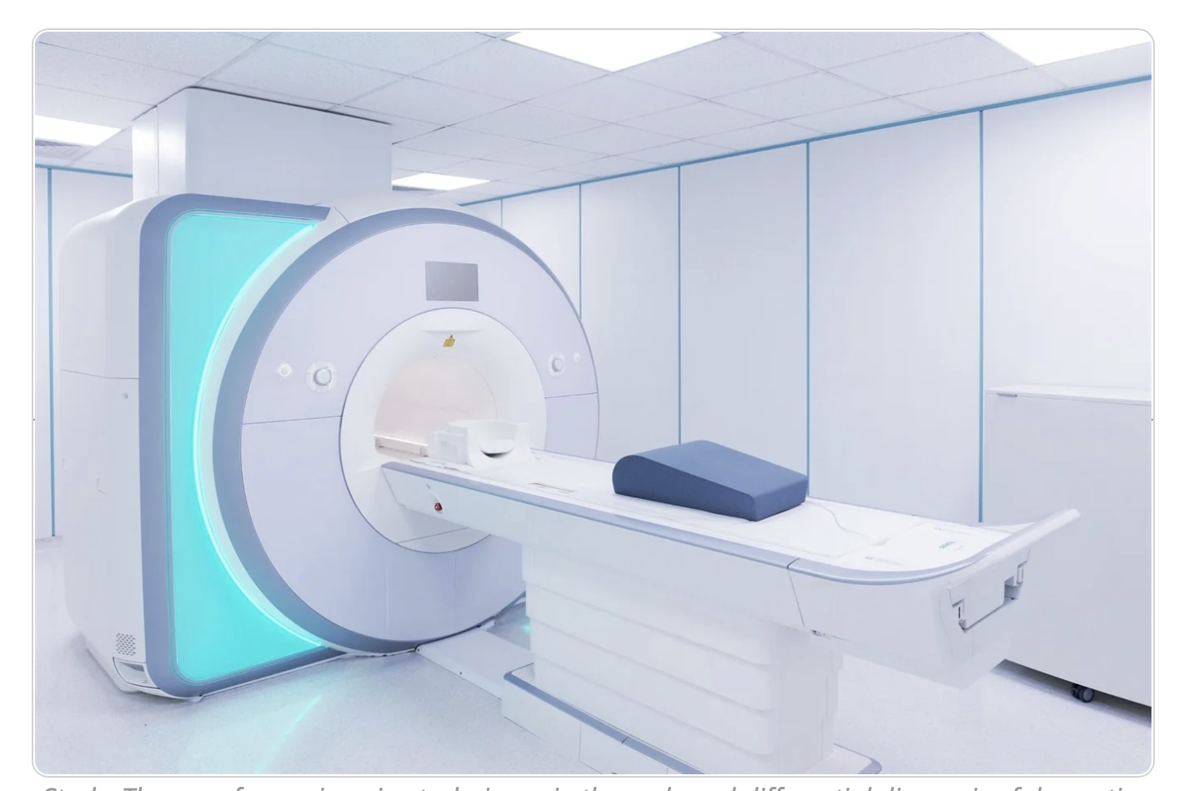
The Use of Neuroimaging Techniques in the Early and Differential Diagnosis of Dementia
Neuroimaging of the brain is increasingly being utilized to stratify clinical trial participants and assess treatment response.
https://doi.org/10.1038/s41380-2023-02215-8

Slide 59

Beta Amyloid Positron Emission Tomography in Dementia and Neurodegenerative Disease
Decision Summary: The Centers for Medicare &
  Medicaid Services (CMS) is proposing to remove the
  national coverage determination (NCD) at § 220.6.20, ending coverage with evidence development (CED) for positron emission tomography (PET) beta amyloid imaging and permitting Medicare coverage determinations for PET beta amyloid imaging to be made by the Medicare Administrative Contractors (MACs) under § 1862(a)(1)(A) of the Social Security Act (the Act).
Notes:
Currently more than 55 million people have dementia worldwide,

Slide 60

Possible Applications of AI in Medical Imaging
Image interpretation
  Quantification of findings
  Quantified comparison between multiple studies
  Multiparametric analysis across multiple modalities
  Volumetric analysis
  Textural analysis
  Automation of Region Of Interest targeting and measuring
Radiologist and practice optimization for productivity and quality
  Automated transcription of audio narration
  Automated population of structured reports
  Optimization for case assignment across teams
  Smarter PACS hanging protocols and synchronization protocols
  Communication and tracking of primary and incidental findings
  Decreased patient waiting times
  Quality improvement in scanning
  Prediction and prevention of missed patient appointments
Patient care and safety
  Detection and prioritization of potentially critical results
  Radiation dose optimization
  Pre-test probability assessment of patient risk of positive findings and contrast reactions
  Cancer and mammography screening
  Automatic protocoling of studies from EMR data

Slide 61


Cockpit of the Future:
Academy for Radiology and Biomedical Imaging Research
http://www.acadrad.org/wp-content/uploads/2019/01/Academy-Article-Academic-Radiology.pdf
Notes:
The Academy for Radiology and Biomedical Imaging Research recently imagined the Radiology Cockpit of the Future. This is a brilliant and encompassing concept. A bit wonky and aspirational. But the real emphasis is getting radiologists beyond simply being image interpreters. That position makes us vulnerable to commoditization like widgets or bots. Instead we would leverage current and soon to be released technology. Radiologists become data aggregators and information synthesizers. Especially for this audience, academia, as centers of innovation reimagining training radiologists. Extracting additional information from our studies so we can make referrals, drive interventions and improve outcomes. Value creation. Making ourselves indispensable not only to referring physicians and administrators but to patients.
The Academy for Radiology and Biomedical Imaging Research recently imagined the Radiology Cockpit of the Future powered by the promise of AI. The diagnostic cockpit is a future-state digital platform to aggregate, organize, and simplify medical imaging results and patient-centric clinical data. It will help clinical radiologists become “diagnostic pilots” in detecting disease early, making accurate diagnoses, driving image-guided interventions, and improving downstream clinical management of patients. Radiologists will be not only interpreters but data aggregators and information synthesizers. The radiology cockpit will be designed to prioritize, enable and enhance these activities. This will help shift the “art” of diagnostics to the “data science” of diagnostics, leading to remarkable advances in patient care.

Slide 62
“AI-assisted modeling and analysis have the potential to dramatically reduce the cost and risk of creating new innovations, helping transform our practices into vast digitally assisted test beds for human ingenuity.”
Notes:
A quote from one of the HBR articles:
AI will begin to fundamentally change the expectations for human workers including those in Radiology. Jobs for both radiologists and allied staff can be redesigned for more cognitive tasks such as creative outside-the-box thinking and interpersonal skills.

Slide 63
Opportunities

Slide 64
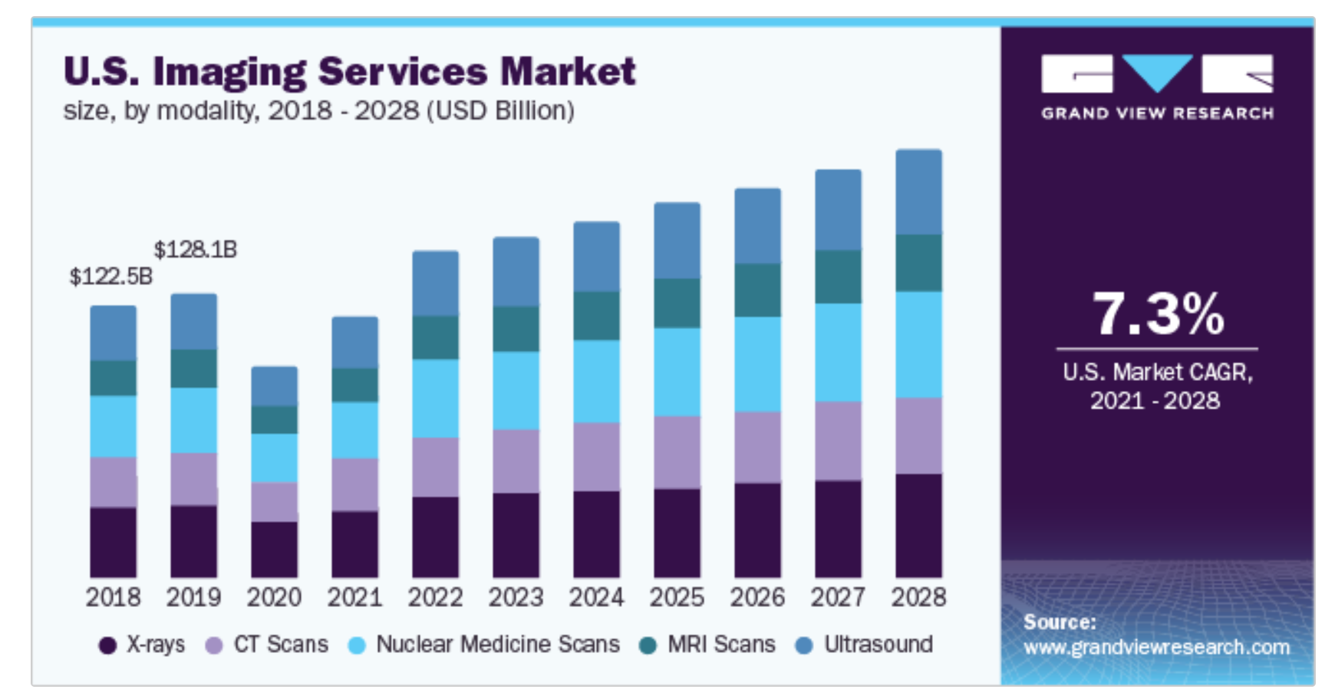
Notes:
The good news I saved for towards the end of my presentation. Every projection for at least the intermediate term is that imaging will continue to increase. Balance between future utilization improvement and increasing demand for services the result will be more studies.

Slide 65
Trend in ACR Career Center Job Postings
Notes:
About one thousand trainees per year.

Slide 66









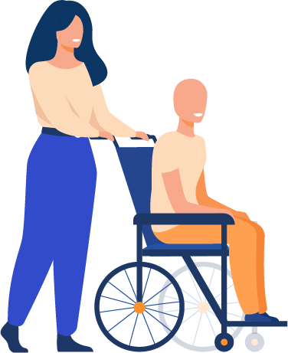
SURVEILLANCE AND PREVENTION
ACUTE CARE
CHRONIC CARE MANAGEMENT
Mammography
Low Dose Chest CT
Virtual Colonoscopy
AAA screening
AI tools
ACR Imaging 3.0 · Choosing Wisely Best Practice Recommendations Clinical Decision Support
IP Care Coordination
Clinical Pathway Management
Follow-up: AAA, Lung Nodules Oncology Intervention
Fatty Liver
Metabolic Syndrome
QALY improvements
ACR IMAGING 3.0 · ACO’S/MSSP · SHARED RISK MODELS WITH PAYERS · MIPS · APM · COMMUNITY HEALTH INITIATIVES
Notes:
Blue ocean strategy. Business term introduced in 2004. Lots of potential, little competition.
We are just beginning to scratch the potential. For example premier screening program, mammography. And additional potential. Only 6% of patients eligible for lung cancer screening were imaged in 2022.
Developing additional screening models such as MR prostate.
Radiology’s expertise in data generation and management along with applying operational scale ideally positions us in this space. Population Health provides a pathway for us to increase our impact as physicians and reach more patients. Most importantly, it’s the right thing to do. But in addition……

Slide 67
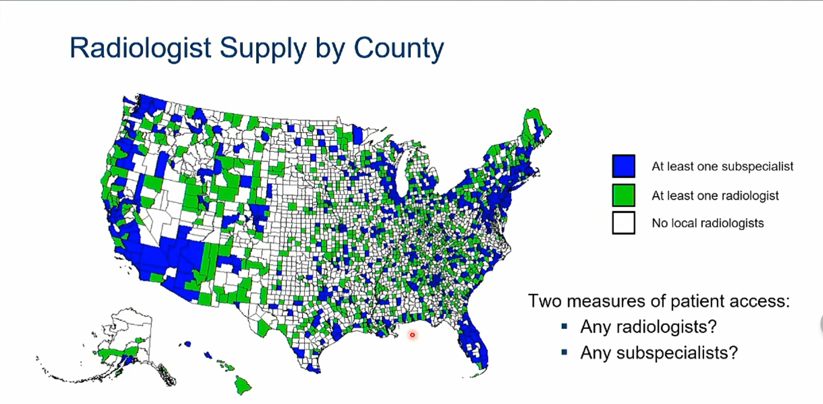
Rosenkrantz, A. A County-Level Analysis of the US Radiologist Workforce: JACR. 15. 10.1016, 2018
Notes:
48.5% of the counties in us- no radiologist.

Slide 68

Health Equity
Notes:
Health Equity: there is no doubt that there is a disparity in services based upon social determinants of health.
More aggressive breast cancer in African Americans
More aggressive prostate cancer in African Americans
Disparate rates of follow up on incidental findings for different ethnicities
American Indians/Alaska Natives have higher death rates from kidney cancer than any other racial/ethnic group
American Indians/Alaska Natives have highest rates of liver and intrahepatic bile duct cancer, followed by Hispanics/Latinos and Asian/Pacific Islanders
500% higher mortality rate for asthma in African American children
Diabetes: compared to non-Hispanic whites
` 77% higher rate in African Americans
66% higher in Hispanics
18% higher in Asians
By directing our practices and departments to limit or eliminate disparities, most importantly we are fulfilling our mission as physicians. But yet again, reaching out to more patients, providing value, supports our departments along with raising the value proposition of our profession.

Slide 69










Slide 70


Slide 71

Notes:
Population health also can support our business models. Look at these numbers. This data illustrates the possibilities. The plenary session on Wednesday addressed counties that are underserved and “interventional deserts”. By reaching out to additional patients, bringing them into the system and providing the medical imaging care that they need, we will realize additional services and revenue flow coming into our practices.

Slide 72
Leadership

Slide 73
“[Organized Radiology] can collectively do for radiologists and their practices what they cannot do for themselves”.
Bibb Allen, M.D
Former Chair and Pres. , ACR

Slide 74
Organized Radiology- The Dilemma
Approximately 55 organizations and societies in Radiology
Limited or decreasing discretionary income
Time demands
Varying priorities and organizational loyalties
  Academics
  Multispecialty practices
  Independent practice
  Corporate models

Slide 75
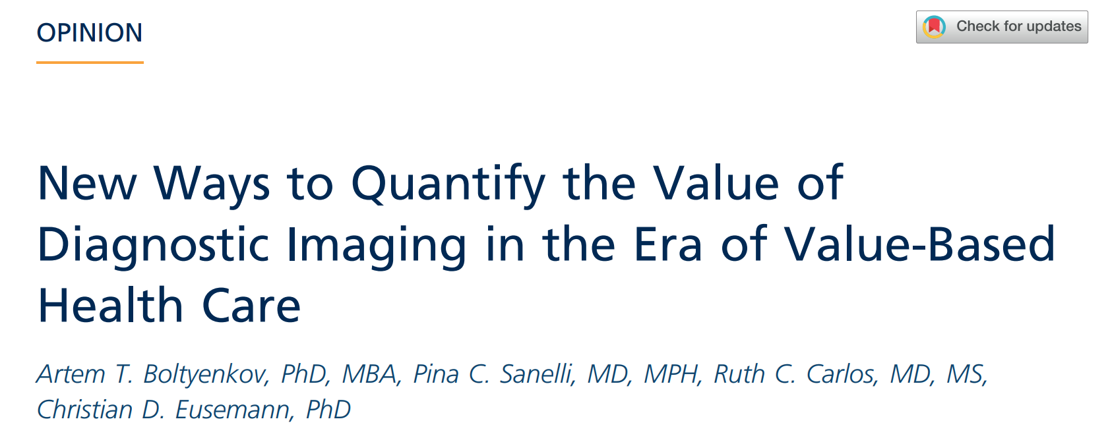
Defining Value
Boltyenkov, Artem T. et al., JACR, Volume 19, Issue 2, 240 - 242
Notes:
Others are defining our metrics. We should not be measured by turn-around times and RVU’s. When you ask for a second opinion from a colleague, are those the metrics that use? We have to define ourselves and that’s beginning to happen in our literature.

Slide 76
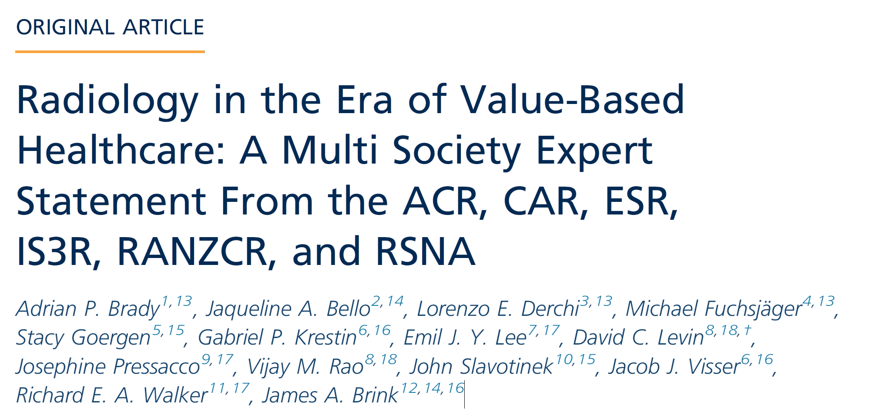
https://pubs.rsna.org/doi/full/10.1148/radiol.2020209027
Notes:
An overused term at this point. Unfortunately its been highjacked to mean lower costs.
TAKE-HOME POINTS
- Value-based healthcare (VBH) is a framework for
improving individual patient health outcomes per unit
of expenditure.
- Radiology is a key component of healthcare, impacting
greatly on patient outcomes, and must be
considered a vital element of VBH.
- Embracing VBH principles, radiology can contribute
to moving to a value-driven system, where all investigations
or interventions contribute positively to
patient outcomes.

Slide 77
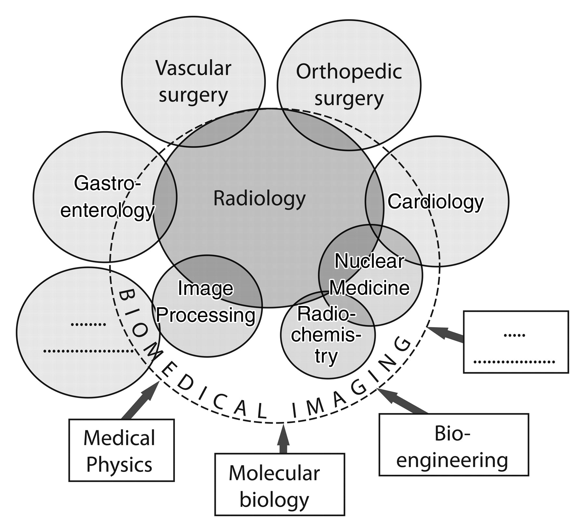
Biomedical Imaging Department
Krestin GP. Published Online: March 01, 2009
https://doi.org/10.1148/radiol.2503081791
Notes:
Standardized workflow
Quality and safety
Training and expertise
Efficiency
AI
We clearly have the talent. We have the tools. We have the experience. Questions that remain are do we have the will and do we have the leadership. I’d argue for radiology all day long.

Slide 78
Conclusion
Radiology has always been a dynamic and innovative specialty.
Given existing limitations under FFS, several Radiology practices have been successful with APM’s.
The Volume to Value transition presents not only challenges but opportunities.
Radiology is well positioned to be not only sustainable but thrive in future healthcare paradigms.

Slide 79


Slide 80

Notes:
Finally, we should develop these concepts together, through organized radiology. If we do as individual institutions, we risk non-standard approaches, variability and longer timelines. Moving together, working as a community, speaking with a unified voice about the vision of the future is a more secure and certain pathway to success.

Slide 81

“Ten people who speak make more noise than ten thousand who are silent."

Slide 82
Thank You
hfleishon@outlook.com| @FleishonMD

Slide 83
Budget Neutrality and Medicare Physician Fee Schedule Reimbursement Trends for Radiologists, 2005 to 2021 https://doi.org/10.1016/j.jacr.2023.07.009
Unadjusted reimbursement to radiologists per beneficiary increased 4.2% between 2005 and 2021, but when adjusted for inflation, it declined 24.9%.
Between 2005 and 2021, the conversion factor declined 7.9%, and when adjusted for inflation, it declined 33.6%.
RVUs per beneficiary performed by radiologists increased 13.1% from 2005 to 2021, but this increase did not offset conversion factor and inflation declines.
From 2005 through 2023, the inflation-adjusted conversion factor declined 43.1%.

