Slide 1

Workforce: Statistics and Analysis
Howard B. Fleishon, MD, FACR, MMM
Immediate Past President, ACR
Professor, Emory Dept. of Radiology

Slide 2

Disclosures
I have no financial disclosures relevant to this presentation.
Investor and Advisor: RomTech, Inc.
Investor: Focused Cryo, Inc.

Slide 3

Survey: 2023 Review of Physician and Advanced Practitioner Recruiting Incentives
Radiology is the third most sought-after specialty among healthcare employers
Radiologists represented the No. 2 most requested search among AMCs, behind only anesthesiologists.
The average starting radiologist salary of $472,000—represents a more than 27% increase from AMN’s 2017/2018 report.
Notes:
based on a representative sample of the 2,676 search engagements the company conducted from April 1, 2022 to March 31, 2023.

Slide 4
Trend in ACR Career Center Job Postings
Notes:
About one thousand trainees per year.

Slide 5
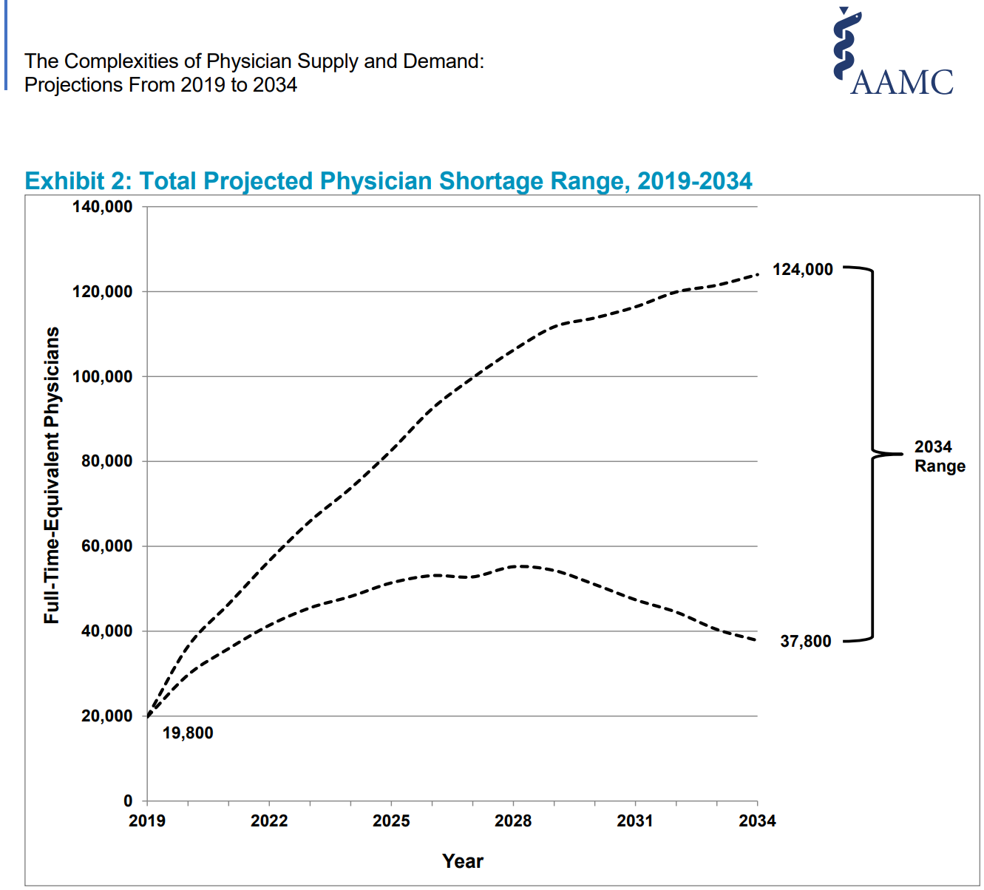
Physician Supply and Demand:
Projections From 2019 to 2034
Notes:
Workforce shortage is not unique to radiology. Here’s a projection of supply shortage relative to demand of all physicians from the Association of American Medical Colleges.

Slide 6
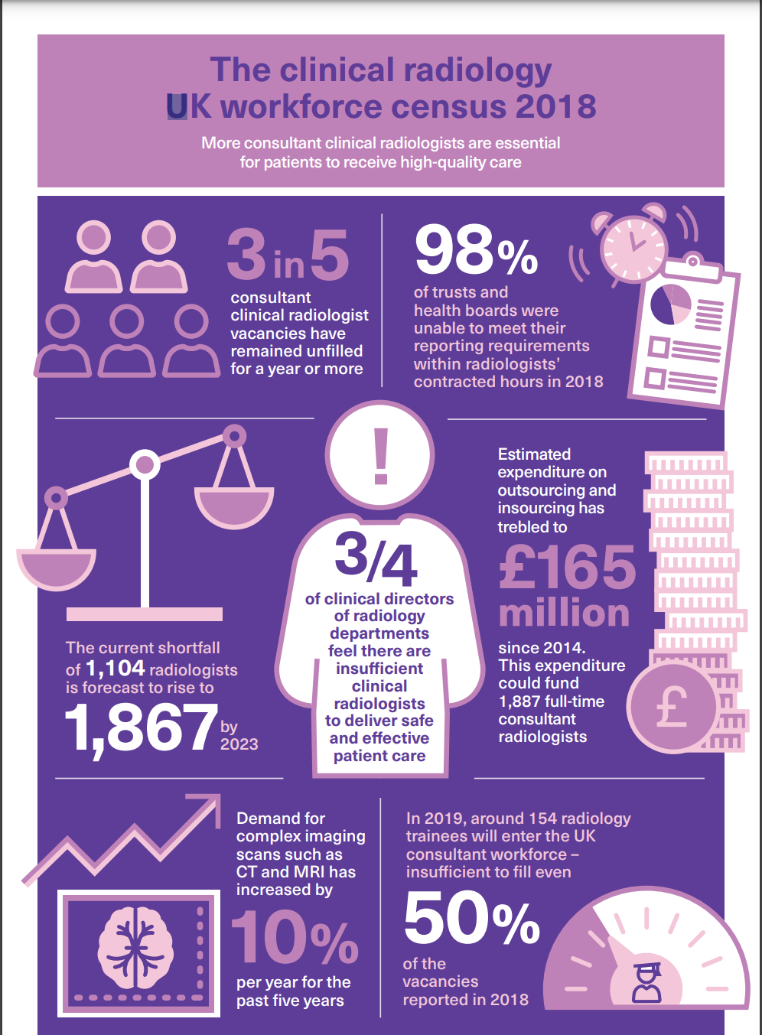
Notes:
Workforce shortage is also an international concern. Britain has significant vacancies as indicated by this graphic. One month turnarounds. Many of the trainees in Ireland look elsewhere for permanent positions. Australia estimates they are short about 10%.

Slide 7
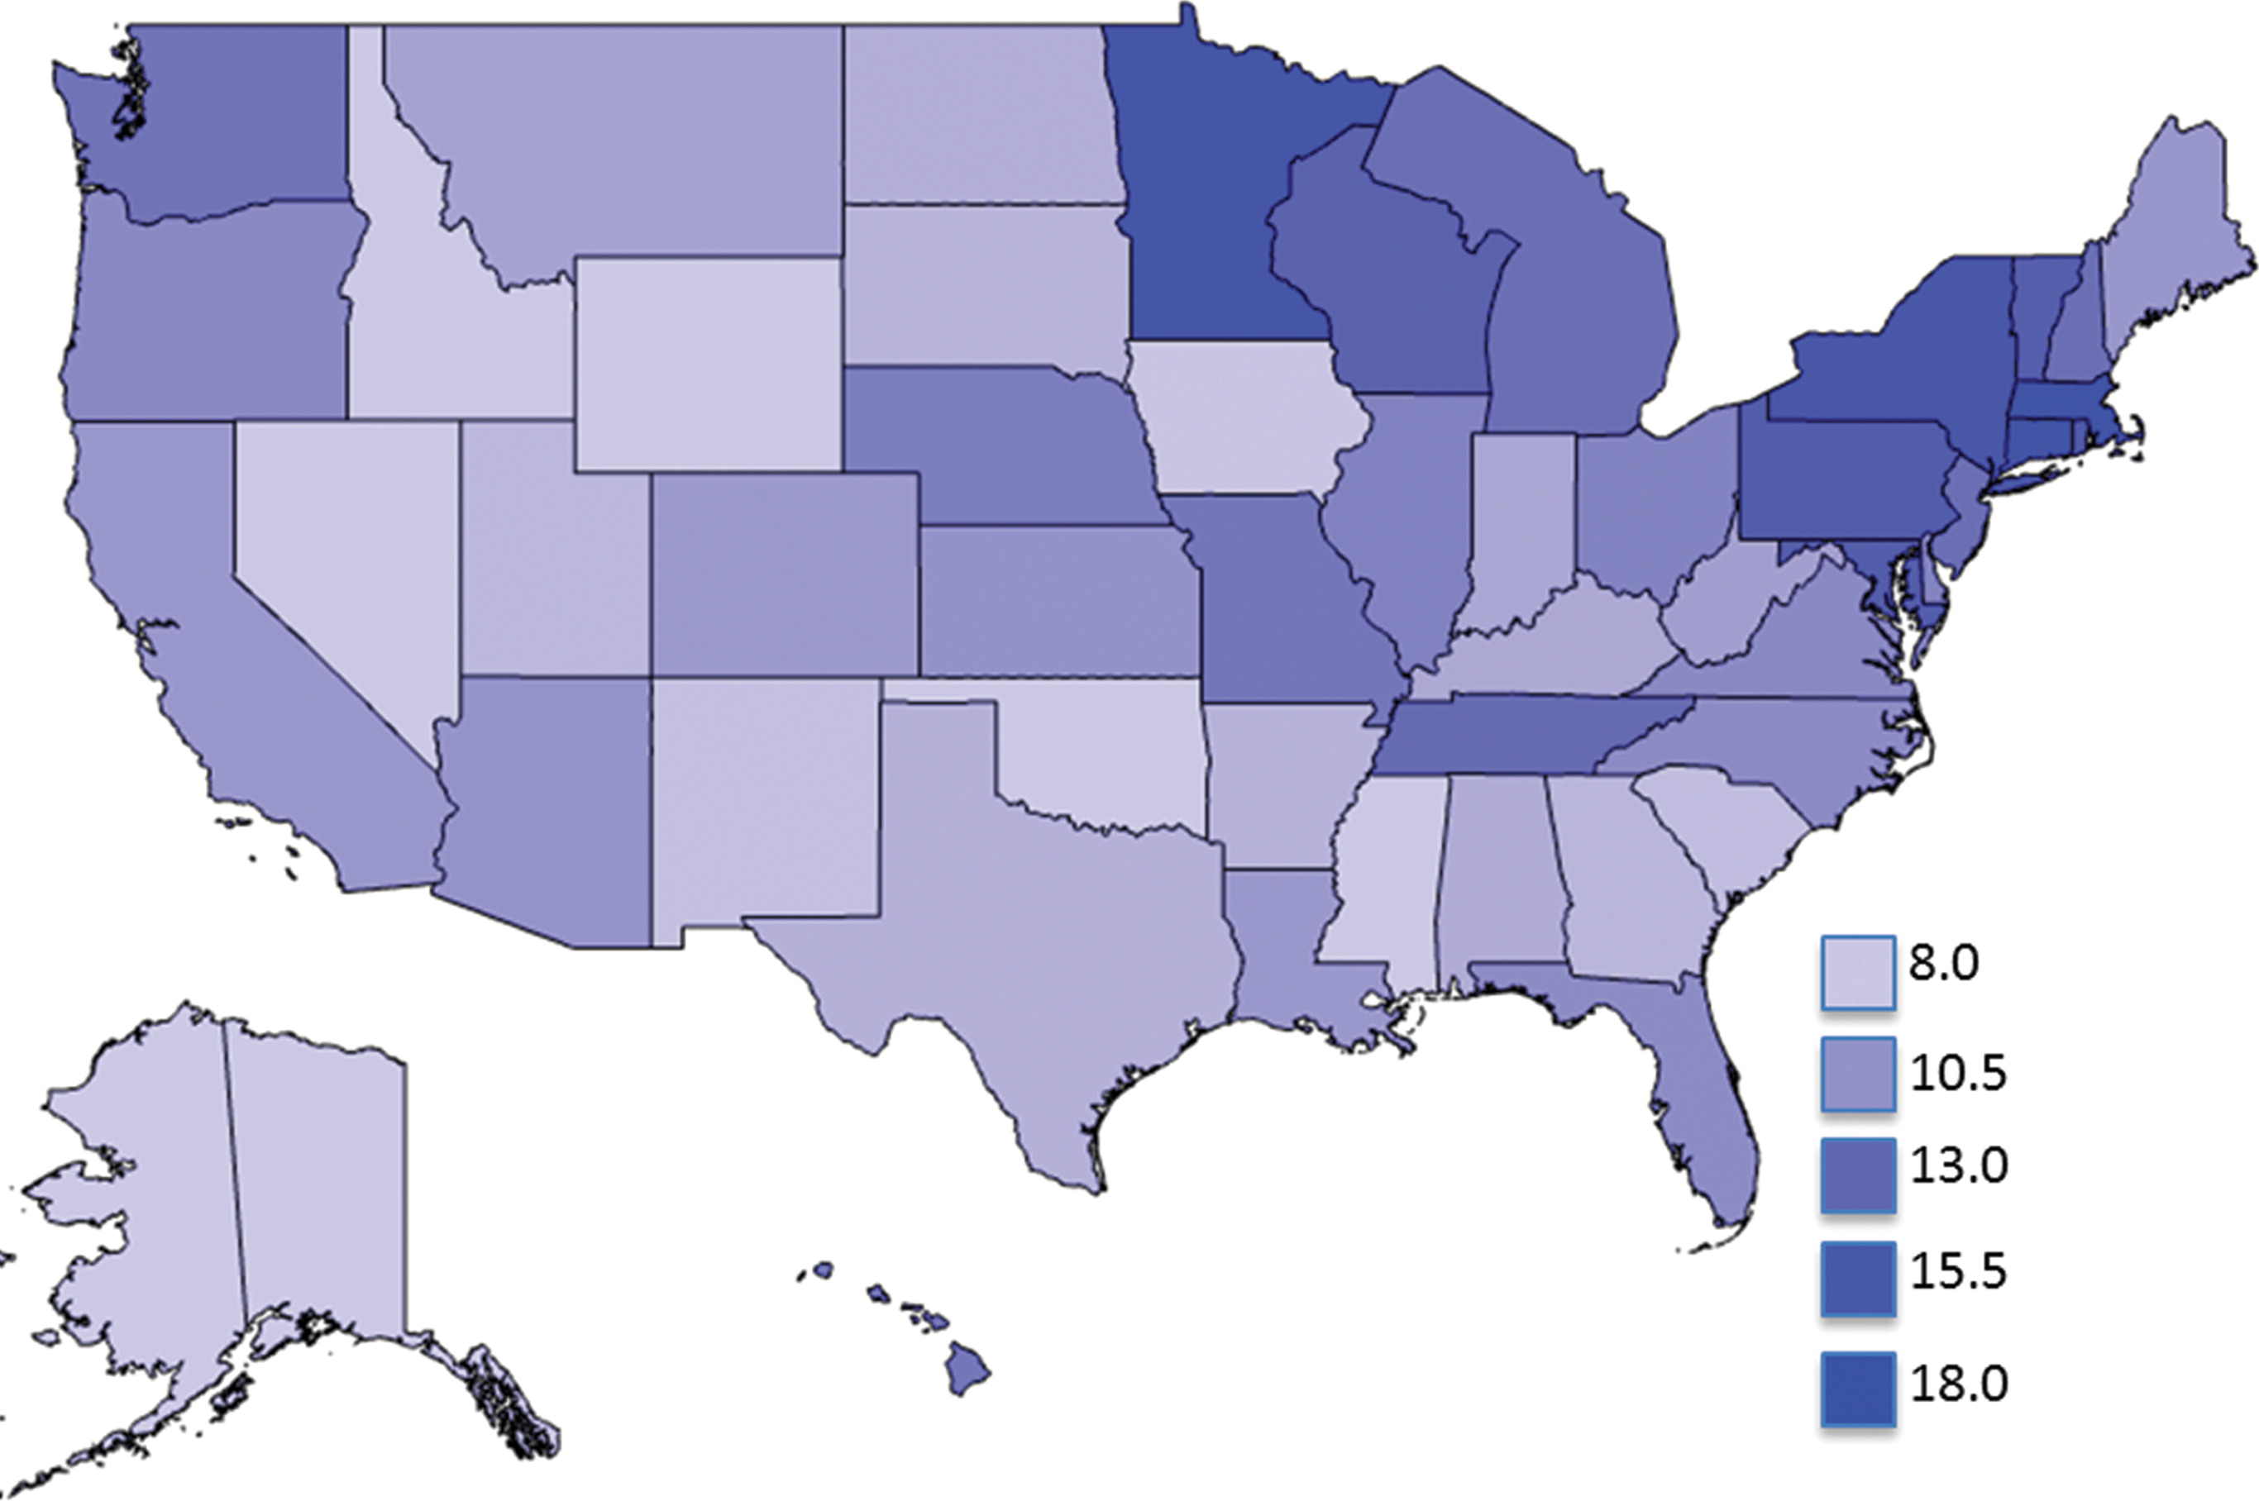
State-wide distribution of Radiologists per 100k
Rosenkrantz AB. Published Online: October 28, 2015
https://doi.org/10.1148/radiol.2015150921
Notes:
Also, some of what we are feeling is regional. There is a maldistribution of radiologists especially in semi-rural and rural areas.

Slide 8

Drivers for Growth of Imaging Volumes
Aging population
The rising prevalence of cancer and cardiovascular diseases.
Growing impact of imaging on disease detection and therapies.
Increasing consumer awareness regarding preventive diagnostic screening.
Advancements in technology and applications.
Growing demand for imaging in an outpatient setting.
Notes:
With age, the risk of developing diseases rises correspondingly. As per the Centers for Disease Control and Prevention (CDC), nearly 80.0% of the elderly in the U.S. have at least one chronic illness. Furthermore, the American Medical Association (AMA) estimates that by 2030, at least 60.0% of people aged 65 and above may have more than one chronic illness. The need for better healthcare facilities, new treatment choices, and drugs will rise with an increasingly aging population.
The prevalence of age-related disorders such as Alzheimer's disease, Parkinson's disease, arthritis, and dementia, as well as cardiovascular disease and cancer, is predicted to increase with the growth of the geriatric population across the globe. This trend is expected to create huge demand for technologically advanced devices.

Slide 9
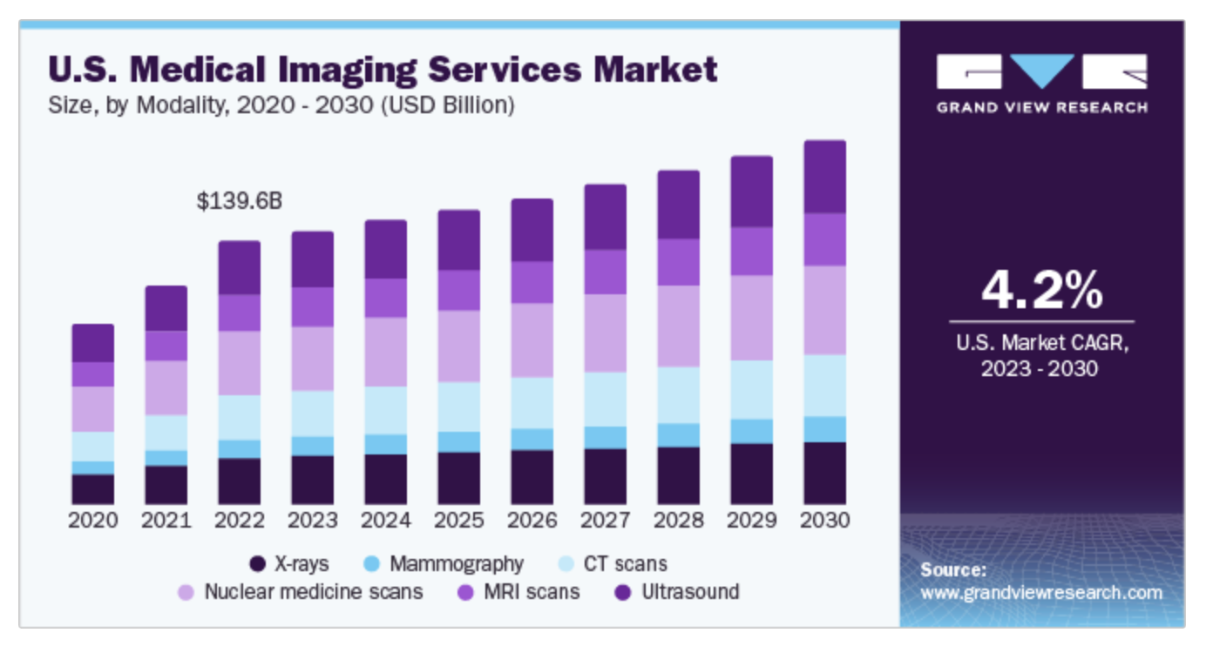

Slide 10
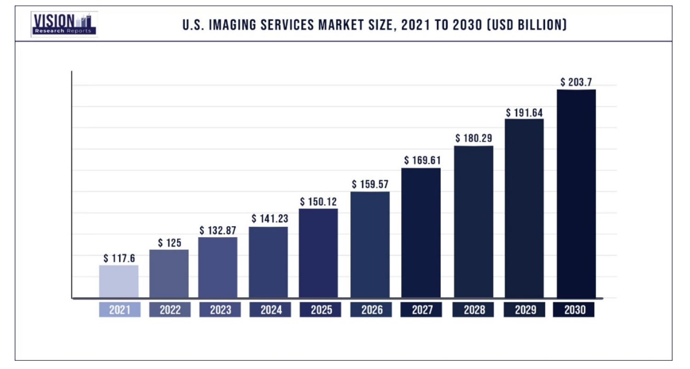
Notes:
6.29% CAGR

Slide 11
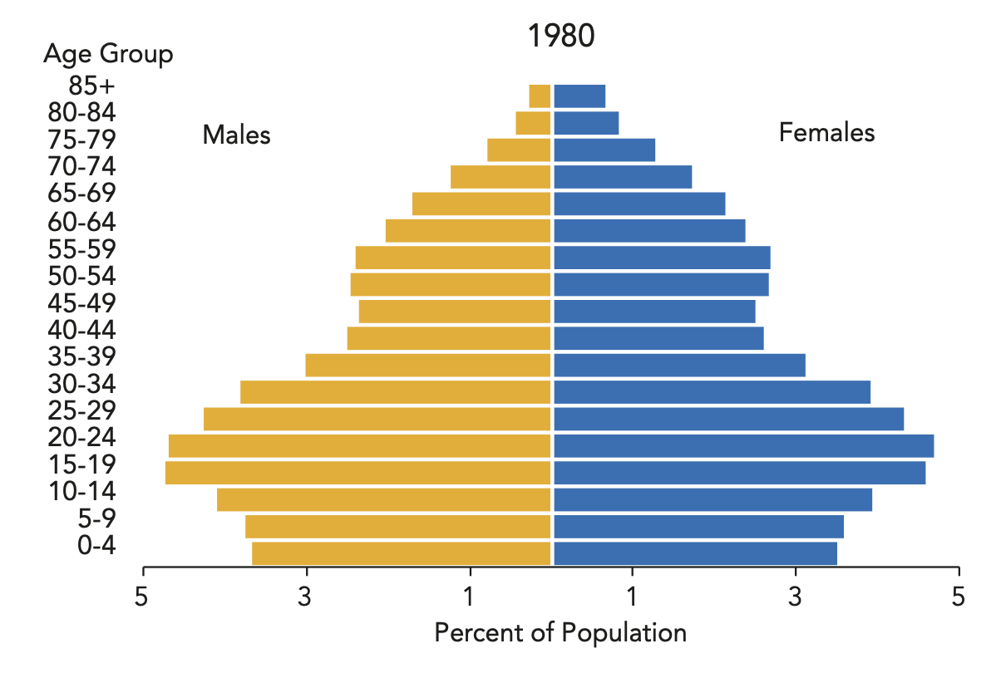

Slide 12
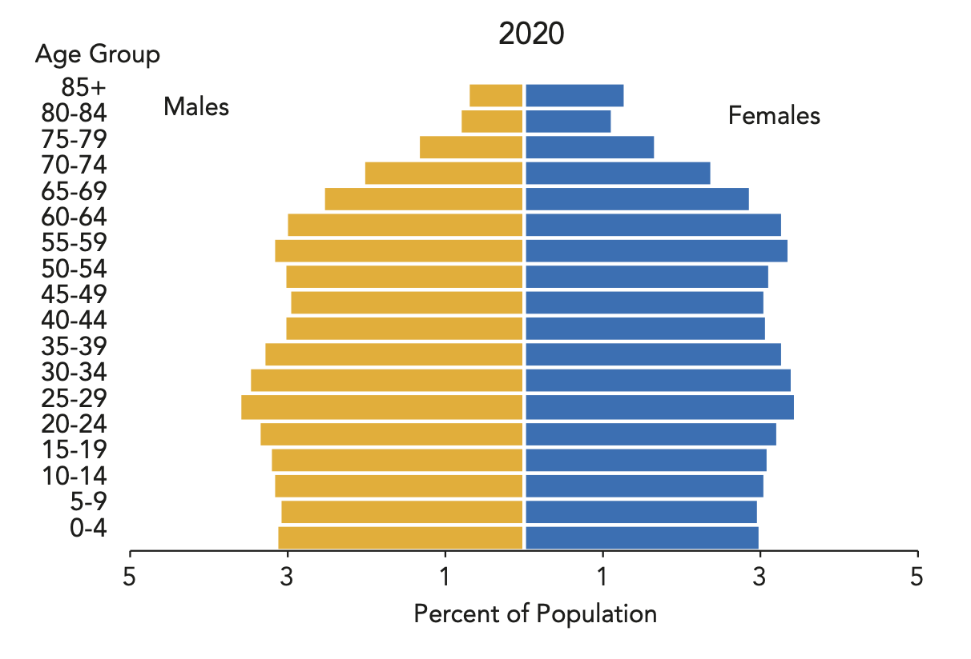

Slide 13
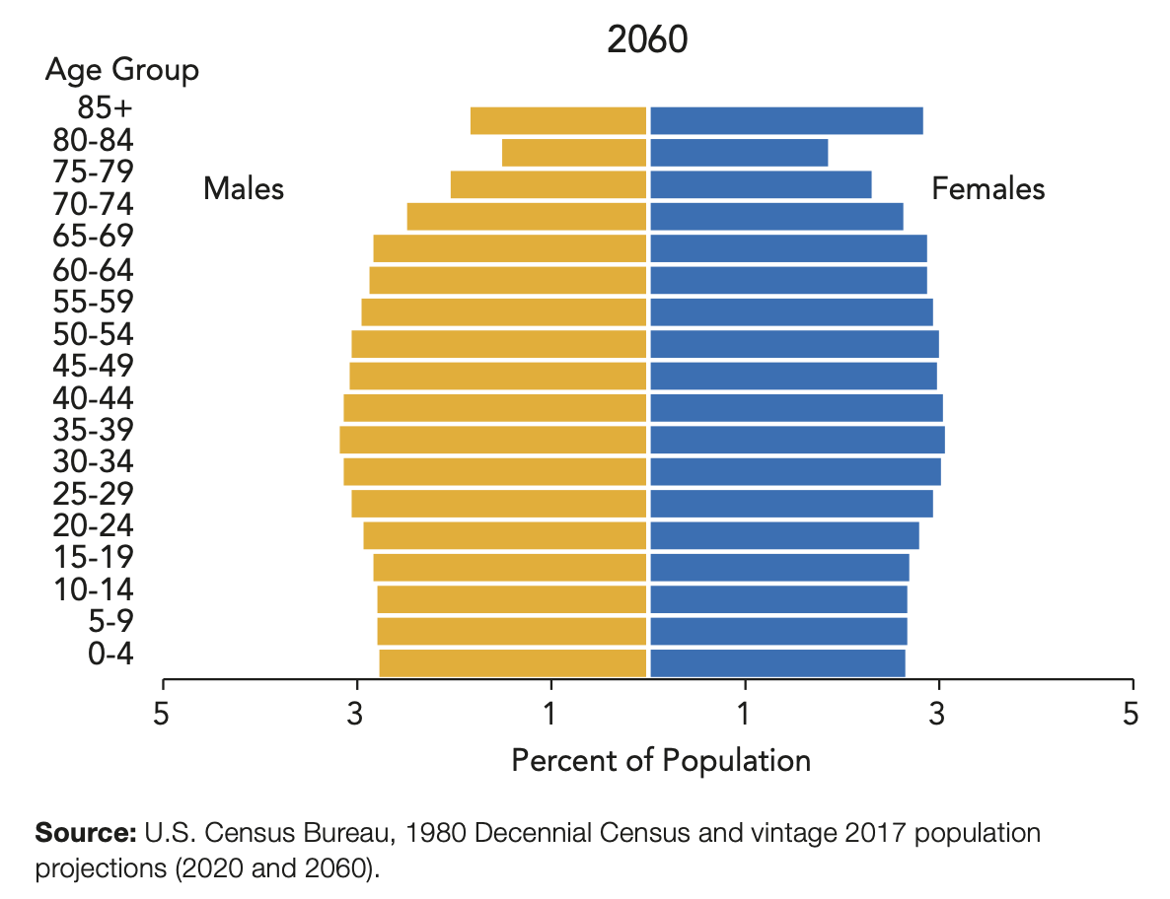

Slide 14
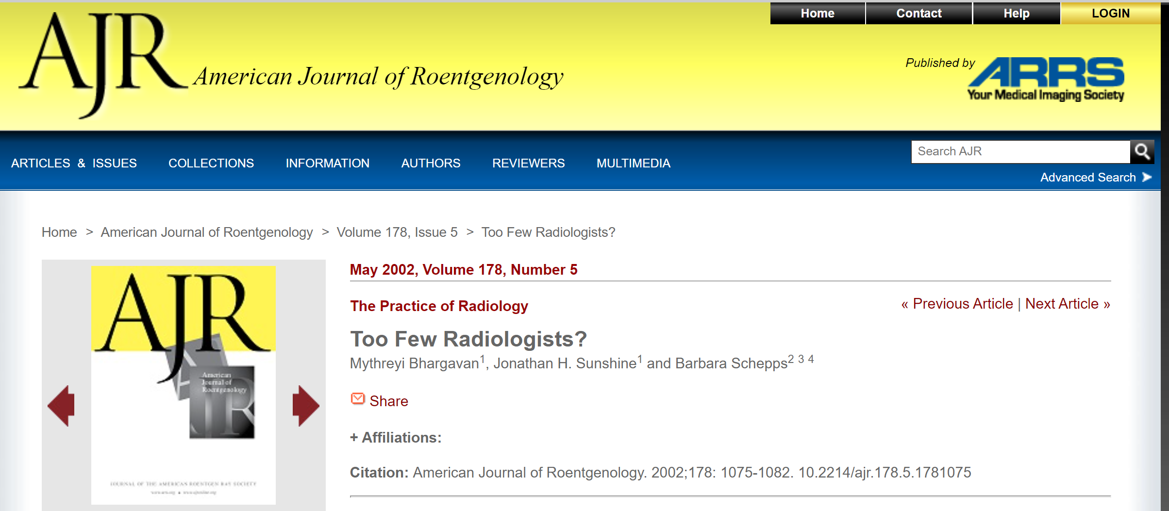

Slide 15

ACR/RBMA Workforce Survey
American College of Radiology®
Topline Insights
Environmental Intelligence

Slide 16
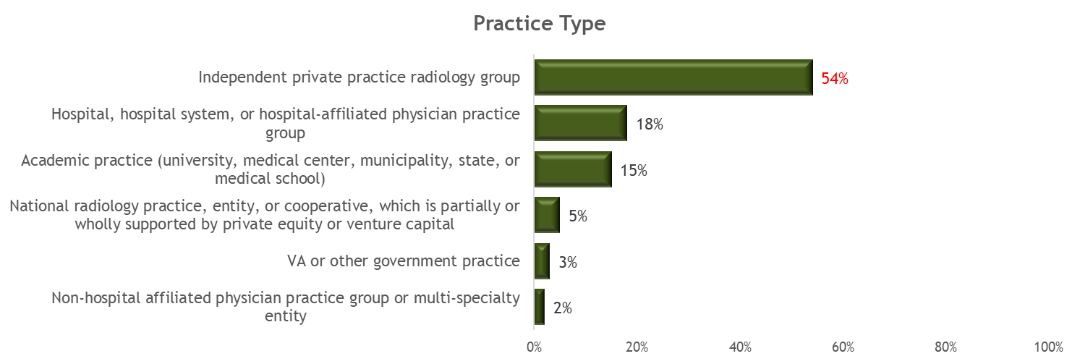
Independent Private Practice Radiology Groups comprise More than Half of Establishments
Practice Type distribution is consistent with other research conducted by the ACR Environmental Intelligence team
Hospital, Hospital System or Hospital-affiliated physician practice groups (18%) and Academic Practices (15%) were the only other practice types representing more than 1 in 10 establishments
Both VA and other Government Practice and Non-hospital affiliated physician practice group or multi-specialty entity represented fewer than 1 in 20 establishments
Nearly 4 in 10 (38%) Independent Private Practices can be found in the South
Academic Practices are found primarily (33%) in the Northeast
A growing body of ACR Environmental Intelligence research indicates that the Independent Private Practice category contains significant variation, likely including National Practices at least partially privately owned, such as Strategic Radiology and Rad Partners.
Future research will work to capture the nuances of this category.
*Measures in Red are significantly higher at a 95% confidence level
Base: Establishments (N=376)
Q: Which of the following best describes your primary place of employment? If you work at multiple sites or organizations, please think about the site or organization at which you spend the most time.

Slide 17
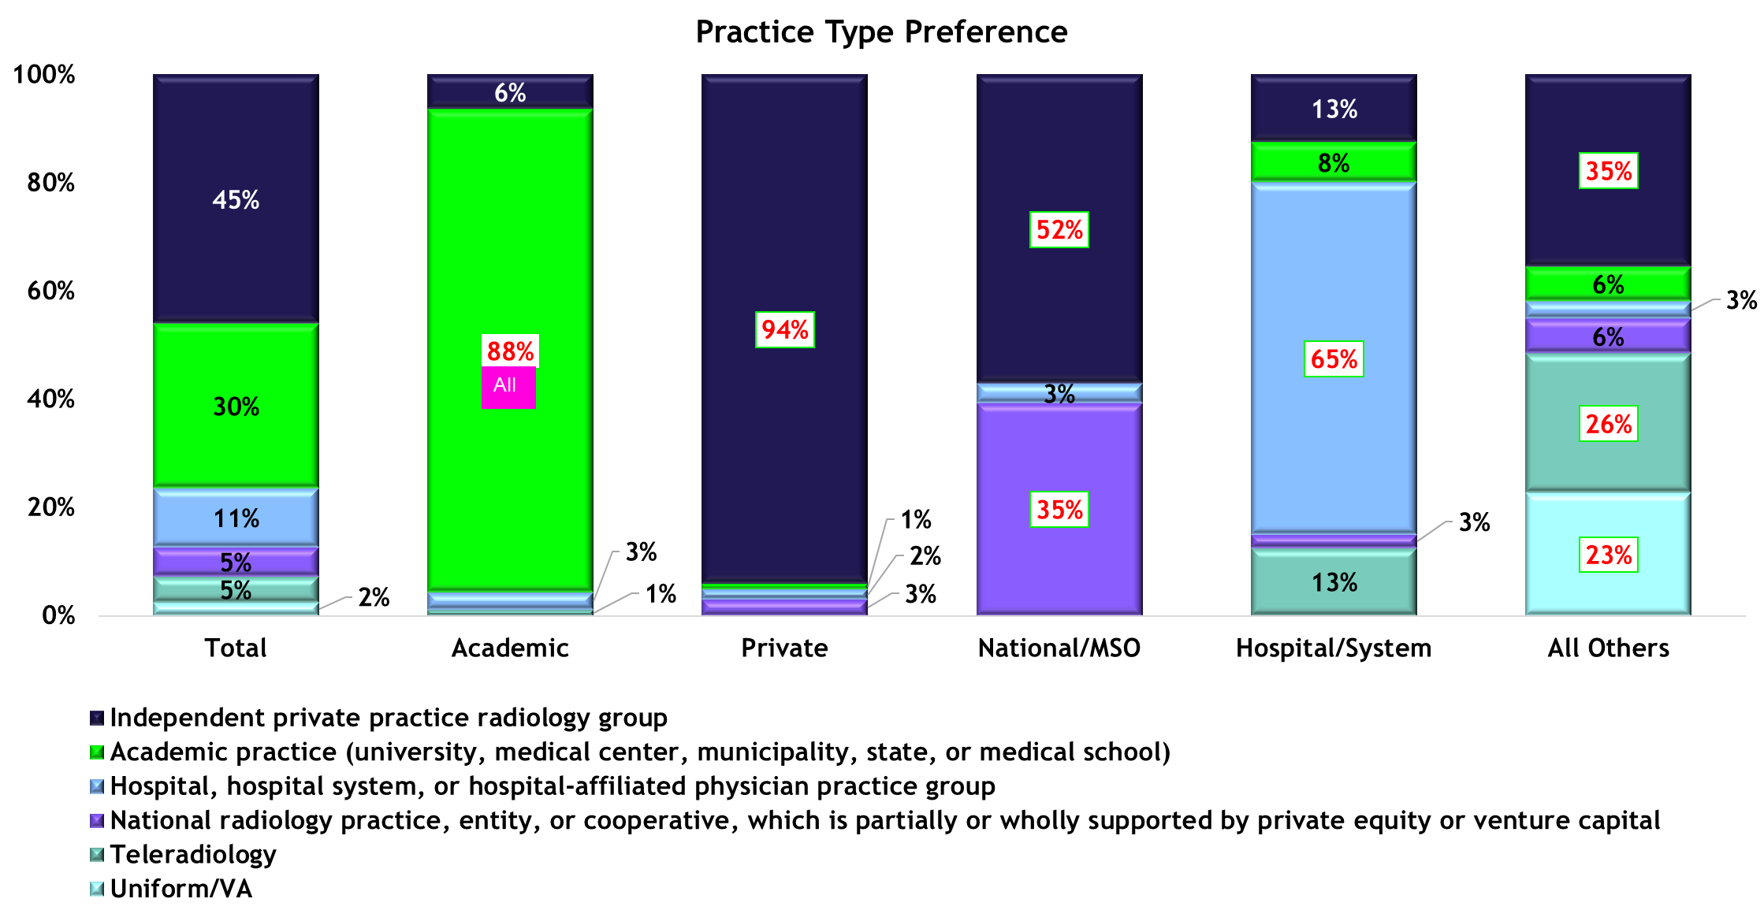
Nearly Half of Radiologists Prefer Independent Private Practice
Academic and Private Practice Radiologists likely to prefer to stay in current practice type
National/MSO Practice Radiologists more likely than not to prefer switch to Private Practice in 5 years
A
A, H
All
All
A, IP
All
A, IP
  Abbreviations for Practice Type Comparisons: A (Academic), IP (Independent Practice), N (National/MSO), H (Hospital), O (Other Practice Types) All (all other Response Options)
Base: Fully and Partially Qualified Respondents who indicated less than 9 years in practice (n=595) Question: Regardless of your employment situation today, ideally in which of the following type of practice/organization would you most like to be working in 5 years?

Slide 18
Hiring needs remain consistent year over year
Breast and Body Imaging remain priority hiring need for nearly half of respondents
General Radiology, Interventional, MSK and Thoracic Imaging dip
Base: Fully Qualified Respondents (n=407) Question: Which 3 of the sub-specialties listed below are your most important hiring needs in ...

Slide 19
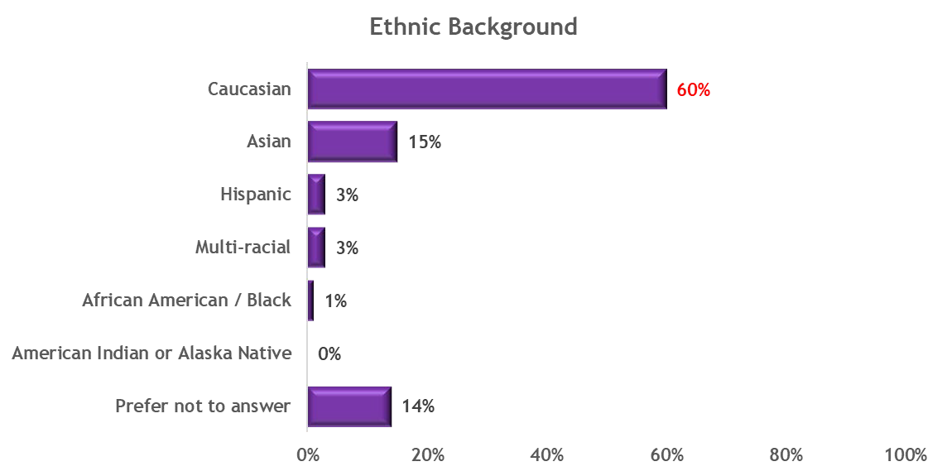
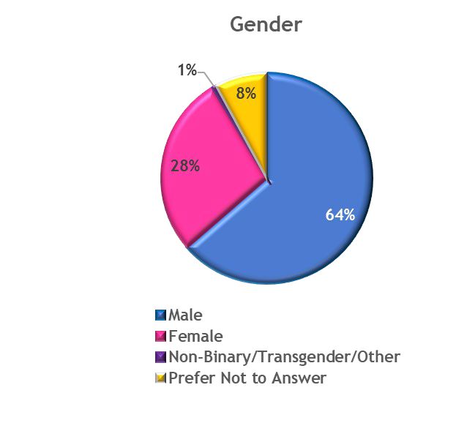
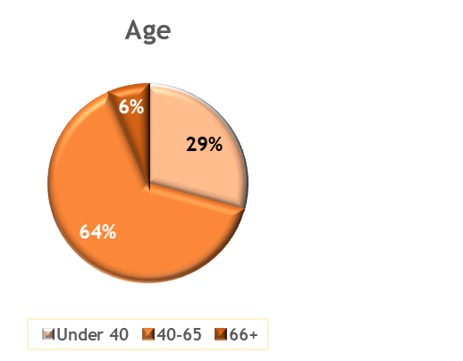
Across the workforce, radiologists likely to be Caucasian men between the ages of 40 and 65
The average age is about 51 years, mirroring that of the average licensed physician in the US (Young et al., 2021) and reflective of prior ACR research among radiologists
Radiologists of retirement age (65+) represent the smallest proportion of practicing radiologists (6%)
Female radiologists represent fewer than 3 in 10 radiologists in practice, regardless of age grouping, and which is a lower rate than the estimated averages for licensed physicians in the US (Young et al., 2021)
Six in ten radiologists (60%) are Caucasian, and most radiologists are men (64%), slightly higher than national physician averages on both counts (AAMC, 2018)

Slide 20
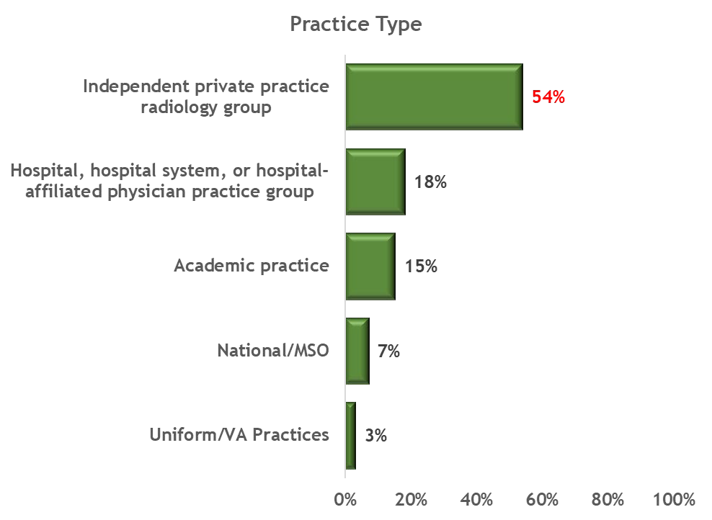
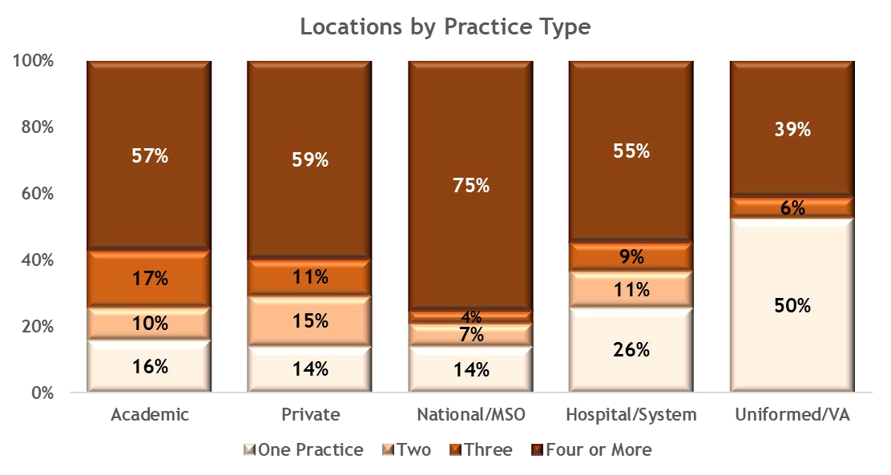
Independent private practice radiology groups comprise more than half of radiology practices

Slide 21
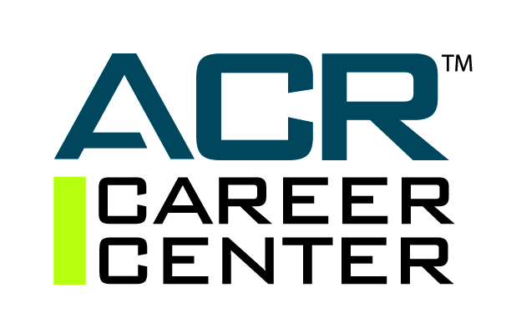

Slide 22
Most Employers Are Seeking Fellowship-Trained New Hires

Slide 23
Fellowship Training Used Once Hired

Slide 24
Top Subspecialties In Recent ACR Career Center Job Postings
75%

Slide 25
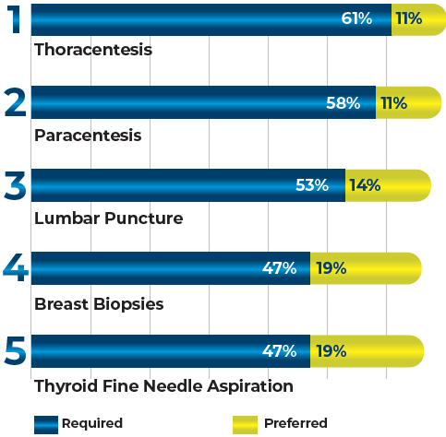
Top Five Procedure Skills that Employers Are Seeking
= 72%
The ACR Career Center survey connected with employers with recent job postings regarding the required and/or preferred procedures that a new hire would need to perform.
= 69%
= 67%
= 66%
= 66%

Slide 26
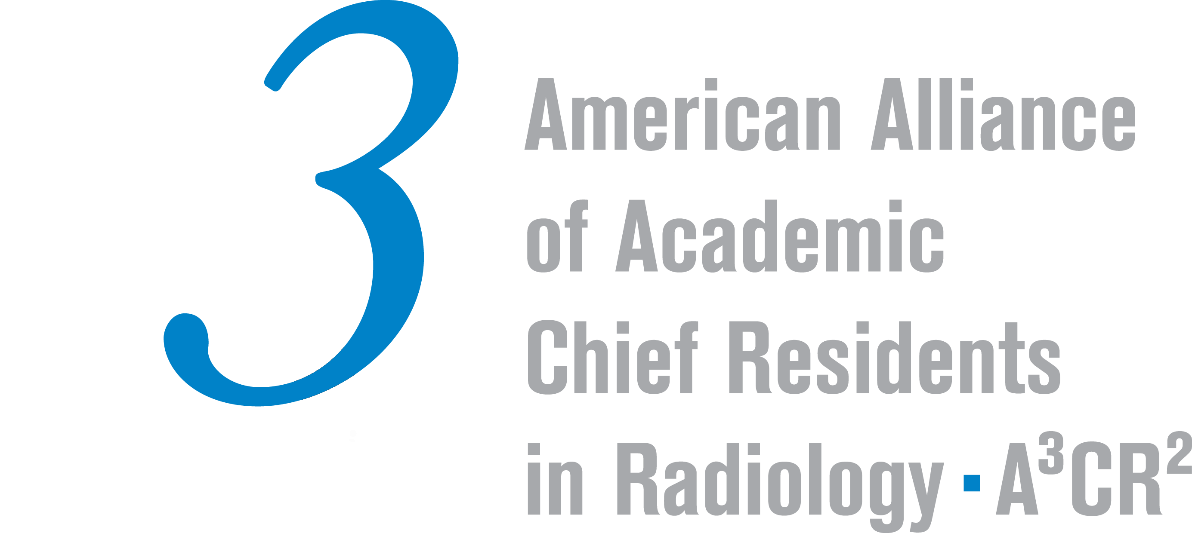
Annual Chief Resident Survey
2022-2023 A³CR²

Slide 27
What is your perception of the current job market for radiologists?
Notes:
The difference in 2023 vs 2021 in proportion of chief residents who rated the job market as “good” is statistically significant.

Slide 28
What type of practice do you prefer to work in?
Notes:
Last year: 35% of chief residents anticipated going into academics

Slide 29
If you prefer to work in academics- what is your top reason?
(free response question)
Reason | # of chiefs (n=46)
Teaching/working with trainees | 34
Research | 12
Lifestyle | 8
Sub specialization | 6
Case complexity | 5
Other reasons (1-2 chiefs each): pubic service loan forgiveness, benefits package, global health work, learning during early career

Slide 30
If you prefer to work in private practice- what is your top reason?
(free response question)
Reason | # of chiefs (n=52)
Money | 31
Vacation | 21
Flexibility/Lifestyle | 13
Business management | 10
Focus on clinical work | 12
General radiology practice | 9
Location | 5
Other reasons (1-2 chiefs each): benefits package, remote work
Notes:
Last year:35% of chief residents anticipated going into academics

Slide 31
What is your perception of corporate radiology/private equity ownership (example: RadPartners) relative to the radiology job market?

Slide 32
Would you consider working for a corporate radiology/private equity-owned practice (example: RadPartners)?
Notes:
Statistically significant increase in the proportion of chief residents who would NOT consider working for private equity-owned practice between 2021 and 2023.

Slide 33
Rank these potential risks to radiology future job market from greatest threat to smallest threat

Slide 34


Slide 36
Notes:
Deloitte Global Gen Z and Millennial Survey 2023

Slide 42
Teleradiology
American College of Radiology®

Slide 43
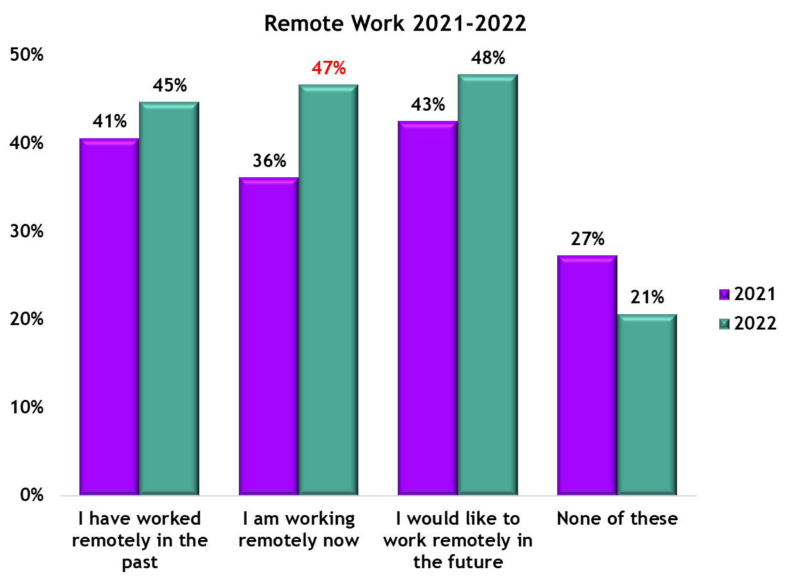
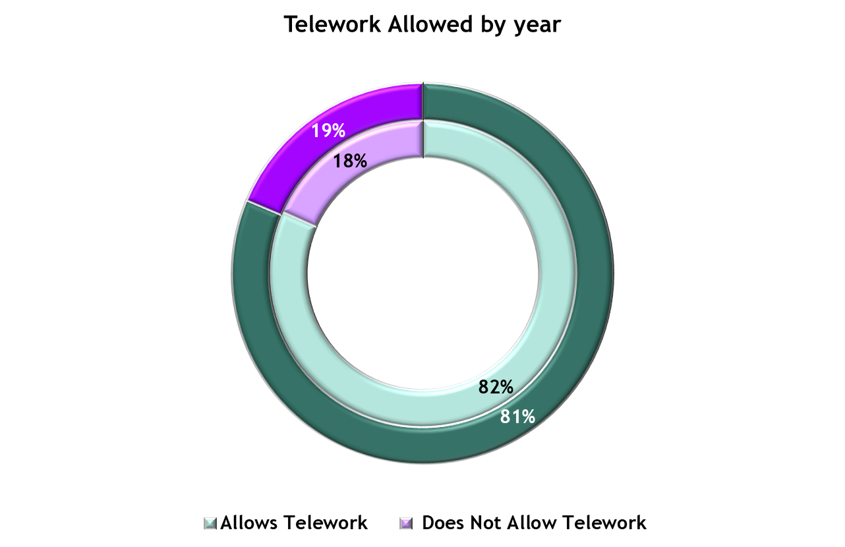
Most Practices Allow Some Form of Telework
While the number of practices indicating that they allow telework decreases slightly, individuals indicating that they are working remotely now show significant growth
2021
2022
2021
  Abbreviations for Remote Work Comparisons: 2021 (2021 ACR/RBMA Workforce Survey), 2022 (2022 ACR/RBMA Workforce Survey)
Base: Fully and Partially Qualified Respondents (2021 n=1394, 2022 n= 1682) Questions: Does your practice allow employees to work remotely (telework)? By telework we mean the intermittent practice of remote reading by radiologists who normally work onsite. With regard to working remotely, which of the following describe what you, yourself, do?

Slide 44
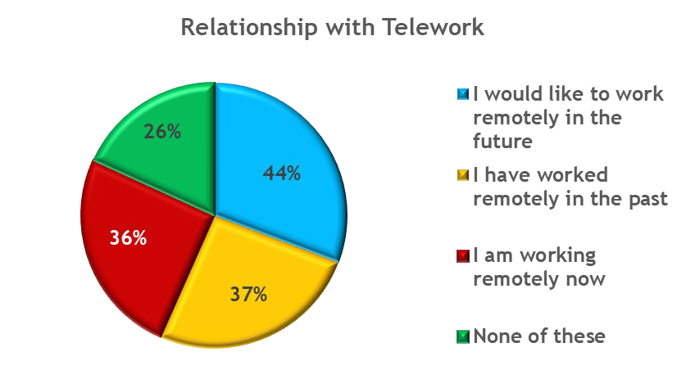
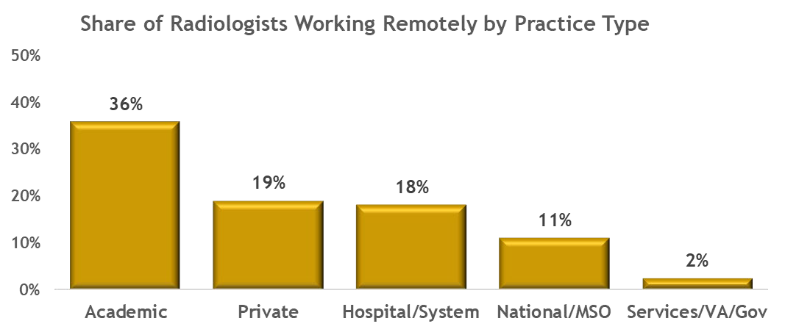
Nearly half of radiologists would like to work remotely
American College of Radiology®
Academic practice, the practice type most likely to see a greater proportion of women in practice, are also more likely to allow telework
Half of radiologists in academic practice hope to work remotely
Fewer than 2 in every 10 radiologists in non-academic settings telework currently

Slide 45
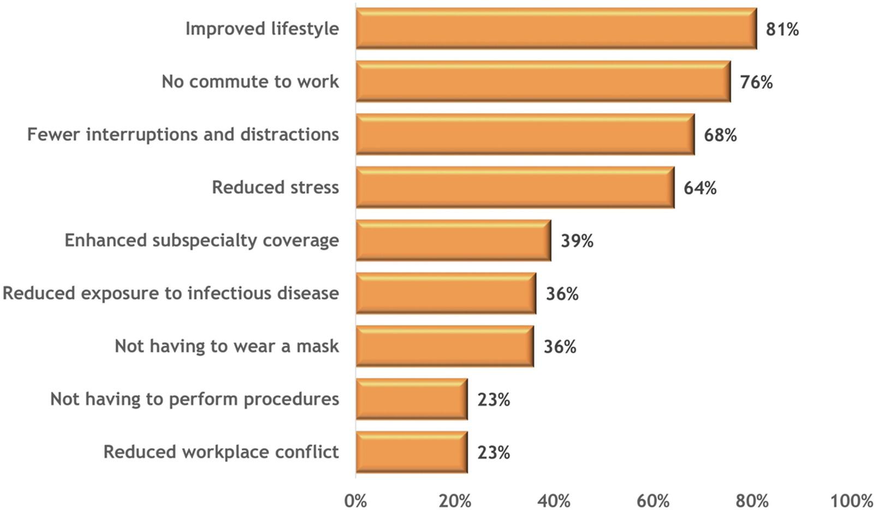
Fig. 1
Perceived Advantages of Remote Reading
The New Normal or a Return to Normal; DOI: 10.1016/j.jacr.2023.04.014
Notes:
Perceived advantages of remote reading.

Slide 46
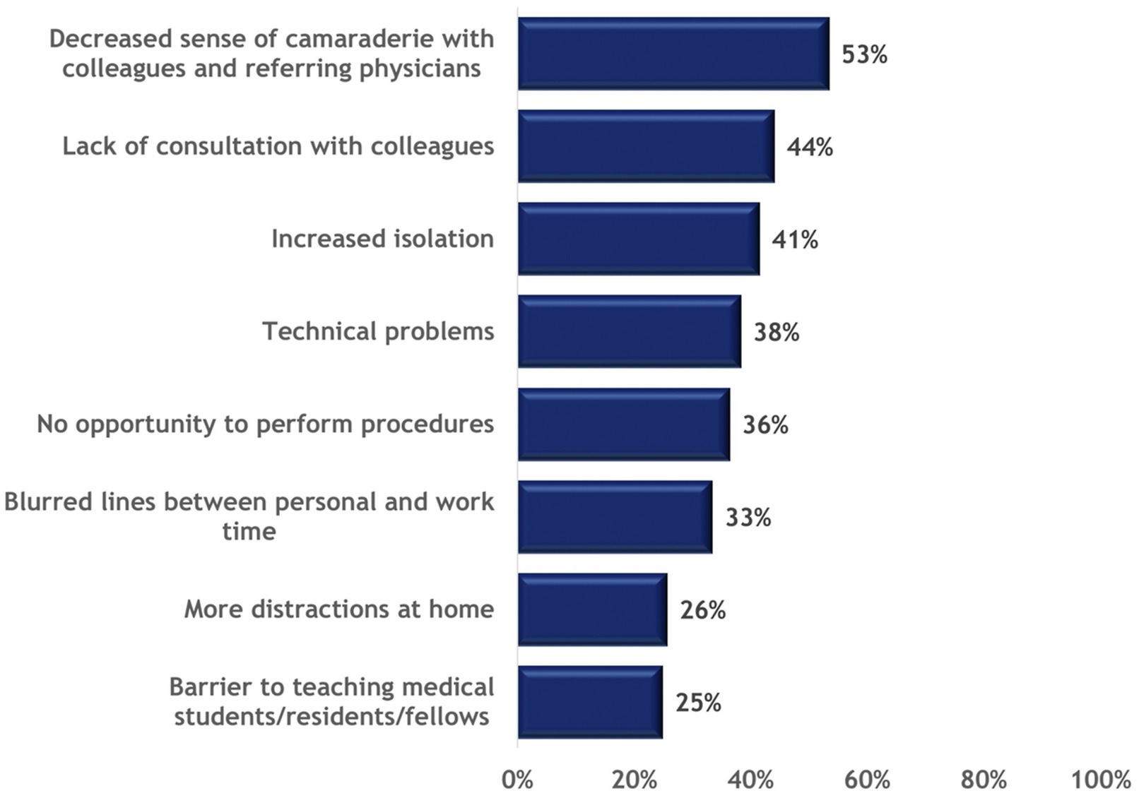
Fig. 2
Perceived Drawbacks of Remote Reading
The New Normal or a Return to Normal; DOI: 10.1016/j.jacr.2023.04.014
Notes:
Perceived drawbacks of remote reading.

Slide 47

RECRUITING BEGINS FOR US RADIOLOGY CONNEXIA: A NEXT GENERATION TELERADIOLOGY ORGANIZATION FOCUSED ON FLEXIBILITY, QUALITY, AND CONNECTIVITY
Lindsay Muns, President of US Radiology Connexia : ”We believe that one of the keys to attracting and retaining talented physicians in this competitive market is providing more options for radiologists who might otherwise consider changing professions, as well as appealing to the next generation of physicians-in-training.”

Slide 48
Potential Workforce Solutions
Leverage the supply/demand market dynamics
Increase number of residency slots
Increase productivity
Increase number and utilization of Non-physician providers
Retain/recruit retired radiologists
Notes:
Leverage: practices are approaching this in 2 ways
1. arbitrage services: eliminating lower tier insurers or hospital contracts
2. subsidies
Retain/recruit- put in a plug for the concept of recruiting senior or retired radiologists. May need different types of compensation packages

Slide 49
Pending Residency Slot Legislation
Resident Physician Shortage Reduction Act
Lower Costs, More Transparencies Act
Specialty Physicians Advancing Rural Care (SPARC) Act (S. 705/ H.R. 2761).
Notes:
RPSRA
Any increase in slots typically requires the hospitals to directly apply through a program administered by CMS and usually certain parameters are required for eligibility, with no guarantee that any would go directly to radiology. For example, this legislation outlines:
Increases the number of residency slots nationally by 2,000 each year between 2025-2031 (total 14,000).
One-third of new residency slots are available to teaching hospitals training over their cap. A hospital may receive a maximum of 75 slots over the distribution period.
In determining which hospitals will receive slots, CMS is required to consider the likelihood of a teaching hospital filling positions and must distribute at least 10% of the slots to each of the following categories of hospitals:
Hospitals in rural or non-contiguous areas;
Hospitals training over their GME cap;
Hospitals in states with new medical schools or new branch campuses; and
Hospitals that serve areas designated as health professional shortage areas (HPSAs), with priority to hospitals affiliated with historically Black medical schools.
Hospitals receiving additional slots must ensure that they agree to increase the total number of resident full-time equivalent positions by the number of such positions awarded by CMS.
Lower Costs, More Transparencies Act: There is a provision increasing funding for the Teaching Health Center Graduate Medical Education Program, which tends to fund residents training in outpatient settings in the community, such as community health centers. Also largely focuses on primary care and psychiatry.
(SPARC) Act (S. 705/ H.R. 2761).
The SPARC Act establishes a new loan repayment program designed specifically for specialty physicians. The program both incentivizes specialists to practice in rural areas and expands access for those lacking access to close and readily available specialists to treat them when needed. The bill authorizes the HHS to provide qualified specialty medicine physicians the opportunity to have a portion of their eligible student loans repaid by the federal government in exchange for practicing in a rural community experiencing a shortage of specialty medicine physicians.
To address physician payment, ACR advocates for passage of the Strengthening Medicare for Patients and Providers Act (H.R. 2474), which would add a permanent Medicare Economic Index-based inflationary update to the annual Medicare Physician Fee Schedule — providing much-needed stability to the Medicare payment system. To resolve physician shortages in radiology, the College highlighted its support of the Resident Physician Shortage Reduction Act (H.R. 2389) that would expand the number of federally supported medical residency positions by 2,000 annually for seven years. Specifically aimed at addressing shortages of physician specialists in rural communities through the creation of a student loan repayment program, ACR also urged committee support for the Specialty Physicians Advancing Rural Care (SPARC) Act (H.R. 2761). ACR also requested to be involved in discussions about site-neutral policies that are developed.

Slide 50

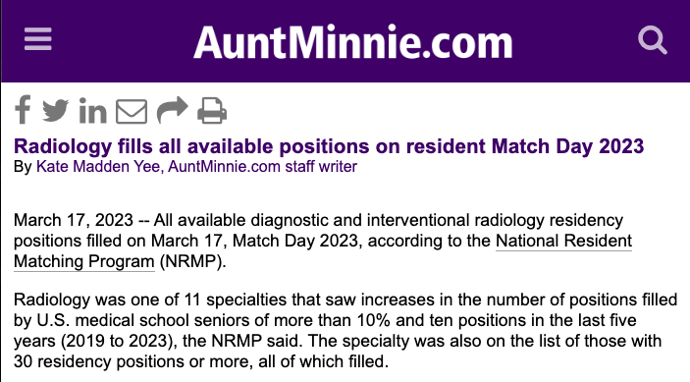
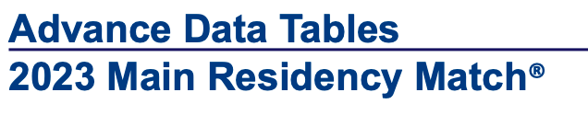
Specialty | # Filled / # Positions
Radiology- diagnostic | 1006/1006
Interventional Radiology (integrated) | 123/125
Orthopaedic surgery | 899/899
Plastic surgery (integrated) | 207/207
Dermatology | 29/29
Neurosurgery | 240/243

Slide 51
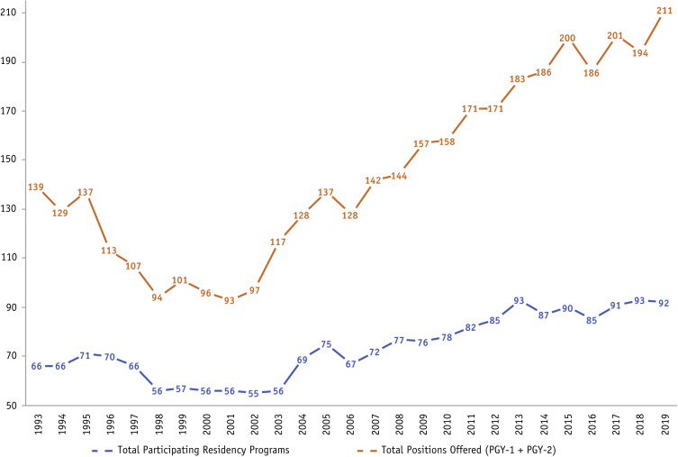
National Residency Match Program
Rad Onc slots
Rad Onc Programs
Kahn, et al, IJROBP 2020;106(1)
Notes:
We project that between 2010 and 2020, demand for radiation therapy will increase 10 times faster than supply of radiation oncologists. In contrast, based on current trainee levels, we project only a 2% increase in the number of FTE practicing radiation oncologists between 2010 and 2020. The number of trainees in the residency classes of 2014 through 2019 would have to double, from 140 per year historically to 280 per year, for the growth in supply of radiation oncologists to meet anticipated growth in demand.

Slide 52
R.O. Expansion: National Residency Match Program

Slide 53
Budget Neutrality and Medicare Physician Fee Schedule Reimbursement Trends for Radiologists, 2005 to 2021
RVUs per beneficiary performed by radiologists increased 13.1% from
2005 to 2021
https://doi.org/10.1016/j.jacr.2023.07.009
Notes:
Improve productivity:
Authors isolated rvu per beneficiary parameter because that was measureable. What was not included was increase in the number of beneficiaries and number of images per study.
? AI

Slide 54
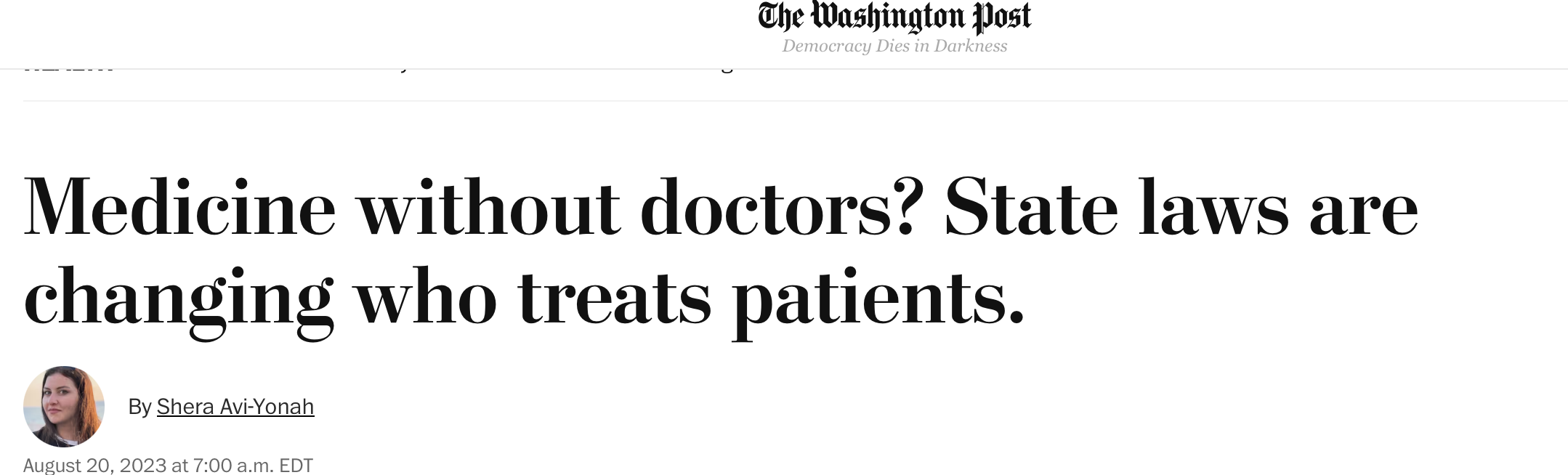
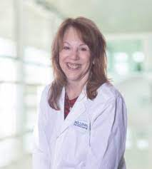
There are more than 350,000 nurse practitioners in the United States.
Organizations have long pushed for N.P. independence.
More than half of states no longer require a physician to sign off on the work of a nurse practitioner.
  1994: 5
  2000: 10
  2005: 11
  2023: 27 and D.C.
Institute of Medicine (2010): “Nurses should be full partners, with physicians and other health care professionals, in redesigning health care in the United States.”
Notes:
Adrienne Wright
Nurse practitioner who is also a doctorate of nursing
I’m in my medicare years and increasing my personal utilization. Most of my office visits have been with or involve physician extenders

Slide 55
Survey: 2023 Review of Physician and Advanced Practitioner Recruiting Incentives
Radiology is the third most sought-after specialty among healthcare employers
Radiologists represented the No. 2 most requested search among AMCs, behind only anesthesiologists.
The average starting radiologist salary of $472,000—which includes base salary and guaranteed income only, and not bonus or benefits—represents a more than 27% increase from AMN’s 2017/2018 report. A regional breakdown of the data shows radiologists earned the highest average starting salary in the Midwest ($495,600) and lowest in the Southeast ($438,622).
“The rapid expansion of the NP workforce, which now includes 355,000 professionals, has been critical to ameliorating the physician shortage.”
Notes:
based on a representative sample of the 2,676 search engagements the company conducted from April 1, 2022 to March 31, 2023.

Slide 56
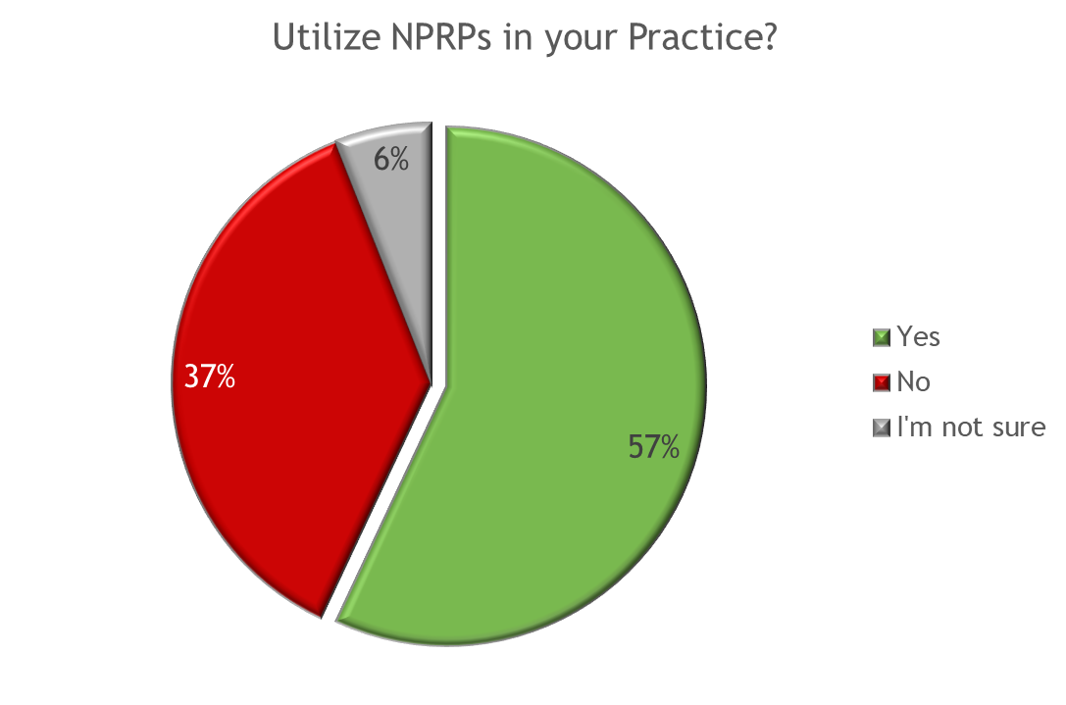
Over half (57%) utilize NPRPs in their Practice
10
Those who are significantly¹ more likely than the total sample to utilize NPRPs include:
  IRs (73%)
  Academic practice (68%)
  National practice (64%)
  Northeast region ( 63%)
  Those who are not very concerned about the future scope of RAs (71%)
  Those extremely/very familiar with MARCA (65%)
  Those who support or are neutral about MARCA (84% and 69%, respectively)
Those who are less likely than the total to utilize NPRPs include:
  DRs (55%), Those who are Late career (54%), those in a hospital setting (51%), those in Uniform (18%), and women (54%)
ACR- Human Resources Commission: Workforce Survey 2021
Notes:
Lots of concern about nprp’s in radiology. Continuing comments on Engage and in social media. Reality is that majority of practices utilize nprp’s. Some larger practices have dozens of nprp’s. I agree that organized radiology should continue to lobby for care by radiologists and radiologist led teams but be aware that as a profession we are being somewhat inconsistent.

Slide 57
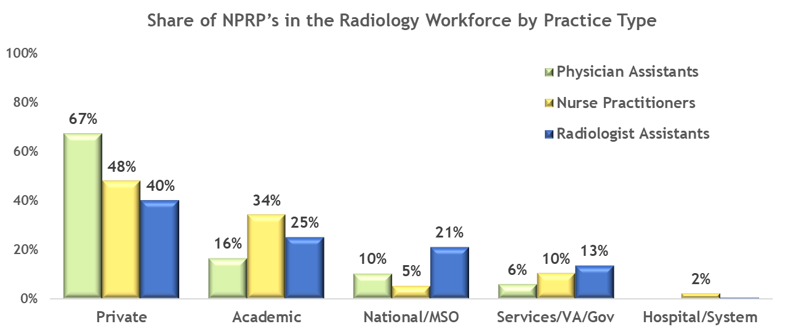
ACR Survey: Non-Physician Radiology Providers
Private practices employ 40% or more of the total share of each NPRP type
Academic practices employ more than one third of all nurse practitioners in radiology practice
Notes:
There’s also been lots of talk about the influence of corporate radiology. Note that the majority of nprp’s in radiology are being hired by private practices. Obviously lots of practical and economic reasons here. But:
It is very doubtful that this trend will reverse. One insight is that during the recent Council controversy, some high profile radiologists maintained “don’t touch my PA’s and NP’s”. When I speak with practice presidents and department chairs, consistently the attitude is I’ll take as many as I can find.
Legislators understand that many of their constituents are now receiving care from extenders. They know the international trends.
Recent literature talked about increasing interpretations by nprp’s although numbers are still very small. Some US centers are still using techs for interpretations although information has been driven underground by the criticism. Understand that in some countries such as UK it is standard of care for techs to interpret plain films. AI is starting to be used for autonomous reading.

Slide 58
Personal Thoughts
Notes:
It could be far worse. Not enough work. Popularity of radiology. In some ways, management problem.
Saying no is not an option: cxr’s and minor procedures may be minor to us but not our patients and administrators. Someone will fill the void if we create one.
Teleradiology- different definition. Has become existential for recruiting for some practices. WFH.
ECR’s: You are in control. This is a seller’s market. Lots of controversy especially about corporatization. The current practicing radiologists, especially early career radiologists, will determine which radiology practice models will be successful.

Slide 59
Thank You
hfleishon@outlook.com| @FleishonMD

Slide 60
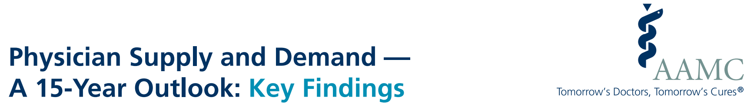
Demographics — specifically, population growth and aging, continue to be the primary driver of increasing demand from 2019 to 2034.
A large portion of the physician workforce is nearing traditional retirement age, and supply projections are sensitive to workforce decisions of older physicians.
If marginalized minority populations, people living in rural communities, and people without health insurance had the same health care use patterns as populations with fewer barriers to access, up to an additional 180,400 physicians would be needed now.

Slide 61
ACR Update:
Impact Table: 2023
Description | Allowed Charges 2022 (Using Actual CF=34.6062 with the Congressional Update) | Allowed Charges 2023 F.R. (with original CF of 33.0607) | Estimated % Impact (with original 2023 F.R. CF) | Allowed Charges 2023 F.R. (with CF of 33.8872) | Estimated % Impact (with updated 2023F CF of 33.8872)
Total | $91,731,379,002 | $89,149,861,924 | -2.8% | $91,378,561,283 | -0.4%
Diagnostic Radiology | $4,718,778,193 | $4,515,747,827 | -4.3% | $4,628,639,132 | -1.9%
Nuclear Medicine | $51,963,834 | $49,621,348 | -4.5% | $50,861,855 | -2.1%
Radiation Oncology | $1,593,441,799 | $1,536,423,682 | -3.6% | $1,574,833,461 | -1.2%
Interventional Radiology | $488,594,483 | $459,692,763 | -5.9% | $471,184,838 | -3.6%

Slide 62
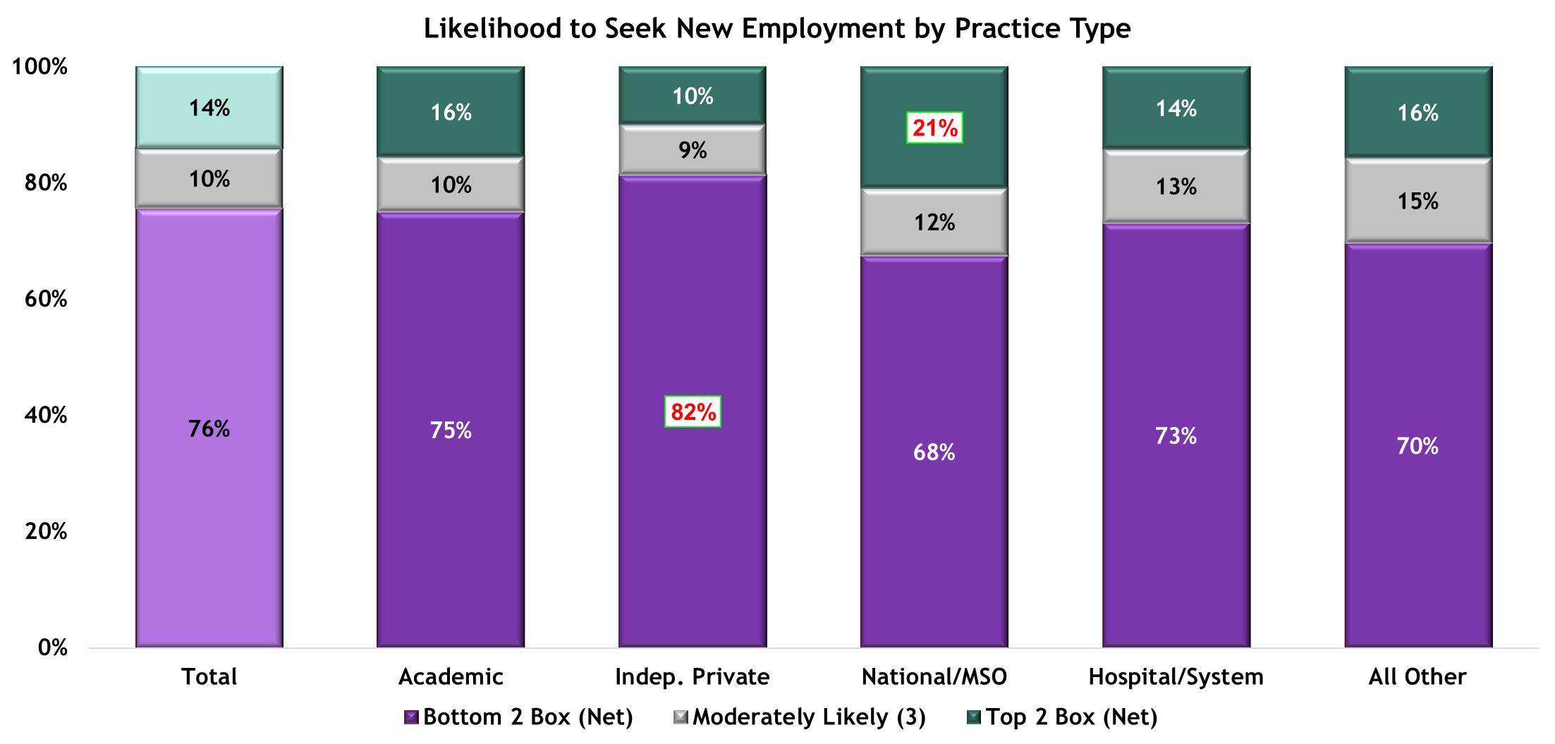
Fewer than two in ten radiologists likely to seek new employment
Likelihood to seek new employment remains low in most practice types
Radiologists in National Practice are significantly more likely to seek new employment with a new practice/organization than those in independent private practice
Netting responses in the Top 2 (Extremely Likely and Very Likely) and Bottom 2 (Not Very Likely and Not At All Likely) boxes, provides insights into the extreme positive and negative sentiment towards the subject, enabling comprehensive understanding of overall perception
IP
N
  Abbreviations for Practice Type Comparisons: A (Academic), IP (Independent Practice), N (National/MSO), H (Hospital), O (Other Practice Types) All (all other Response Options)
Base: Fully and Partially Qualified Respondents (n=1831) Question: Between now and the end of 2023, how likely is it that you will seek out employment in a different practice/organization?

Slide 63
Trends in Diagnostic Imaging by Nonphysician Practitioners https://doi.org/10.1067/j.cpradiol.2023.06.001.
Take Home Points
In this retrospective study of more than 110 million imaging claims, NPPs interpreted 2.6% and 3.3% of imaging studies in 2016 and 2020, respectively—a 26.9% increase.
In comparison to metropolitan residents, micropolitan, and small town/rural residents saw 50% and 30% higher odds, respectively, of NPP-interpreted imaging.
In recent years, states with moderately restrictive or the least restrictive NPP practice authority saw the most significant increases in NPP-interpreted imaging.

Slide 64
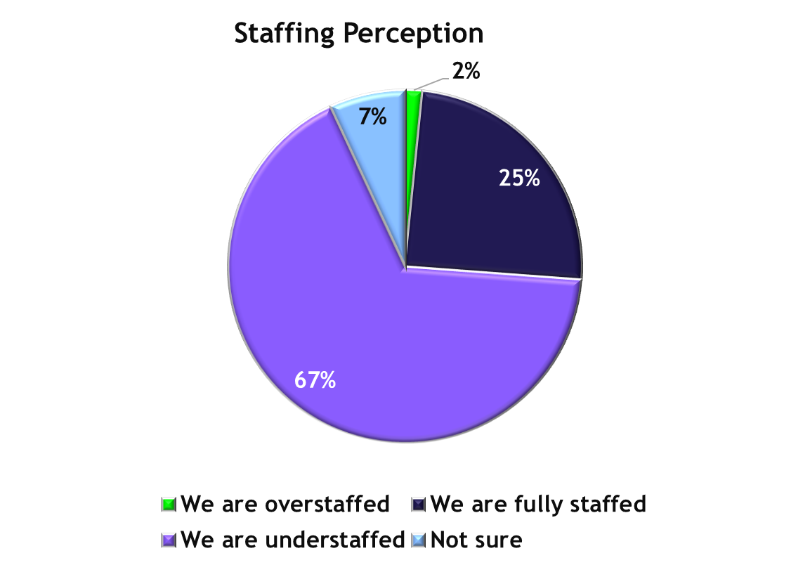
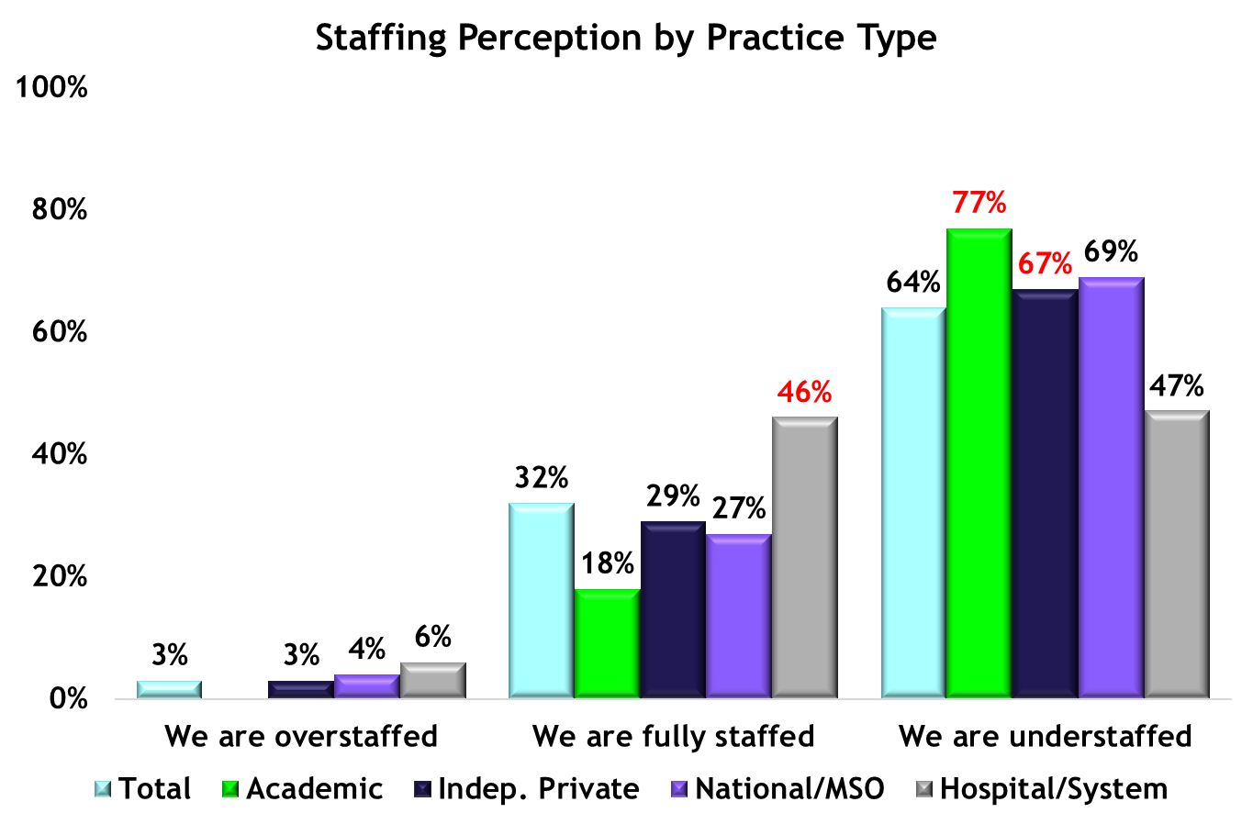
Most Radiologists see their practice as understaffed
Radiologists in the larger practice types (National and Academic Practice) are more likely to indicate that their practices are understaffed than those in private practice
Hospital-base radiologists are significantly more likely than Academic or Private practices to indicate that they are fully staffed
H,O
H,O
A,P
  Abbreviations for Practice Type Comparisons: A (Academic), IP (Independent Practice), N (National/MSO), H (Hospital), O (Other Practice Types) All (all other Response Options)
Base: Fully and Partially Qualified Respondents (n=1790) Fully Qualified Respondents (n=524) Question: As you head into 2023, which of the following best describes the level of staffing of in your practice for radiologists and non-radiologist professionals?

Slide 65
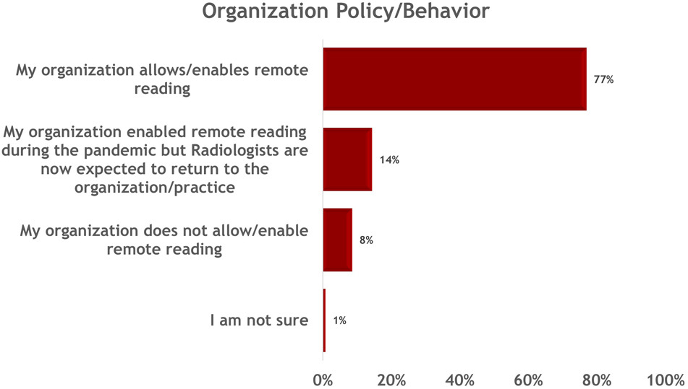
Supplementary Figure 1
The New Normal or a Return to Normal; DOI: 10.1016/j.jacr.2023.04.014
Notes:
Distribution of responses regarding the policy/behavior towards remote reading by respondents’ organization

Slide 66
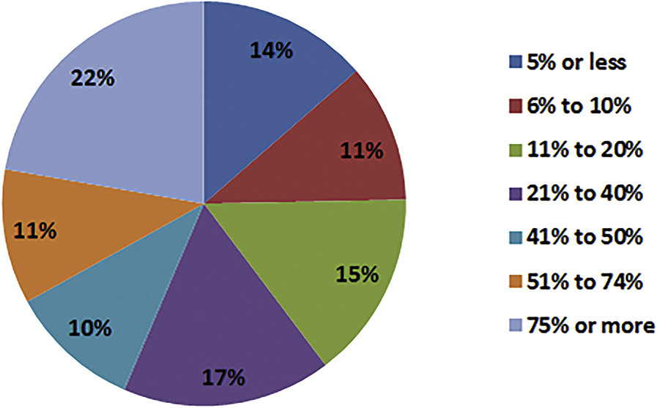
Online Appendix Figure 1
The Current State of Teleradiology Across the United States: A National Survey of Radiologists’ Habits, Attitudes, and Perceptions on Teleradiology Practice DOI: 10.1016/j.jacr.2019.05.053

Slide 67
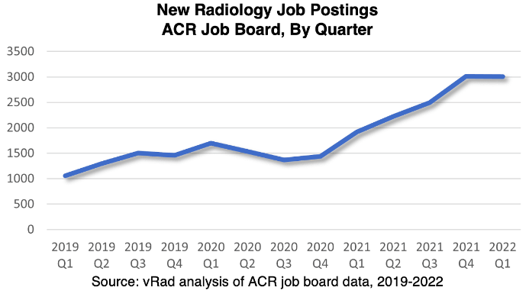

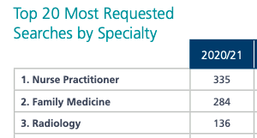
Notes:
X

Slide 68
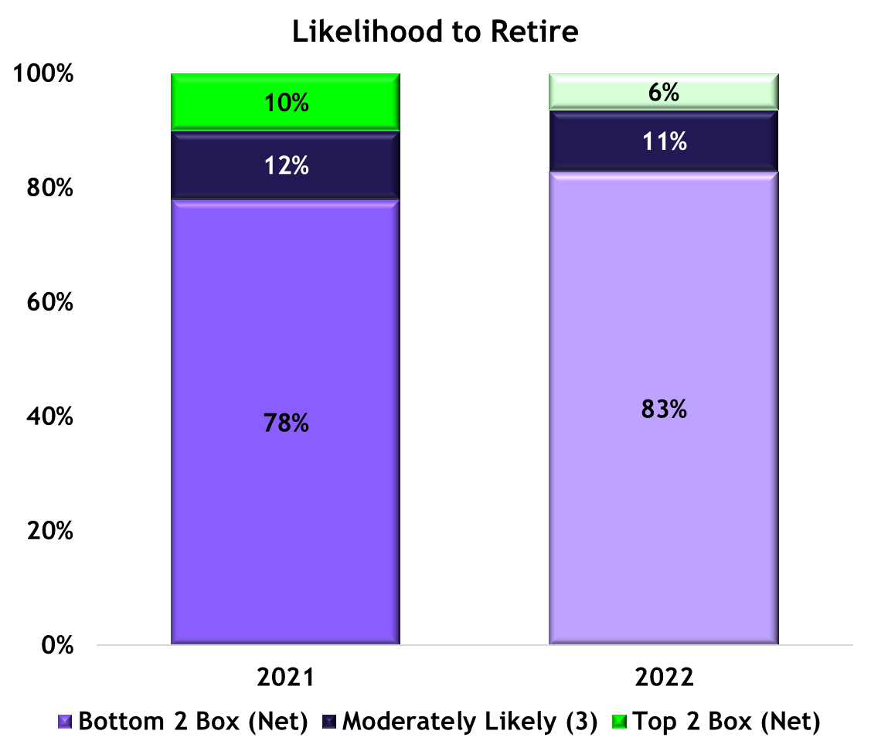
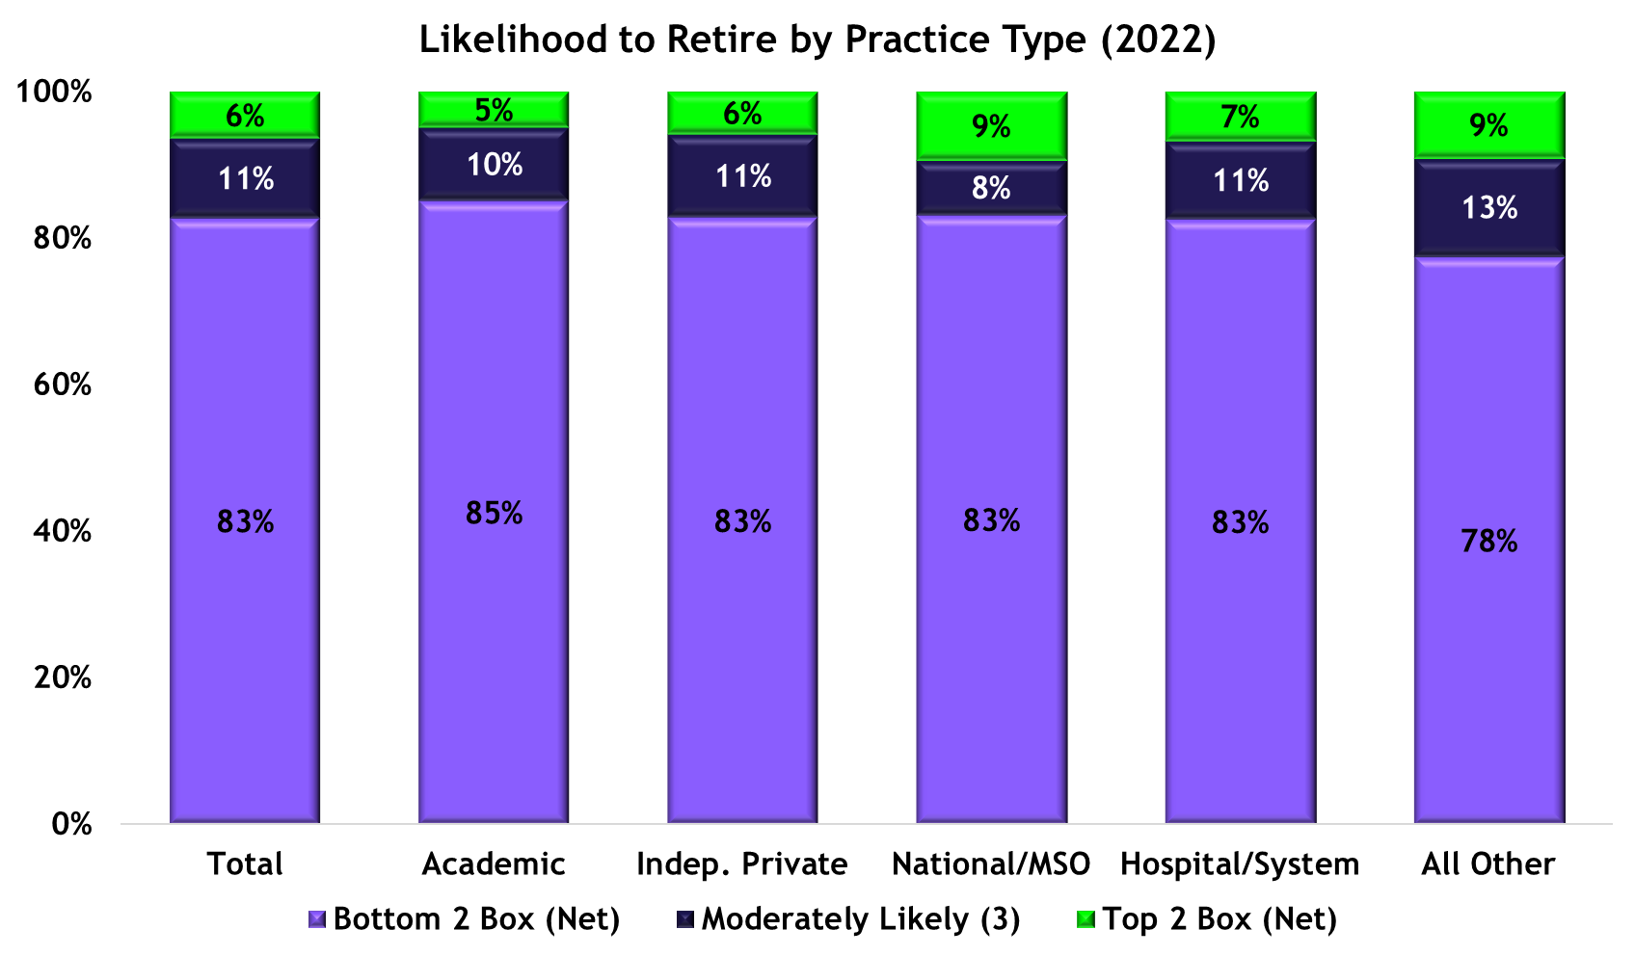
Likelihood to retire comparable to previous years
Across practice types, among radiologists in practice more than 9 years, likelihood to retire remains low
Base: Fully and Partially Qualified Respondents who indicated 9 years or more in practice (n=2368) Question: Between now and the end of 2023, how likely is it that you will retire?

Slide 69
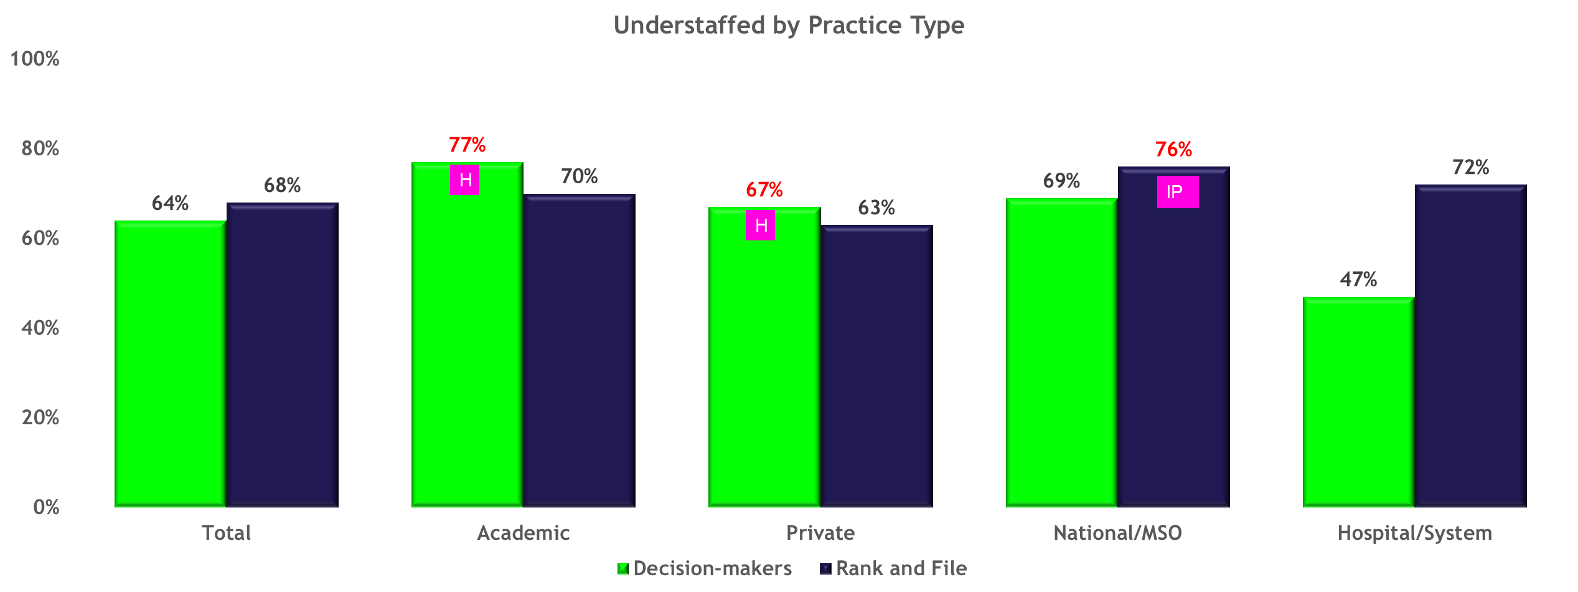
Staffing perceptions differ among practice types and roles
Decision-makers in Academic and Private practice are more likely than rank and file radiologists to perceive their practices as understaffed when compared to Rank and File radiologists in the same practice types
The Opposite is true for National and Hospital-based practices
Staffing perceptions in Hospital-based practices vary widely by role
Rank and File radiologists in National Practices are significantly more likely than those in Private practices to indicate that they understaffed
  Abbreviations for Practice Type Comparisons: A (Academic), IP (Independent Practice), N (National/MSO), H (Hospital), O (Other Practice Types) All (all other Response Options)
Base: Fully and Partially Qualified Respondents (n=1790) Fully Qualified Respondents (n=524) Question: As you head into 2023, which of the following best describes the level of staffing of in your practice for radiologists and non-radiologist professionals?

Slide 70
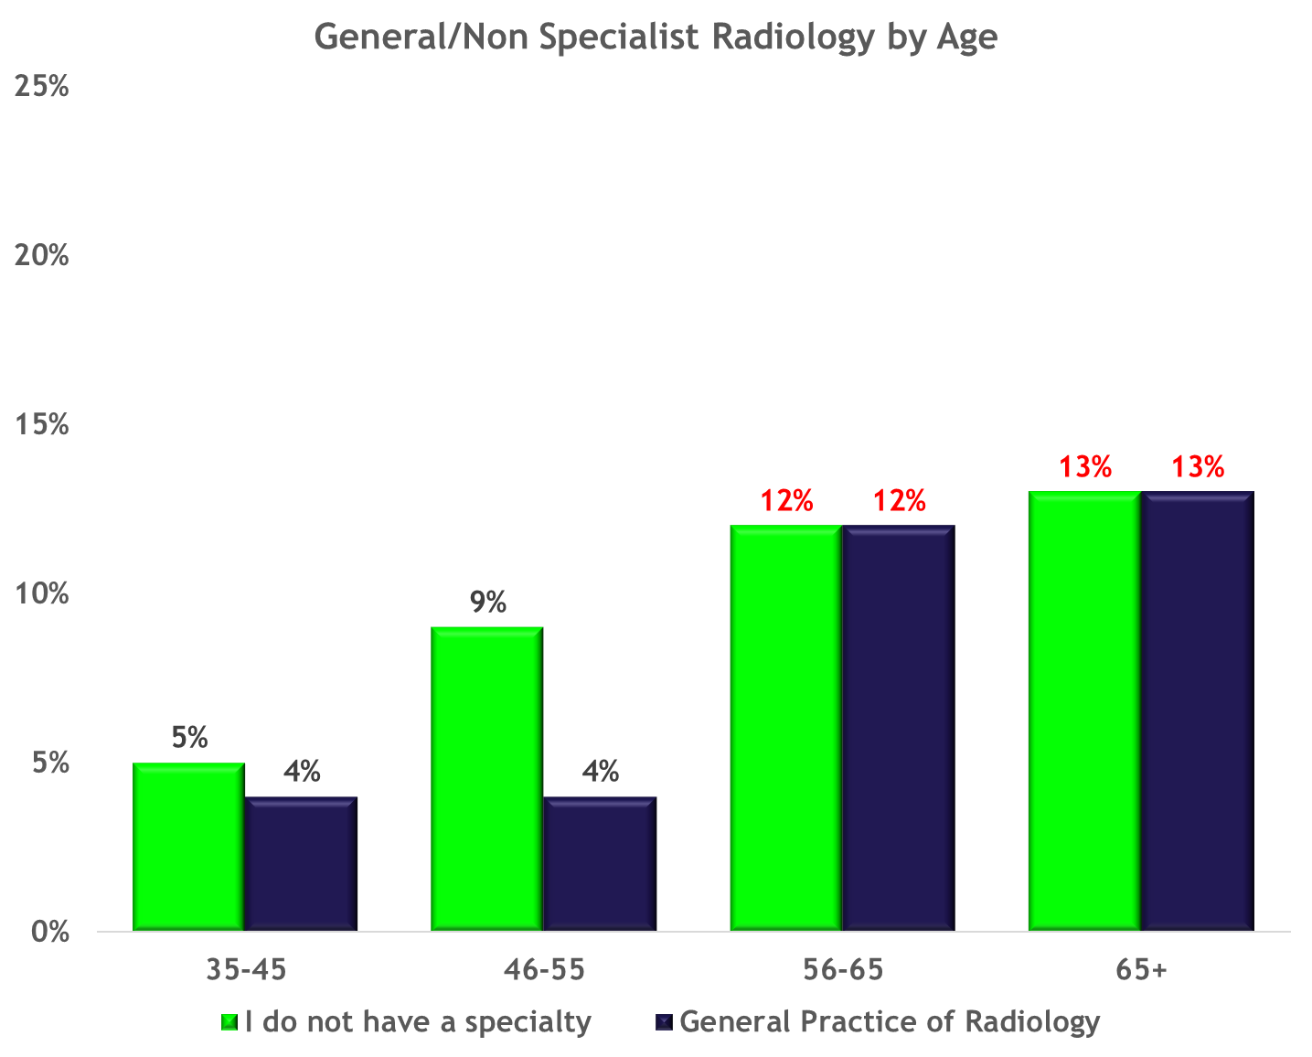
General and Non-specialized Radiologists are aging
Radiologists who are 56+ are significantly more likely than their younger colleagues to identify as specializing in the General Practice of Radiology or to indicate that they do not have a subspecialty
Fewer than 1 in 10 rank in file radiologists 55 or under identify as General or Non-specialized
The only other subspecialty showing significant aging was Radiation Oncology which saw an identical pattern (56+ significantly more likely to identify as Rad Onc than 55 or under)
35,45
&
46-55
35,45
&
46-55
35,45
&
46-55
35,45
&
46-55
BASE: Rank and File Respondents n=1284 Question: Which of the following describe subspecialties for which you are fellowship trained?

Slide 71
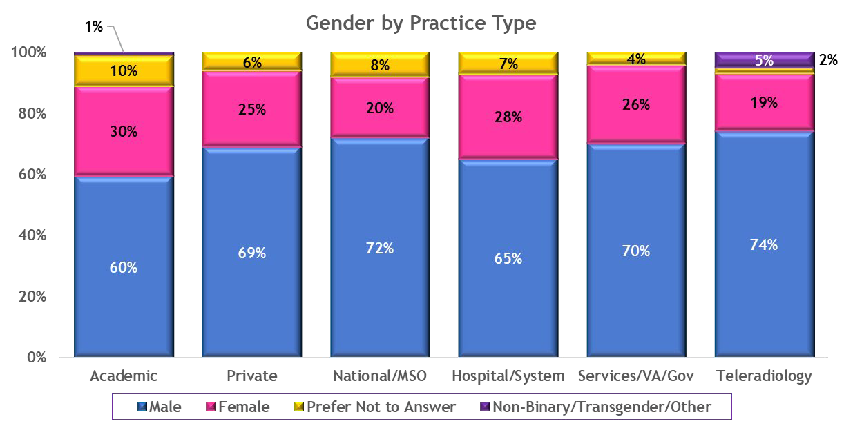
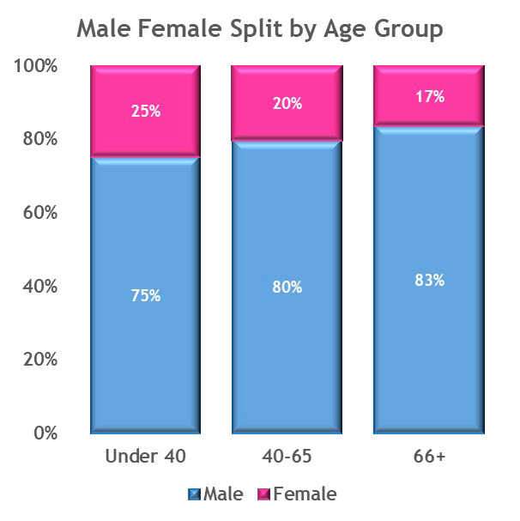
Female radiologists are in the minority within every practice type
Younger female radiologists are more numerous than radiologists of retirement age, possibly mirroring the growing incidence of female physicians of all types across the medical field (Boyle, 2021)
At the individual practice level, non-Binary, transgendered and other gender types are rare in radiology practice, but they do appear in academic and teleradiology settings (1% and 5% respectively)
Q1. How many of the ... full-time physician(s) of all kinds in your practice excluding physician leaders fall into the age and gender groups shown below? Base 1: Establishments (n=341) Base 2 Q2. What best describes your gender identity? Base: Rank and File Respondents (n=1022)

Slide 72

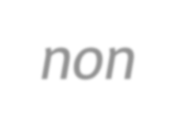


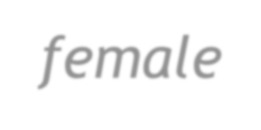
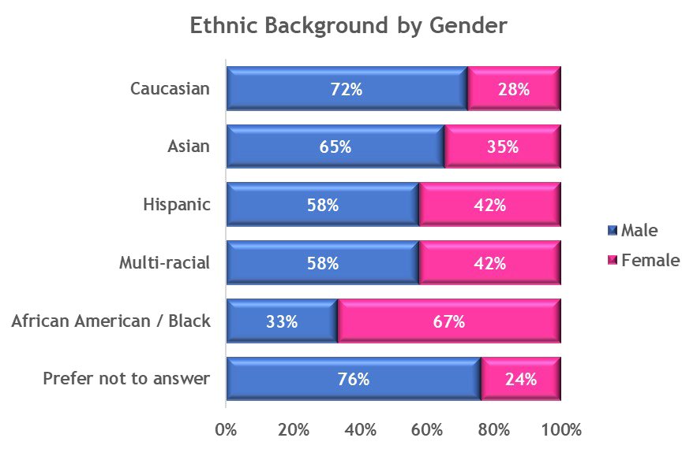
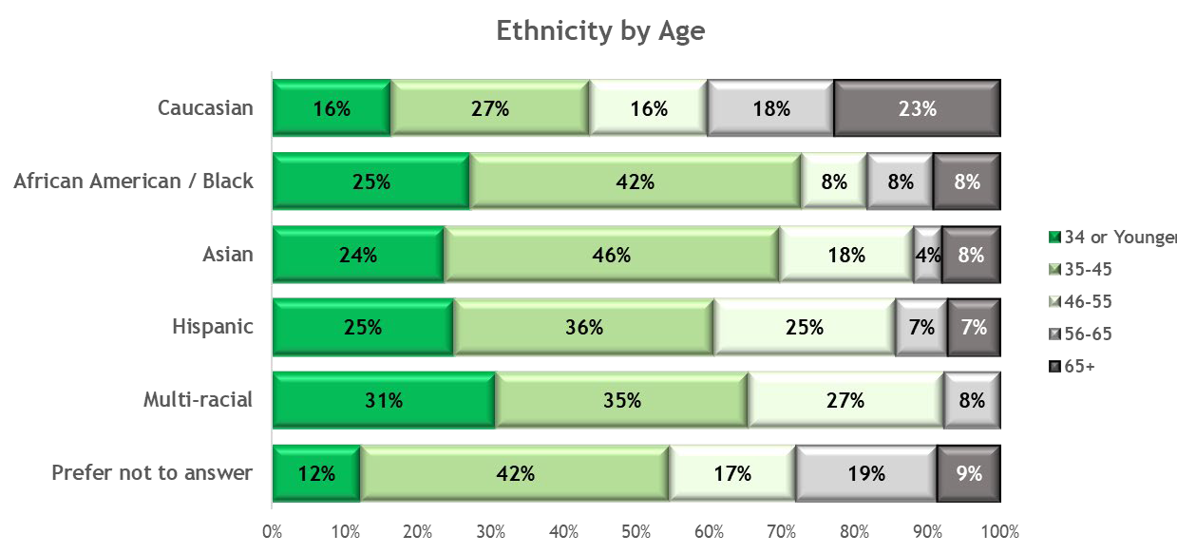
Caucasian radiologists are evenly distributed across age groups
American College of Radiology®
More than 2 in 10 Caucasian radiologists is aged 65 or older (23%)
More than half of non-Caucasian radiologists are under the age of 46
Fewer than 2 in 10 non-Caucasian radiologists are over 56 years old
All ethnic groups skew male except African American/Black, which skews female (57%)
Q: What do you consider to be your ethnic background? Base: Rank and File Respondents (N=1022)

Slide 73







More than one third of non-owners think of ownership as an important goal
Women are significantly less likely than men to identify as partner/owners of their practices and are more likely to consider ownership as extremely or very unimportant compared to men
Most physician leaders are men between the ages of 40 and 65
The proportion of female physician leadership is lower than the proportion of female
radiologists (21% and 28%, respectively)
Feelings about Ownership by Gender
100%
21%
80%
41%
19%
60%
19%
40%
60%
20%
39%
0%
Male Female
Top 2 Box (Extremely…, Very Important) Moderately Important
Bottom 2 Box (Not Very…, Not at All Important)
Q1: Please indicate how many of the ... physicians of all kinds in your practice, excluding physician leaders, and how many of the ... physician leaders in your practice are in the categories below? Base: Decision-Making Respondents (N=356) Q2: Which of the following best describes your feelings about being an owner or partner of a radiology practice at some point in your career Base: Rank and File Respondents (N=414) Q3: Are you, yourself, a partner/owner in your practice? (N=356)

Slide 74
Practice Dynamics
American College of Radiology®
Private practice is the predominant practice type with regard to both physician and practice count
  A growing body of ACR Environmental Intelligence research indicates that the Independent Private Practice category contains significant variation, likely including some National Practices at least partially privately owned, such as Strategic Radiology and Rad Partners. Future research will work to capture the nuances of this category.
A majority of radiology practices have four or more locations and the number of physicians per practice varies significantly among practice types

Slide 75

Private Practices Hired the Largest Proportion of both Full Time and Part Time Radiologists Hired in 2021
Of the total share of Radiologists hired in 2021 nearly 4 in 10 were hired in Full Time positions in Independent Private Practice
Private Practice also hired the largest share of Part Time Radiologists (6%)
Academic Practices represented 26% of the total Radiologist hired in 2021 (Full Time – 23%, Part Time - 3%)
While Private Practices represented the greatest share of radiologists hired, Academic Practices hired significantly* more radiologists per practice (3.5 on Average) than Private Practice (1.58 on Average), Hospital/Hospital Systems (1.48 on Average) and Uniform VA (1 on Average)
Only Uniform/VA practices hired more Part Time Radiologists than Full Time Radiologists (Part Time – 2%, Full Time – 1%)
Base: Fully qualified respondents (All Answering) (n=376)
Q. How many physicians did your practice hire in 2021? - Full-time & Part Time hires.
*Measures in Red are significantly higher at a 95% confidence level

Slide 76

General Radiologists Represent One-Quarter of Radiologists Hired in 2021
Breast Imagers account for 21% of the Radiologists hired in 2021
Body Imagers and Neuroradiologists account for more than 1 in 10 Hires each (16% and 10%, respectively)
Base: Establishments (N=229)
Q. Of the ... physicians you hired in 2021, how many were in each of the sub-specialties below? - # of Hires in 2021 who work at least 50% of time in sub-specialty

Slide 77

https://doi.org/10.1016/j.jacr.2022.06.005

Slide 78

Radiologists Older than 56 years
Bluth EI. Published Online: October 10, 2018
https://doi.org/10.1148/rg.2018180015
Notes:
We have an aging workforce.. Many of our physicians are beyond 56 years old and planning for retirement.

Slide 79
NPRP’s and SOP Legislation
Nurse Practitioners
  325,000: (shorturl.at/fuS23)
  Independent practice in 25 states, DC, Guam, Northern Mariana Islands
  SOP Legislation pending in most states: “order and interpret exams”
Physician Assistants
  150,000: (shorturl.at/kHMVW)
  $26 mil allocated to change name to “Physician Associates”
Radiology Assistants
  631 (personal communication ARRT)
  Recognized in 33 states
Notes:
57% nprp survey respondents have nprp’s in their practice.
2019 Workforce survey estimated between 40-50% of practices had nprp’s
Estimate of 2500 nprp’s in radiology
Preliminary data from this year’s workforce survey: most nprp’s work in either independent practice or academics.

