Slide 1
Secretary Report 9/24/2024
MRS Board of Trustees

Slide 2
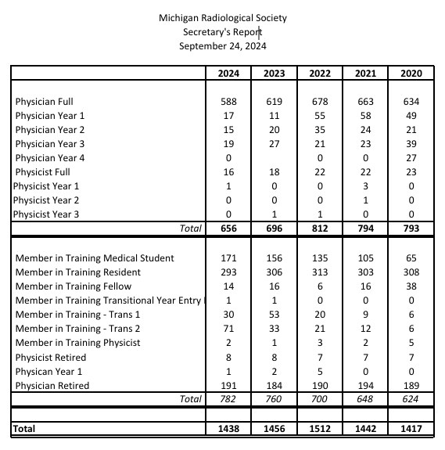

Slide 3
Trainees’ Membership

Slide 4
Physicians and Physicists Membership

